Slide 1
The Evolution of Chili Pizza
From Standard to Model: A Journey of Taste and Innovation

Slide 2
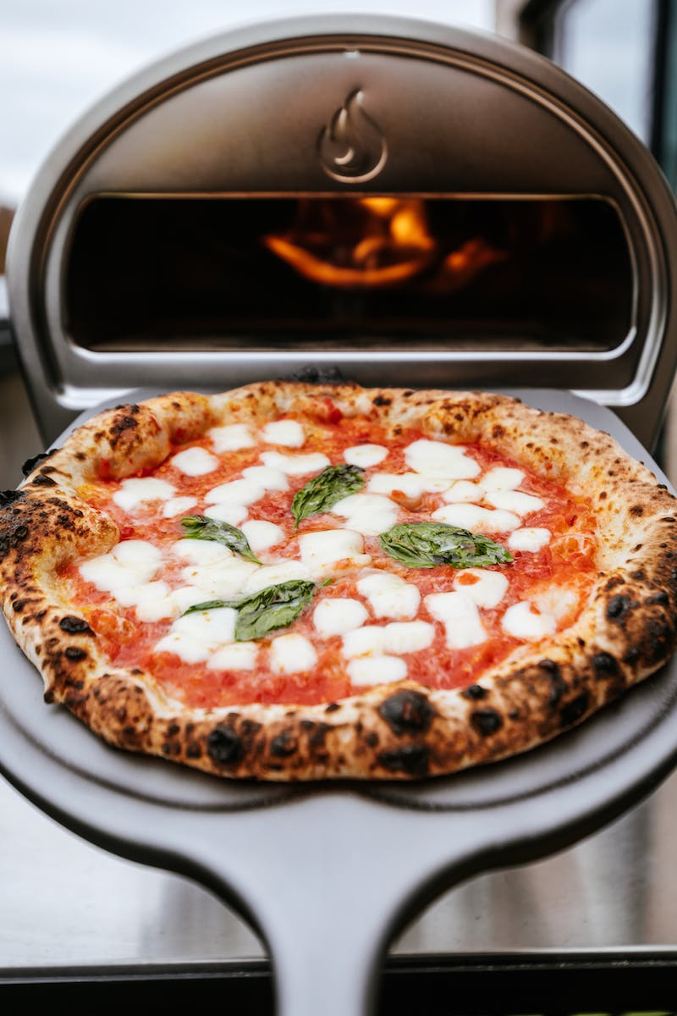
Introduction
• Overview of chili pizza
• Importance of chili pizza in the culinary world
• Exploring the standard chili pizza
• Introducing the Chili pizza model
Photo by Pexels

Slide 3
The Standard Chili Pizza
• Ingredients and preparation of the standard chili pizza
• Traditional toppings and flavors
• Popular variations across different regions
• Cultural significance of standard chili pizza
Photo by Pexels

Slide 4
The Chili Pizza Model
• Innovative approaches to chili pizza
• New ingredients and flavors
• Healthier alternatives and dietary considerations
• Experiments with presentation and aesthetics
Photo by Pexels

Slide 5
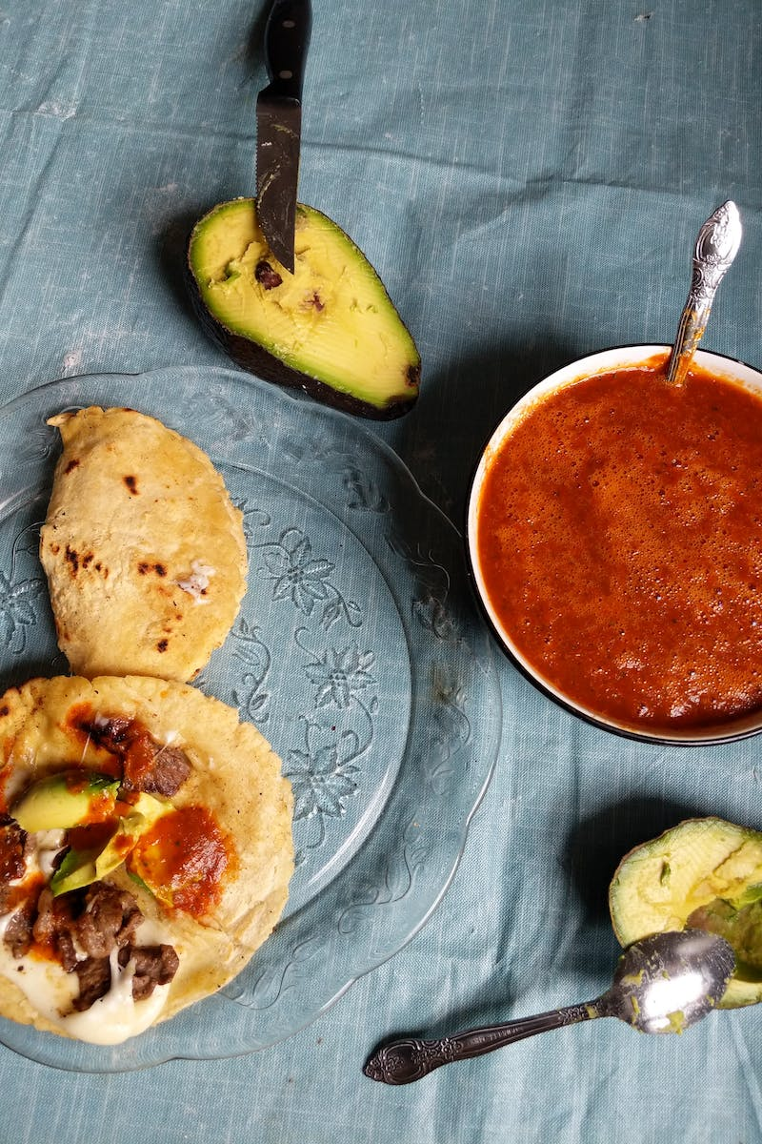
Taste Testing and Feedback
• Gathering feedback from food enthusiasts
• Expert opinions on the chili pizza model
• Comparison with the standard chili pizza
• Impact of the chili pizza model on the culinary industry
Photo by Pexels

Slide 6
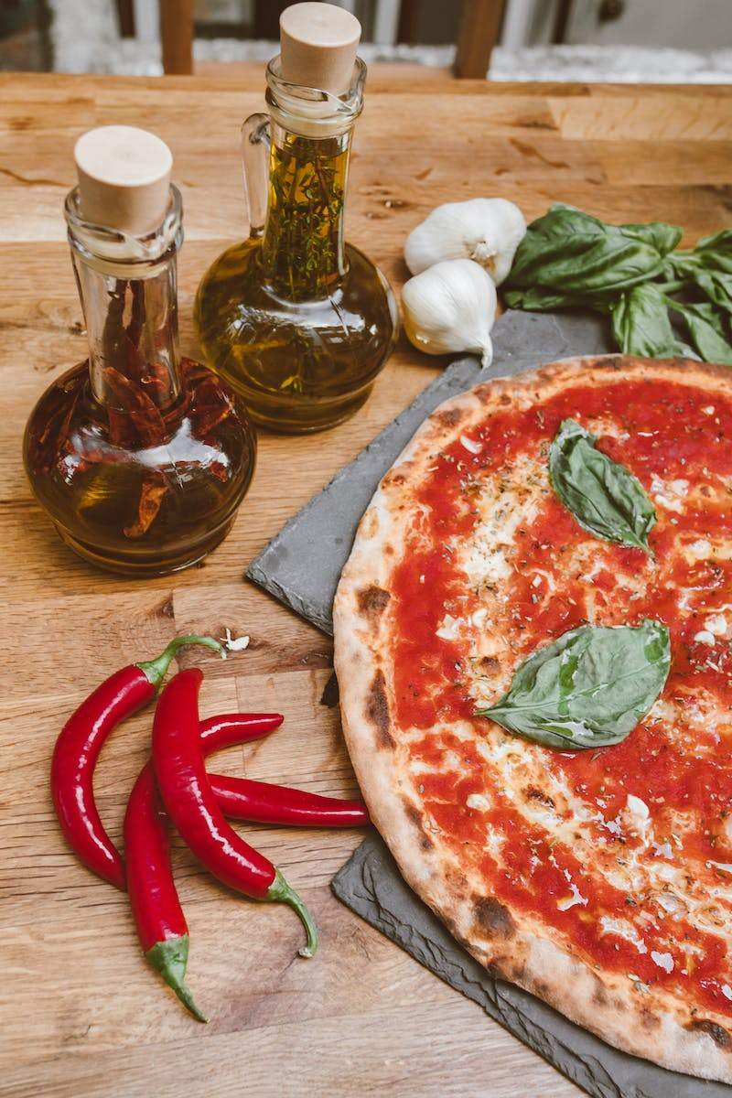
Conclusion
• Summary of the presentation
• Reflection on the evolution of chili pizza
• Future trends and possibilities
• Closing remarks
Photo by Pexels

