Slide 1
The Technology Behind Mobile Communications
Exploring the Evolution and Functioning of Mobile Phones

Slide 2
Introduction
• Mobile phones are an integral part of our lives
• Curiosity about mobile communications technology
• Understanding how phones make calls and different generations
• Exploring the technology behind mobile communications
Photo by Pexels

Slide 3
Voice to Digital Signal
• Voice picked up by phone's microphone
• Microphone converts voice to digital signal
• Digital signal represented as zeros and ones
• Antenna transmits zeros and ones as electromagnetic waves
Photo by Pexels

Slide 4
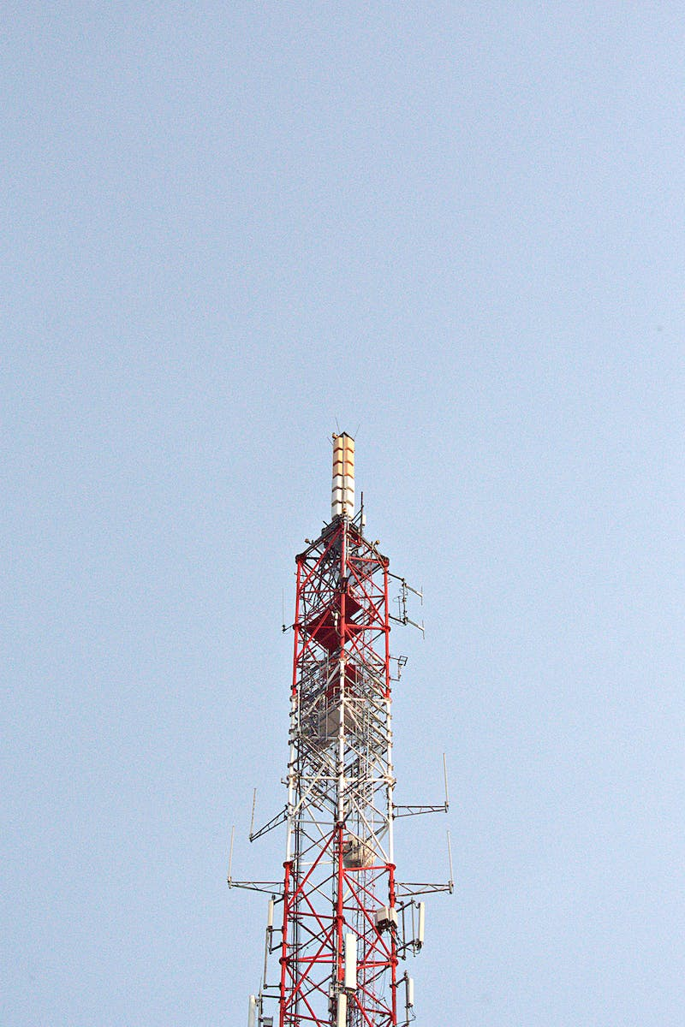
Limitations of Electromagnetic Waves
• Electromagnetic waves lose strength over long distances
• Obstacles and environmental factors reduce wave strength
• Cell towers introduced to overcome these issues
• Concept of cellular technology and division into hexagonal cells
Photo by Pexels

Slide 5
Mobile Switching Center
• Mobile switching center helps locate cell tower area
• Subscriber's location updated periodically
• Location updated when crossing predefined number of towers
• Location updated when phone is turned on
Photo by Pexels

Slide 6
Frequency Spectrum and Mobile Phone Communications
• Limited frequency spectrum for cellular communications
• Frequency slot distribution among cell towers
• Multiple access technique for efficient distribution among active users
Photo by Pexels

Slide 7
Evolution of Mobile Phone Technologies
• 1G - First wireless phones with analog transmission
• 1G limitations: poor voice quality and security
• 2G - Introduction of digital multiple access technologies
• 2G advancements: SMS and internet browsing
Photo by Pexels

Slide 8
3G and 4G
• 3G - Focus on higher data transfer speed
• 3G advancements: WCD multiple access technique and increased bandwidth
• 4G - Higher speeds suitable for high-resolution content
• 4G advancements: OFD multiple access and MIMO technology
Photo by Pexels

Slide 9
The Future of Mobile Communications - 5G
• 5G to support seamless connectivity for the internet of things
• Enhanced MIMO technology and millimeter waves
• Suitable for driverless cars and smart homes
Photo by Pexels

Slide 10
Conclusion
• Mobile communications are a combination of wireless and wired technology
• Understanding the underlying technology enhances our appreciation for mobile phones
• Mobile communications continue to evolve to meet new demands
Photo by Pexels

