Slide 1
The Essence of Guru Tatva
Understanding the Power and Potency of the Original Guru Tatva

Slide 2
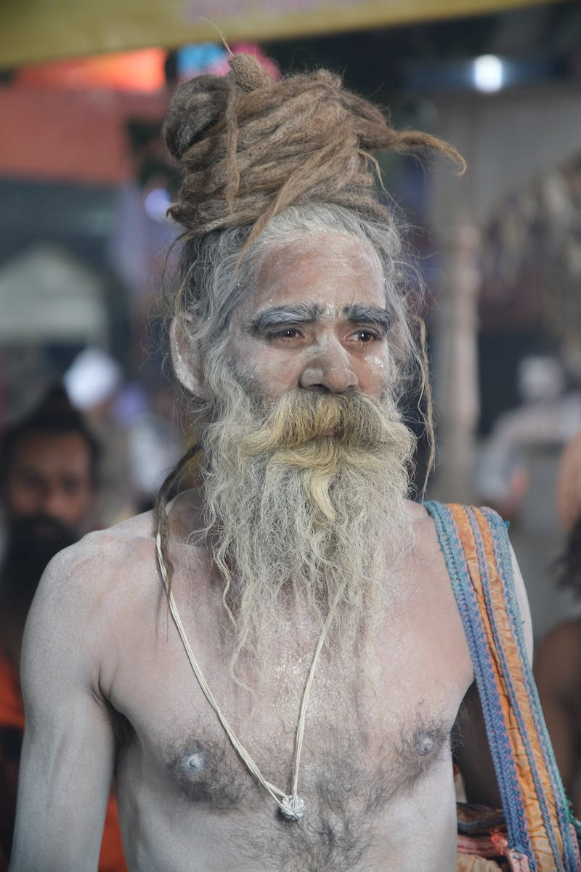
Introduction
• Guru Tatva is the essence of spiritual guidance
• Understanding its power and potency is crucial
• Guru Tatva descends from the original guru, Nitai
• His mercy enables our connection with Krishna
Photo by Pexels

Slide 3
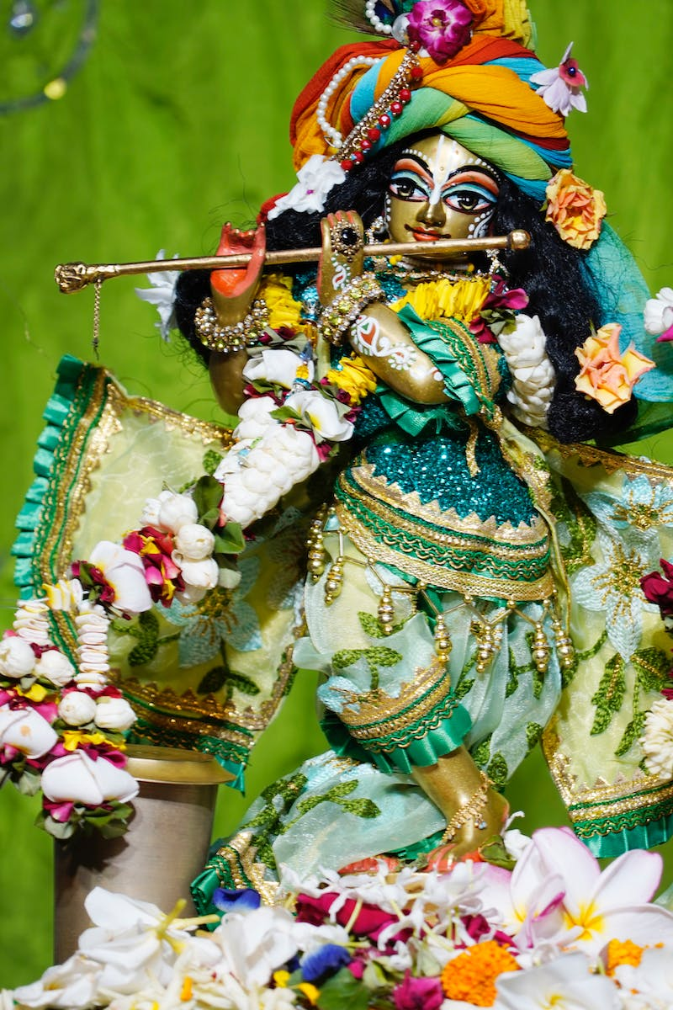
The Potency of Nitai
• Nitai is the real guru and our shelter
• His mercy is essential to reach Krishna
• Nitai's mood of love and protection is profound
• Visiting Nitai and receiving his mercy is transformative
Photo by Pexels

Slide 4
The Bond between Nitai and Mahaprabhu
• Nitai and Mahaprabhu's relationship is profound
• When Mahaprabhu appeared, Nitai followed the same mood
• Nitai's love and protection are essential for our spiritual journey
• By accepting Nitai, we automatically accept Mahaprabhu
Photo by Pexels

Slide 5
The Potency of Nitai's Wife, Jahnava Mata
• Jahnava Mata is Nitai's wife and a source of strength
• She nourishes and protects the devotees
• Her presence is filled with potency and mercy
• Jahnava Mata is a testament to Nitai's power
Photo by Pexels

Slide 6
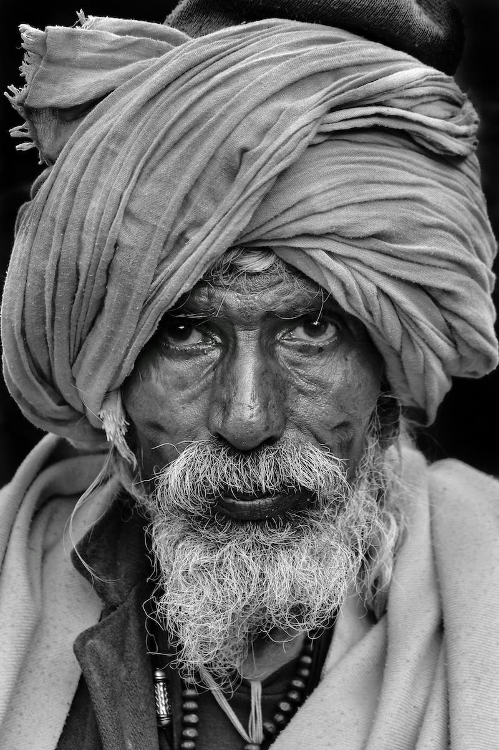
Following Guru Tatva
• Guru is our shelter and guide
• Follow the teachings and instructions of the previous acharyas
• Maintain a high standard and never deviate
• Surrender fully to the Guru and have faith
Photo by Pexels

Slide 7
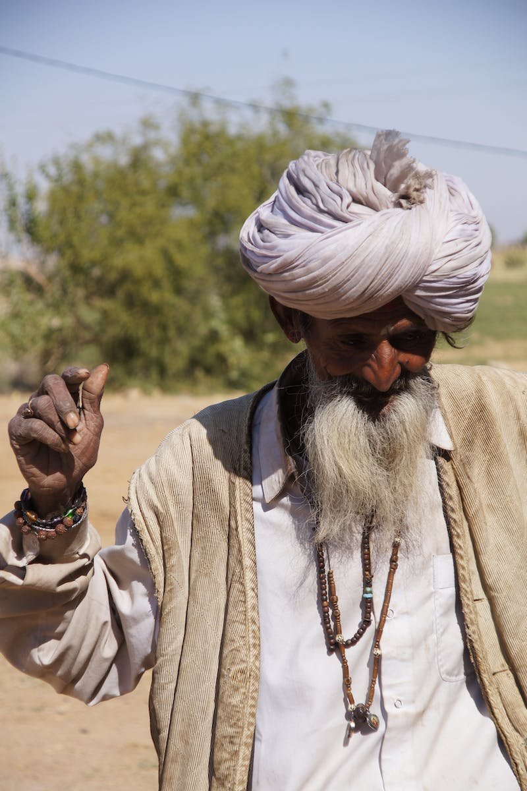
Conclusion
• Guru Tatva is the key to spiritual progress
• Understand the power and potency of Nitai
• Visit Nitai for his mercy and spiritual benefit
• Follow the path set by the great acharyas
Photo by Pexels

