Slide 1
Introduction to Artificial Intelligence
Exploring Concepts and Algorithms

Slide 2
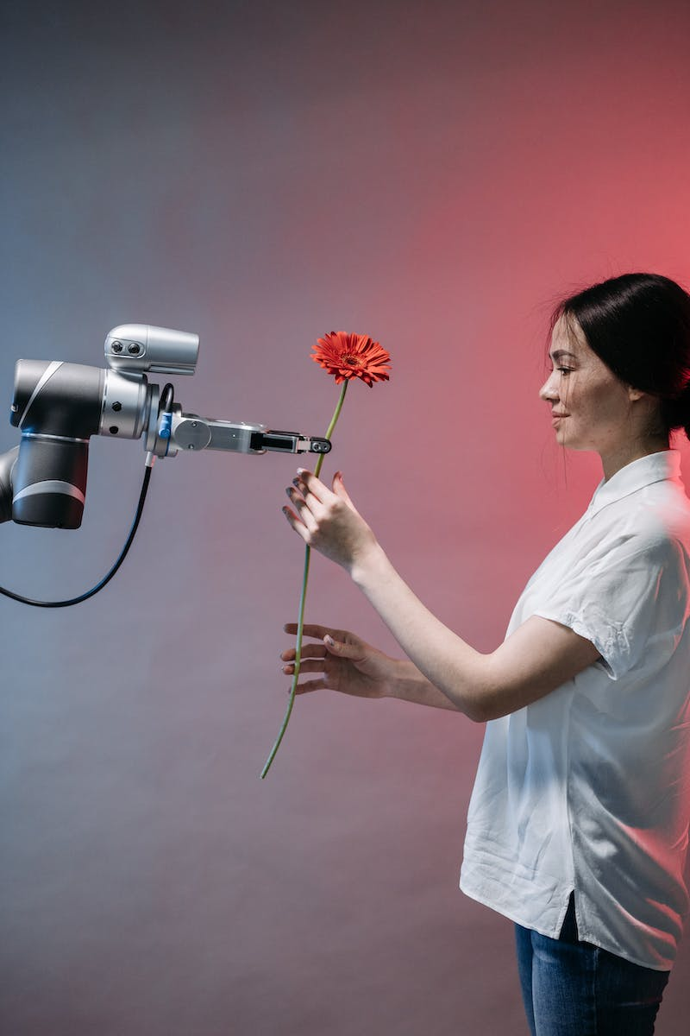
Course Overview
• Learn concepts and algorithms at the foundation of modern artificial intelligence
• Gain exposure to graph search algorithms, classification, optimization, and more
• Explore machine learning, neural networks, and natural language processing
• Taught by Brian Yu from Harvard University
Photo by Pexels

Slide 3
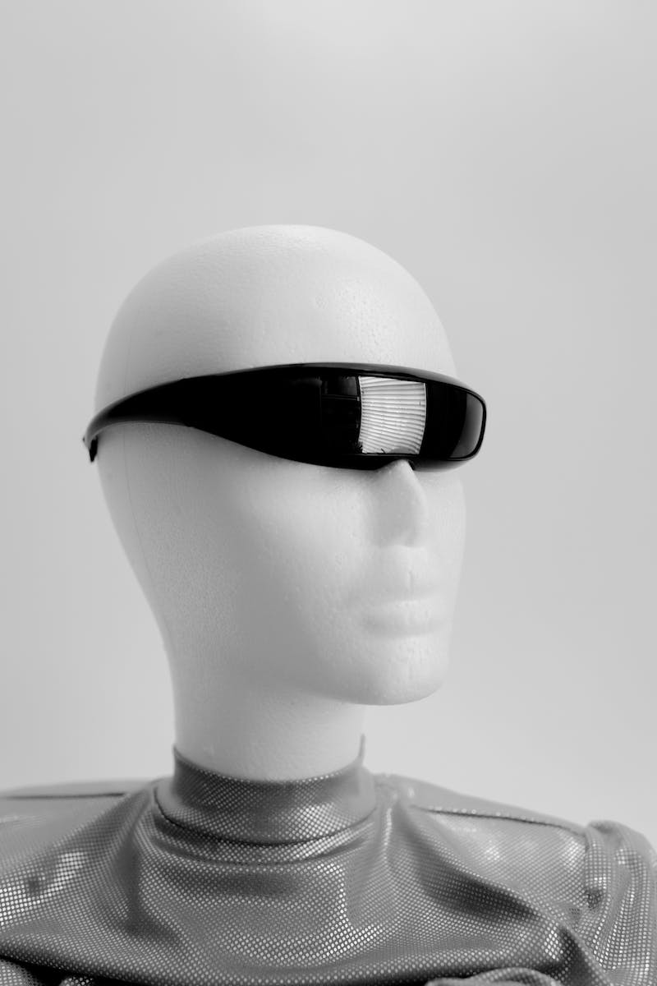
Introduction to AI
• AI encompasses technologies like game-playing engines, handwriting recognition, and machine translation
• Graph search algorithms, classification, and optimization are key components of AI
• Reinforcement learning and machine learning enable AI to learn and improve over time
• Neural networks, inspired by human brains, are popular tools in modern AI
Photo by Pexels

Slide 4
Search Algorithms
• AI searches for solutions to problems, such as finding driving directions or playing games
• States represent configurations of the agent in its environment
• Actions are choices that can be made in a given state
• Transition model defines the result of applying an action in a state
Photo by Pexels

Slide 5
Optimization and Machine Learning
• Optimization problems aim to maximize profits, minimize costs, or satisfy constraints
• Machine learning enables AI to learn from data and experiences
• Neural networks, inspired by the human brain, are powerful tools in machine learning
• Natural language processing enables AI to understand and interpret human language
Photo by Pexels

Slide 6
Conclusion
• Artificial intelligence encompasses a wide range of technologies and algorithms
• AI enables machines to perform tasks that require intelligent and rational behaviors
• In this course, students will explore key concepts in AI and gain hands-on experience
• Build your own AI programs and dive into the world of artificial intelligence
Photo by Pexels

