Slide 1
Journey to the Depths: Exploring the Kola Superdeep Borehole
Unraveling the Secrets of the Earth's Crust

Slide 2
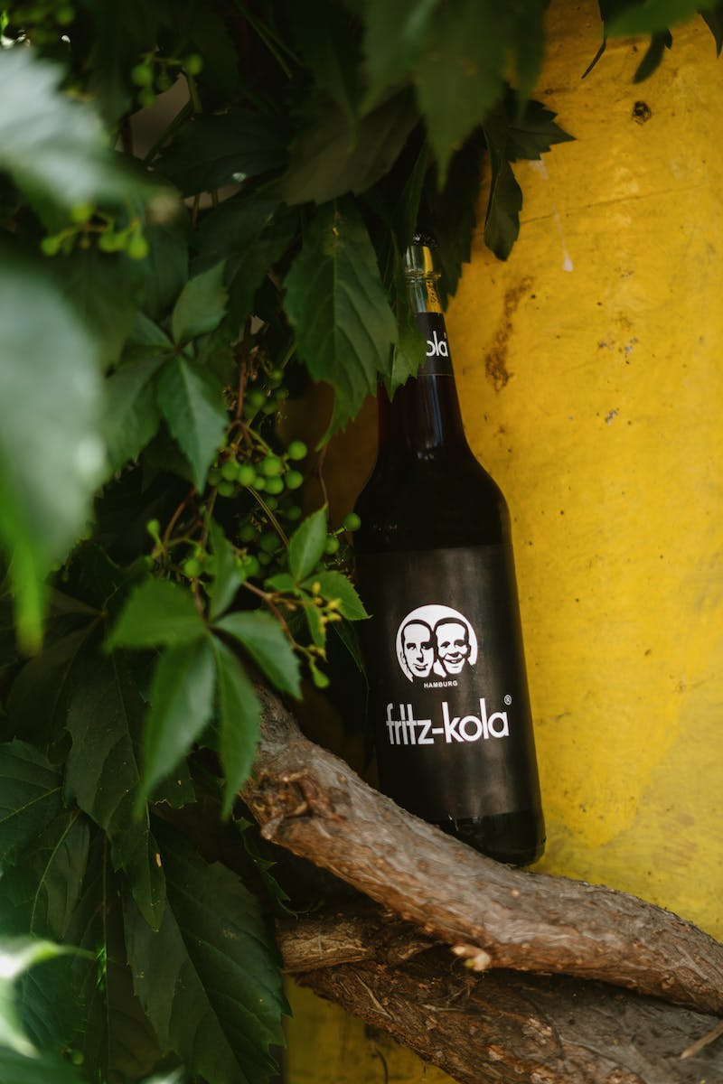
Introduction
• Overview of the Kola Superdeep Borehole
• Goal: Explore the geological layers from the surface to the deepest depths
• Highlighting the challenges and achievements of the drilling project
Photo by Pexels

Slide 3
Geological Cross-section
• Description of the geological layers encountered during the drilling process
• Highlights of the different diameters and characteristics of the borehole
• Overview of the drilling equipment used and its limitations
Photo by Pexels

Slide 4
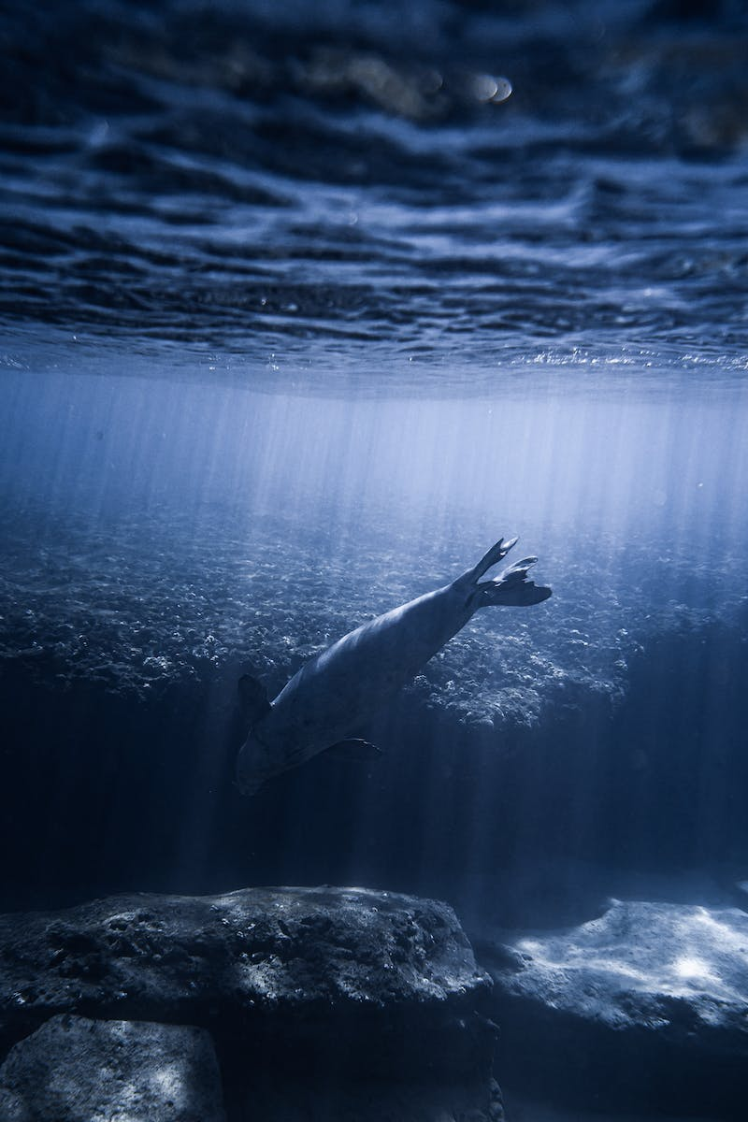
Exploring the Depths
• Discoveries and challenges in the deeper sections of the borehole
• Observations of different rock types, including gneiss, diabase, and amphibolite
• High temperatures and pressure at lower depths
Photo by Pexels

Slide 5
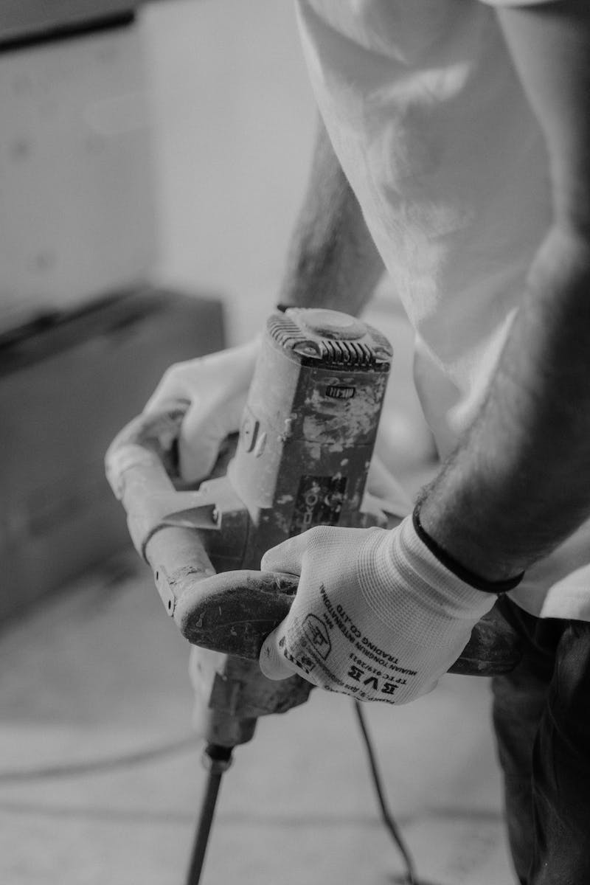
Technical Advancements
• Introduction of advanced drilling techniques and equipment
• Automation and turbine drilling
• Benefits of low-speed drilling and automatic detection of rock shifts
• Innovative core sampling and cataloging methods
Photo by Pexels

Slide 6
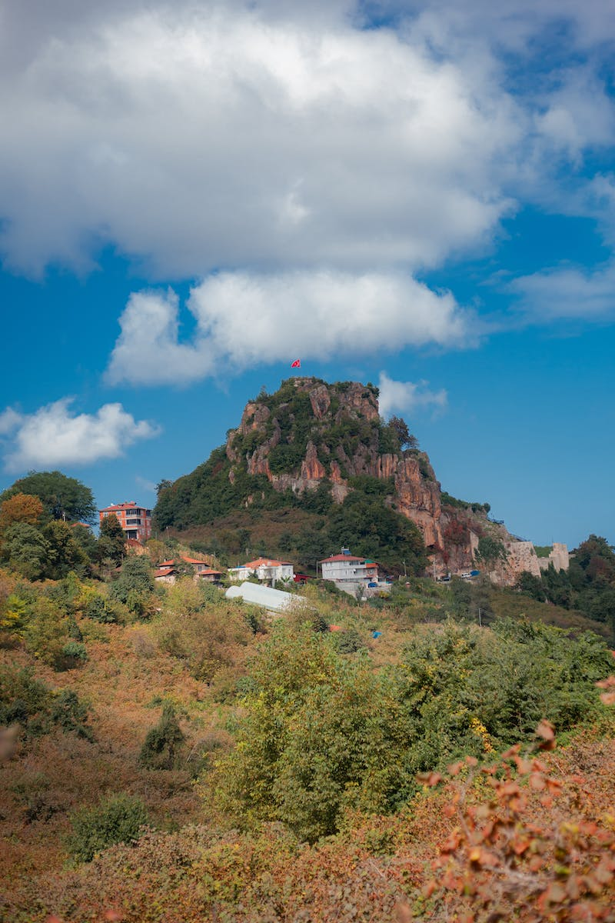
Exploring Ancient Time
• Encounters with ancient geological periods
• Overview of the Archean and Proterozoic eons
• Discoveries of prehistoric microorganisms
• Insights into the formation of Earth's crust
Photo by Pexels

Slide 7
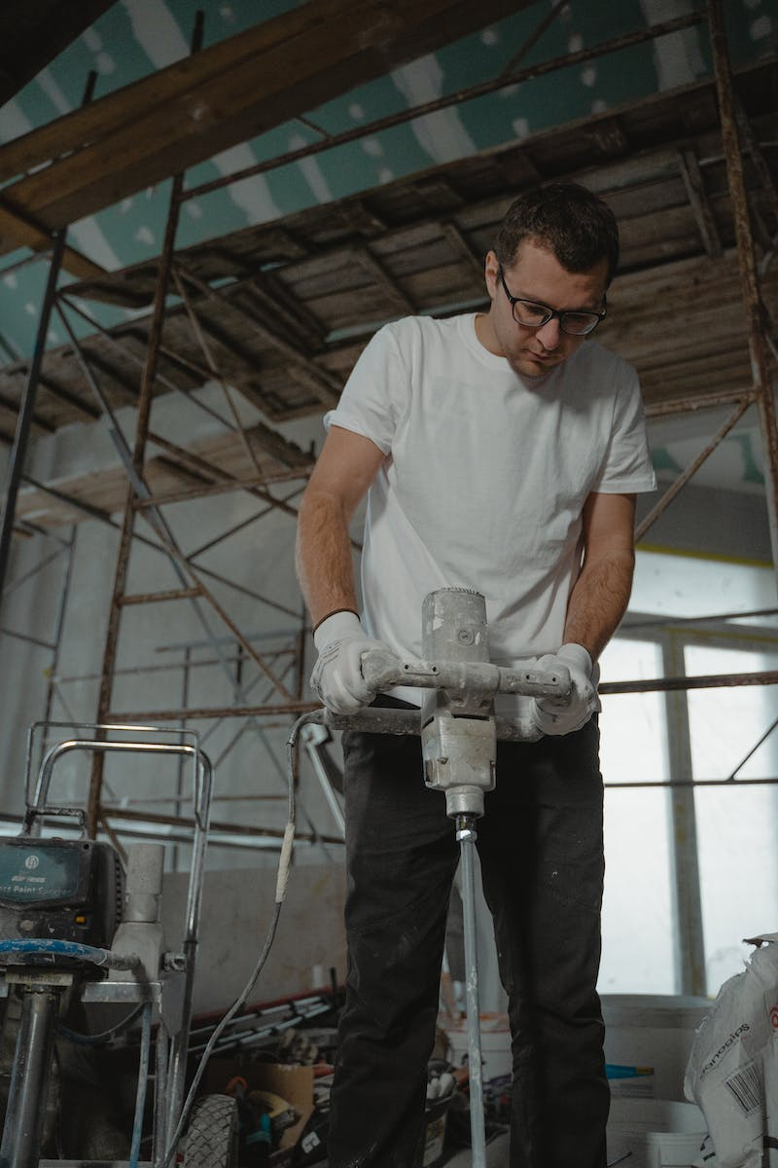
Unforeseen Challenges
• Difficulties encountered beyond the 7 km mark
• Inability to drill through expected basalts
• Fractured and porous rock strata
• Multiple cases of stuck drilling equipment
Photo by Pexels

Slide 8
Archaeiskaya Suite
• Description of the Archaeiskaya Suite
• Characteristics of gneiss and amphibolite rocks
• Observations of significant radiation levels
Photo by Pexels

Slide 9
The Final Leg
• The last section of the borehole: Levin Suite
• Focused on biotite-plagioclase gneiss
• Zinc, copper, and gold deposits discovered
• Extreme temperatures nearing the melting point of tin

Slide 10
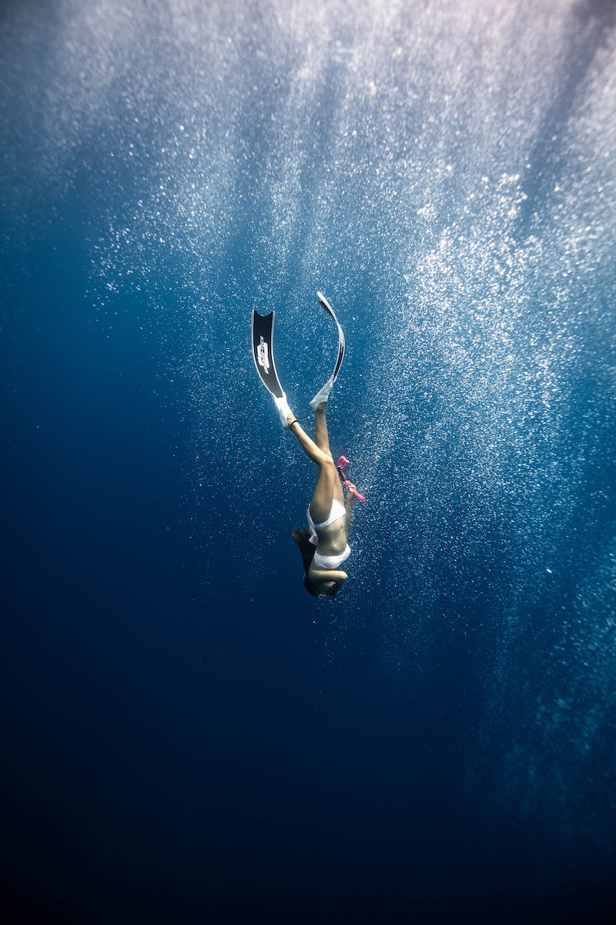
Beyond the 12 km Mark
• Attempts to reach further depths
• Unable to penetrate the Archean gneisses
• Extreme temperatures of around 150°C
• Concluding the drilling operations
Photo by Pexels

Slide 11
Conclusion
• Summary of the Kola Superdeep Borehole project
• Significance of the discoveries and challenges
• Implications for understanding Earth's geology and history
Photo by Pexels

