Slide 1
The Wonders of the Mind
Exploring the Mysteries Within

Slide 2
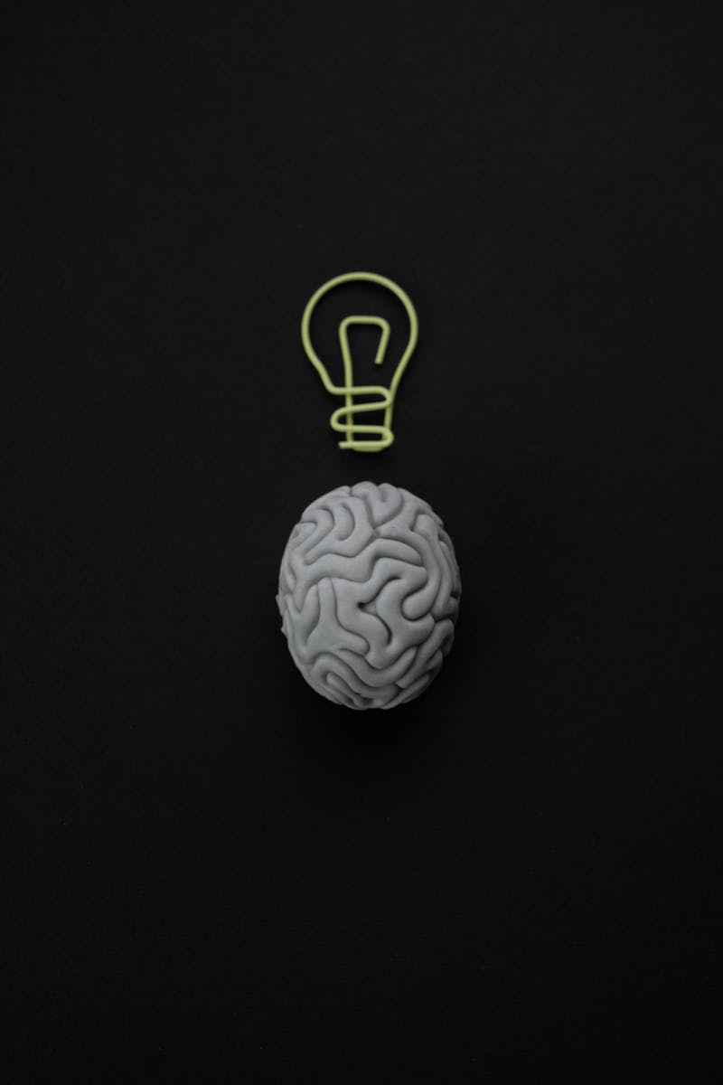
Unveiling the Brain
• The brain is the most intricate organ in the human body
• It controls our thoughts, emotions, and actions
• Made up of billions of neurons
• Responsible for our consciousness
Photo by Pexels

Slide 3
The Origins of Brain Research
• Brain research dates back to ancient civilizations
• Early scholars in Spain made significant contributions
• They laid the groundwork for modern neuroscience
• Their discoveries paved the way for our understanding
Photo by Pexels

Slide 4
Journey to the Mainland
• Traveling from Spain to new horizons
• Exploring the wider world of neuroscience
• Seeking knowledge and collaboration
• Discovering new perspectives
Photo by Pexels

Slide 5
The Game of Science
• Brain research is a dynamic field
• Constantly evolving with new discoveries
• Scientists engage in a game of knowledge
• Each finding adds a piece to the puzzle
Photo by Pexels

Slide 6
Unraveling the Windings
• The complex network of brain connections
• Interactions between different regions
• Understanding the wiring of the mind
• Unraveling the secrets within
Photo by Pexels

Slide 7
Savoring the Wine of Knowledge
• Brain research leads to remarkable insights
• Unlocking the potential for medical advances
• Improving mental health and well-being
• Indulging in the wine of knowledge
Photo by Pexels

