Slide 1
Unlocking Nature's Secrets: A Digital Herbarium
Preserving Botanical Knowledge for Future Generations with Digital Innovation.

Slide 2
Table of Contents
01
Digital Herbarium: Unveiled
02
Botanical Renaissance
03
Herbarium Horizons: Unlocking Botanical Data
04
Empowering Plant Analysis
05
Research Revolution: Botanical Breakthroughs
06
Tracking Nature's Pulse
07
Digitizing Herbarium Specimens
08
Digital Herbaria: Wide Reach

Slide 3
Table of Contents
09
Digital Preservation: Navigating the Maze
10
Botanical Renaissance

Slide 4
Digital Herbarium: Unveiled
01
Digitized specimens are meticulously curated, providing a virtual window into botanical history and diversity.
02
Bypassing geographical barriers, researchers worldwide gain immediate access to invaluable botanical data.
03
Accelerating research through enhanced data analysis, enabling new discoveries in plant science and conservation.
04
Safeguarding fragile specimens from damage and deterioration, ensuring their longevity for future study.
05
A dynamic platform that is continuously updated and expanded, incorporating new data and research insights.

Slide 5
Botanical Renaissance
01
Creating a comprehensive digital archive of plant specimens, accessible globally for research and conservation efforts, enhancing collaboration.
02
Utilizing artificial intelligence to analyze plant data, identify patterns, and accelerate the discovery of medicinal properties effectively.
03
Implementing controlled environment agriculture using sensors and automation to optimize plant growth and resource utilization sustainably, increasing output.
04
Unlocking the genetic code of plants to understand their evolution, adaptation, and potential applications in medicine and agriculture comprehensively.
Photo by Google

Slide 6
Botanical Renaissance
05
Engaging the public in data collection and analysis, fostering a collaborative approach to botanical research and conservation, educating people.
Photo by Google

Slide 7
Herbarium Horizons: Unlocking Botanical Data
Global Reach
Hidden Costs
Global Access to herbarium data accelerates research, fostering collaboration and discoveries across geographical boundaries.
Local Knowledge is preserved and amplified, providing invaluable insights into regional flora and ecological changes.
Democratized data empowers citizen scientists, educators, and conservationists with crucial botanical information.
Increased accessibility promotes biodiversity awareness and supports informed decision-making for sustainable resource management.
Digitization requires substantial investment in equipment, personnel, and ongoing maintenance of digital infrastructure.
Data standardization and quality control are crucial but complex, demanding expertise and rigorous validation processes.
Copyright and intellectual property rights need careful consideration to ensure fair use and attribution of data.
Cybersecurity threats and data breaches pose risks to sensitive information, necessitating robust protection measures.

Slide 8
Empowering Plant Analysis
01
Instant access to a wealth of plant data, accelerating research and identification processes significantly.
02
High-resolution images provide unparalleled detail, crucial for accurate species recognition and feature analysis.
03
Comprehensive metadata offers crucial contextual information, aiding in deeper understanding of plant characteristics.
04
Facilitating detailed plant identification, empowering experts and enthusiasts alike with advanced tools.
05
Enabling in-depth plant analysis, driving discoveries and promoting informed conservation strategies effectively.

Slide 9
Research Revolution: Botanical Breakthroughs
01
Pinpoint specific data with refined search criteria, accelerating discovery and eliminating wasted time combing through irrelevant information.
02
Uncover hidden patterns and correlations within vast datasets, unlocking new insights into plant behavior and evolution.
03
Experience significantly faster research cycles, enabling quicker validation of hypotheses and more efficient project completion rates.
04
Reduce errors and improve data quality, fostering greater confidence in research findings and promoting reliable conclusions.
05
Facilitate seamless collaboration among researchers, fostering knowledge sharing and accelerating collective understanding of the plant kingdom.

Slide 10
Tracking Nature's Pulse
Baseline Established
Change Detection
Initial surveys document plant distributions across key habitats, providing a baseline for future comparisons. These early efforts focus on identifying indicator species sensitive to environmental stressors, aiding in early warning...
Analysis of longitudinal data reveals significant shifts in plant distributions, correlating with observed changes in climate patterns and land use practices. Conservation strategies are adjusted to address identified threats and...
2005
2010
2015
2020
Monitoring Expansion
Conservation Actions
Monitoring programs broaden to include new geographical areas and a wider range of environmental parameters, such as temperature, precipitation, and soil composition. Remote sensing technologies are introduced to enhance data...
Targeted conservation interventions are implemented in areas experiencing the most severe environmental impacts, focusing on habitat restoration, invasive species control, and community engagement. Monitoring efforts continue to assess the effectiveness.

Slide 11
Tracking Nature's Pulse
Adaptive Strategies
Ongoing data analysis and modeling informs adaptive management strategies to ensure conservation efforts remain effective in the face of evolving environmental challenges. Collaboration with local communities and stakeholders increases resilience.
2024

Slide 12
Digitizing Herbarium Specimens
01
High-resolution images are captured, ensuring detailed records of the plant's physical characteristics for future research.
02
Images are processed for optimal clarity, including cropping, color correction, and resolution adjustments.
03
Information is carefully extracted from the specimen label and other relevant sources to build the digital record.
04
Extracted data is systematically entered into a database, linking it to the corresponding specimen image.
05
Data is rigorously validated for accuracy and completeness, ensuring reliability of the digital herbarium collection.

Slide 13
Digitizing Herbarium Specimens
06
Locational data is refined, providing precise geographic coordinates for each specimen's collection site.

Slide 14
Digital Herbaria: Wide Reach
01
Essential for plant identification, classification, and understanding plant evolution; a cornerstone of botanical research.
02
Analyzing plant distributions and environmental impacts, revealing crucial patterns in ecosystems through digitized collections.
03
Supporting drug discovery by providing access to plant specimens with known or potential medicinal properties; powerful resource.
04
Monitoring environmental change, tracking invasive species, and assessing biodiversity using historical plant data from herbaria.
05
Informing conservation strategies by documenting plant diversity, aiding efforts to protect endangered species and their habitats.

Slide 15
Digital Herbaria: Wide Reach
06
Studying phenological shifts in plants due to climate change, providing valuable historical data to enhance predictive models.

Slide 16
Digital Preservation: Navigating the Maze
Upsides Unveiled
Downsides Loom
Enhanced data accessibility ensures wider reach and usage of valuable digital assets for future generations.
Improved data integrity safeguards against loss, corruption, and unauthorized alteration, maintaining authenticity.
Standardized metadata facilitates efficient searching, retrieval, and management of digital collections across platforms.
Strengthened compliance with legal and ethical requirements related to data privacy and intellectual property rights.
High initial investment costs associated with infrastructure upgrades and specialized expertise can strain budgets.
Complexity in implementing new preservation technologies and workflows requires significant training and adaptation.
Potential for technological obsolescence necessitates continuous monitoring and migration strategies to avoid data loss.
Ongoing maintenance and monitoring efforts are essential to address evolving threats and ensure long-term viability.

Slide 17
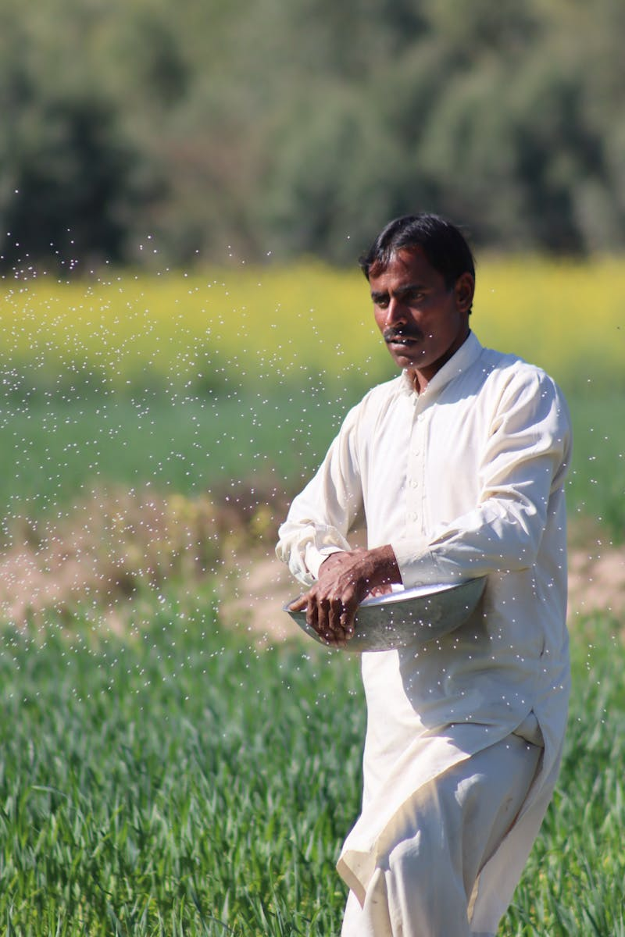
Botanical Renaissance
01
Enhanced accessibility, global collaboration, and preservation of fragile specimens are key advantages of digital herbaria initiatives.
02
Interactive learning modules using digital collections foster deeper understanding and engagement with plant science for students.
03
Accelerated discovery of plant properties, evolutionary relationships, and conservation strategies is driven by digitized data.
04
Digital herbaria promote knowledge sharing and collaborative research projects across international botanical institutions and communities.
Photo by Google

Slide 18
Botanical Renaissance
05
Informed conservation decisions are facilitated by accurate plant identification and distribution data from comprehensive digital collections.
Photo by Google

