Slide 1
The Impact of Climate Change on Biodiversity
Exploring the relationship between global warming and species extinction

Slide 2
Introduction: The Threat of Climate Change
• Rising global temperatures pose a significant threat to Earth's biodiversity
• Increase in greenhouse gas emissions leads to climate change
• More extreme weather events cause habitat destruction
• Rapid temperature changes disrupt ecosystems
• Loss of biodiversity can have cascading effects on the planet
Photo by Pexels

Slide 3
Biodiversity Hotspots
• Certain regions have higher levels of biodiversity
• Hotspots are areas with many endemic species
• Hotspots are particularly vulnerable to climate change
• Loss of biodiversity in hotspots would be a major blow to global diversity
• Conservation efforts should focus on protecting these areas
Photo by Pexels

Slide 4
Impact on Ecosystems
• Climate change disrupts the delicate balance of ecosystems
• Changes in temperature affect species' ability to survive and reproduce
• Shifts in temperature and precipitation patterns impact food availability
• Loss of key species can lead to ecosystem collapse
• Understanding ecosystem dynamics is crucial for conservation
Photo by Pexels

Slide 5
Extinction Risks
• Rapid climate change increases the risk of species extinction
• Species with narrow geographic ranges are most vulnerable
• Habitat loss and fragmentation further exacerbate the risks
• Loss of keystone species can have cascading effects
• Preventing extinctions requires urgent action
Photo by Pexels

Slide 6
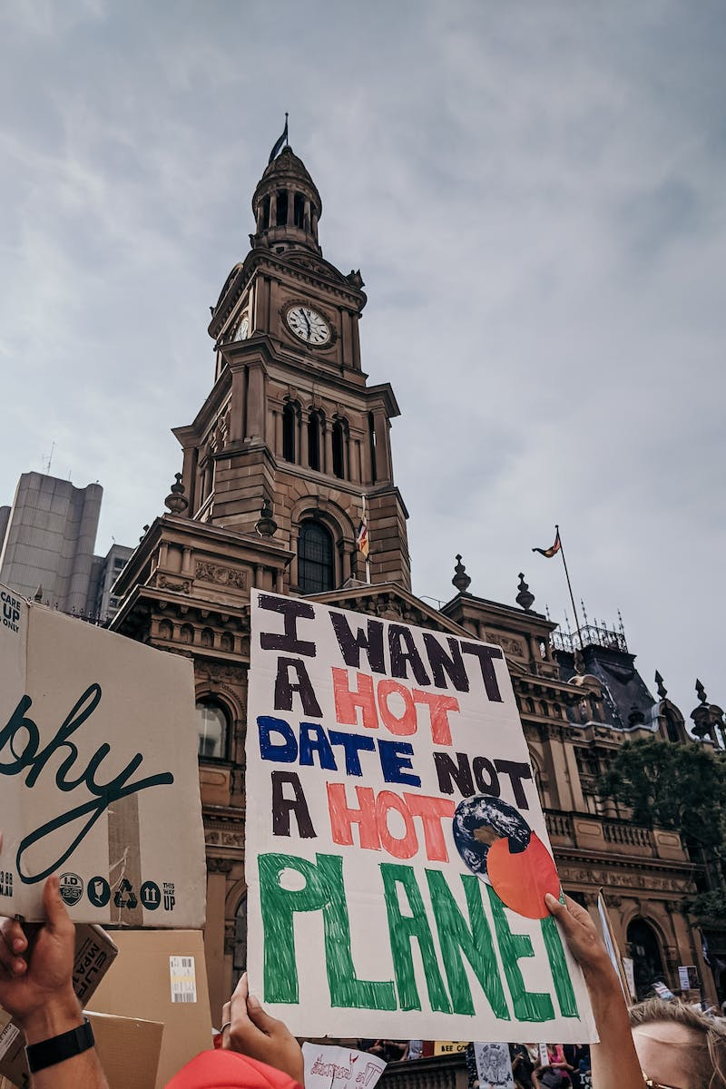
Mitigation and Adaptation Strategies
• Reducing greenhouse gas emissions is crucial to mitigate climate change
• Conservation efforts should prioritize protecting biodiversity
• Creating wildlife corridors can help species adapt to changing conditions
• Raising awareness and promoting sustainable practices are essential
• Collaboration between individuals, organizations, and governments is necessary
Photo by Pexels

