Slide 1
Time Management and Fun Activities
Making the Most of Your Time

Slide 2
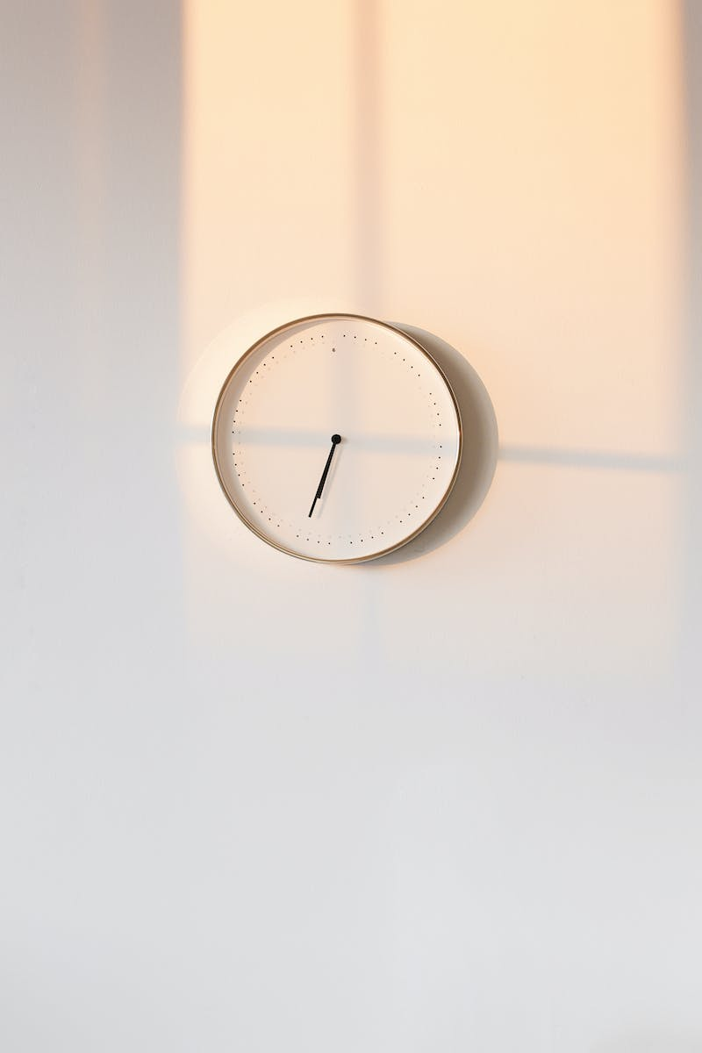
Introduction
• It's quarter to twelve. The farmer is asleep.
• It's twelve o'clock midnight. Where's the football?
• Here it is. Shoot.
• It's quarter past twelve. I'm tired.
Photo by Pexels

Slide 3
Playing Dots
• Let's play dots.
• Good idea. Great. Brilliant. Nor the woo.
• It's half past twelve. What can we do now?
Photo by Pexels

Slide 4
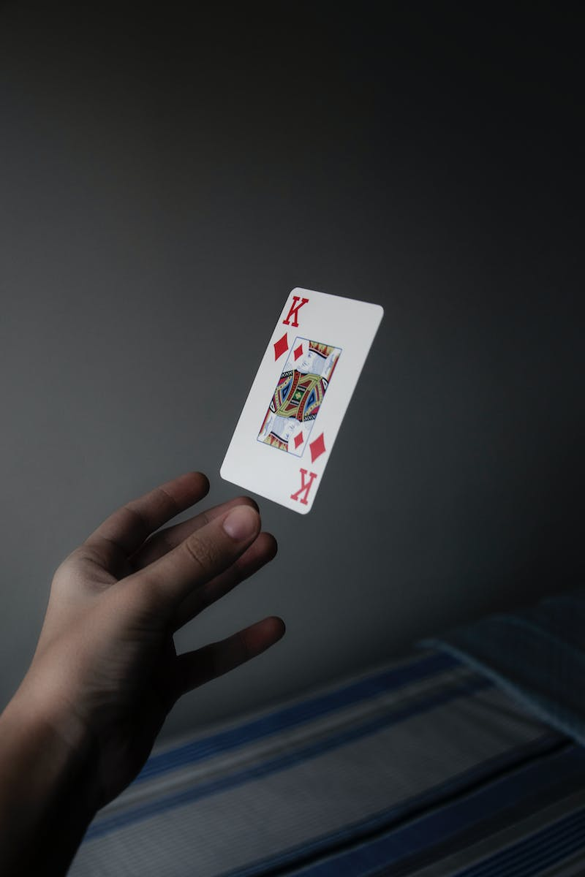
Playing Cards
• Let's play cards.
• Good idea. It's your turn, duck. When? When.
• It's quarter to one. When when... What can we do now?
Photo by Pexels

Slide 5
Singing a Song
• Let's sing a song. Where the shoulders knees and toes.
• Knees and toes and eyes and and mouth and nose.
• It's one o'clock. And shoulders toes. Are toes the farmer is coming. Watch this?
• Playing cards? Whoa wow. Like where are the cards? Am I---
Photo by Pexels

