Slide 1
The Art of Meat Preparation
Exploring techniques and flavors for a succulent experience

Slide 2
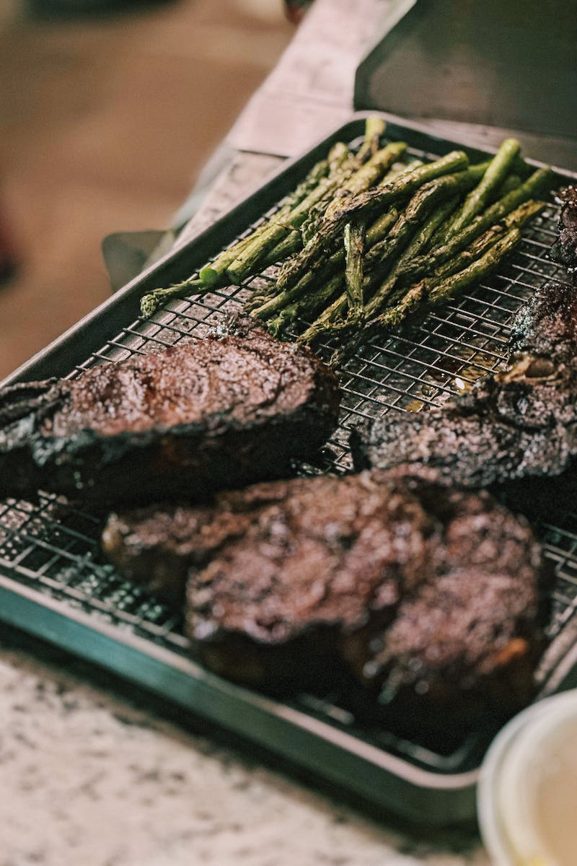
Hello, B c, d e f g h I j k l m n n n g o b q r s t u v w x, y at z.
• Introduction to the world of meat preparation
• Exploring different cuts and cooking methods
• Understanding the importance of seasoning
• Unleashing the potential of flavors
Photo by Pexels

Slide 3
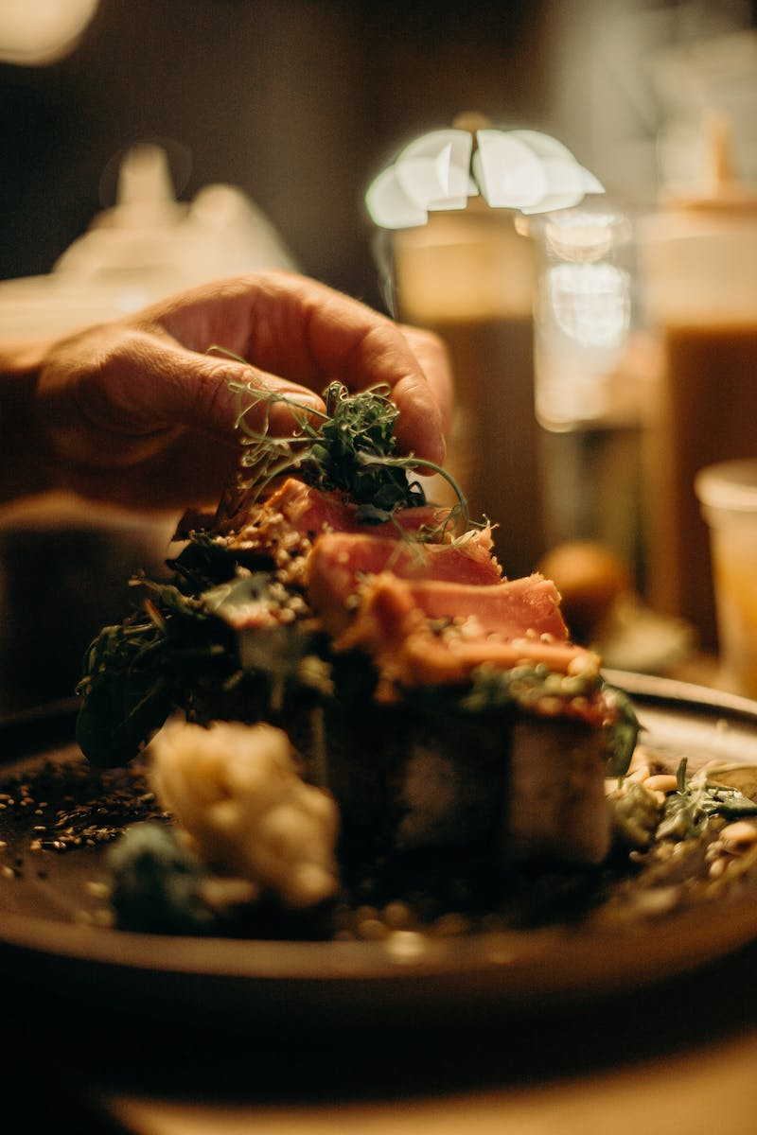
Lester, miguel julia at alex.
• The role of skilled chefs in the meat preparation process
• Highlighting the expertise of Lester, Miguel, Julia, and Alex
• Their influence on enhancing the dining experience
• Recognizing the value of culinary craftsmanship
Photo by Pexels

Slide 4
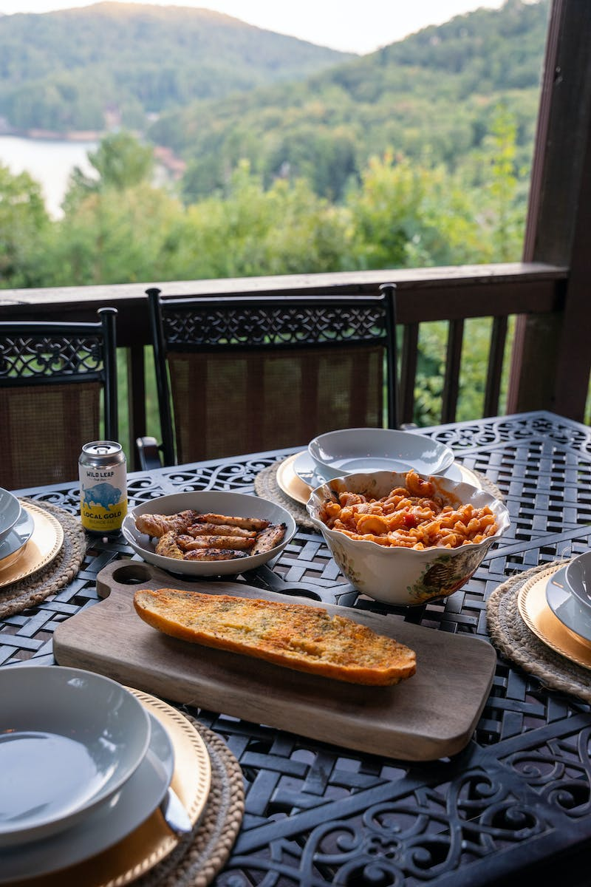
Using r we miguel, m j l m.
• Exploring the 'R' technique in meat preparation
• Understanding its significance in achieving tenderness
• Miguel's expertise with the 'R' technique
• Mastering the art of precise cooking temperatures
Photo by Pexels

Slide 5
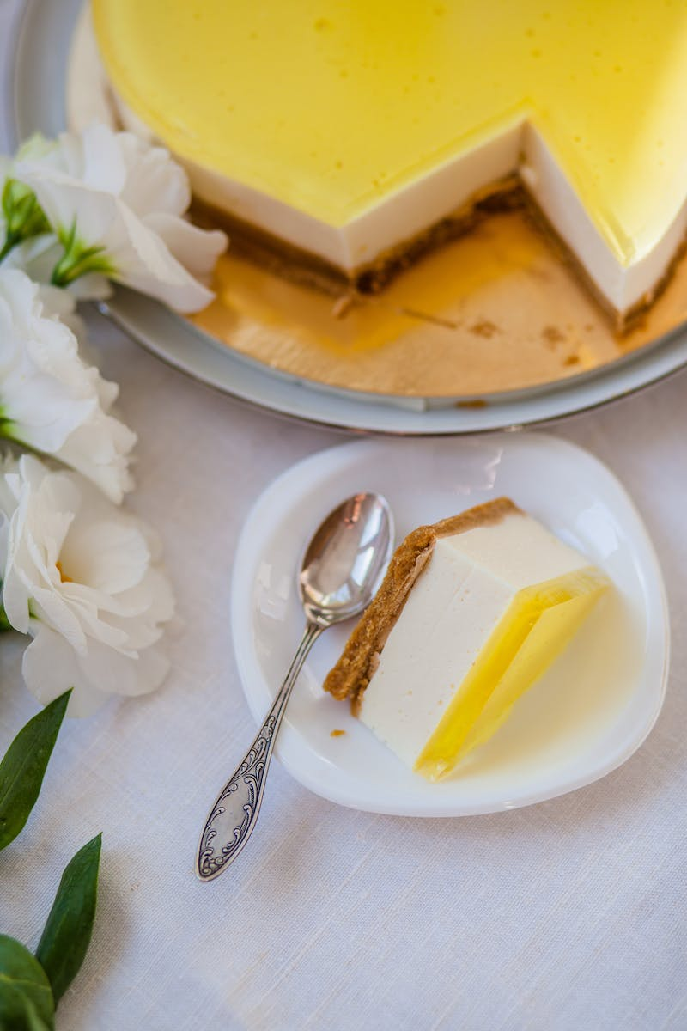
I r lester Miguel Rica Go Going among, nothing butter and, dip.
• Exploring the concept of layering flavors
• Lester's unique approach to creating flavor profiles
• Miguel's incorporation of traditional and innovative flavors
• Rica Go's expertise in enhancing sauces and dips
• Experimenting with different combinations for a taste explosion
Photo by Pexels

Slide 6
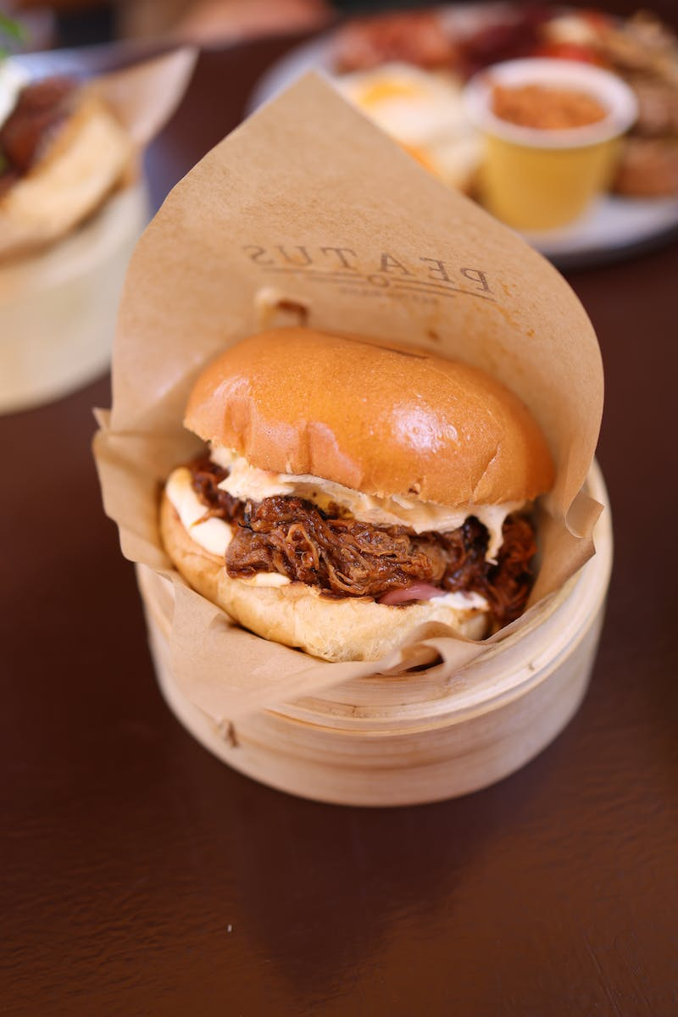
The meat, up the.
• Understanding the significance of quality meat
• Exploring different types and cuts of meat
• Choosing the right meat for specific dishes
• The impact of meat quality on final flavors
Photo by Pexels

