Slide 1
The Future of Artificial Intelligence
Exploring the Implications and Possibilities

Slide 2
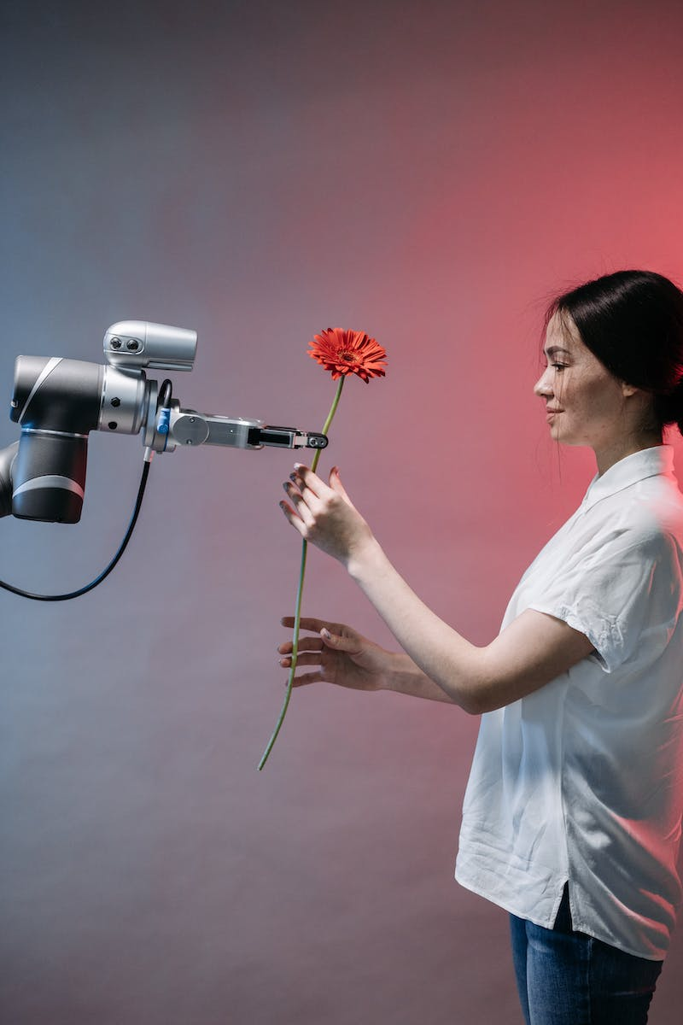
Introduction to Artificial Intelligence
• Definition and scope of AI
• Historical advancements
• Applications in various industries
• Current challenges and limitations
Photo by Pexels

Slide 3
Machine Learning and Neural Networks
• Overview of machine learning
• Types of neural networks
• Deep learning advancements
• Examples of successful ML applications
Photo by Pexels

Slide 4
Natural Language Processing and Chatbots
• Understanding natural language processing
• Chatbots and virtual assistants
• Benefits and limitations of NLP
• The impact on customer service and communication
Photo by Pexels

Slide 5
Ethics and Bias in AI
• Concerns regarding AI ethics
• Bias in AI algorithms
• Potential consequences of biased AI
• Efforts to address ethics and bias
Photo by Pexels

Slide 6
Future Trends and Impact
• Emerging technologies in AI
• AI's potential impact on jobs
• Augmented intelligence and human-AI collaboration
• Societal implications and challenges
Photo by Pexels

