Slide 1
Delicious Delights in My Lunchbox
Exploring the Mouth-Watering Treats I Find Every Day

Slide 2
Introduction
• My school lunchbox always holds amazing treats
• Mouth-watering snacks that are both enjoyable and satisfying
• Every day is a surprise as I open my lunchbox
• Curiosity piques as I wonder what I will find
Photo by Pexels

Slide 3
A Delectable Apple
• Crisp and juicy, an apple is the perfect healthy snack
• It offers a burst of freshness and natural sweetness
• A satisfying crunch with every bite
• Loaded with essential vitamins and dietary fiber
Photo by Pexels

Slide 4
Delicious Cupcakes
• Indulge in the melt-in-your-mouth delight of cupcakes
• Soft and fluffy, with a sweet frosting on top
• A treat that brings joy and satisfaction
• Perfect for birthdays, celebrations, or a sweet pick-me-up
Photo by Pexels

Slide 5
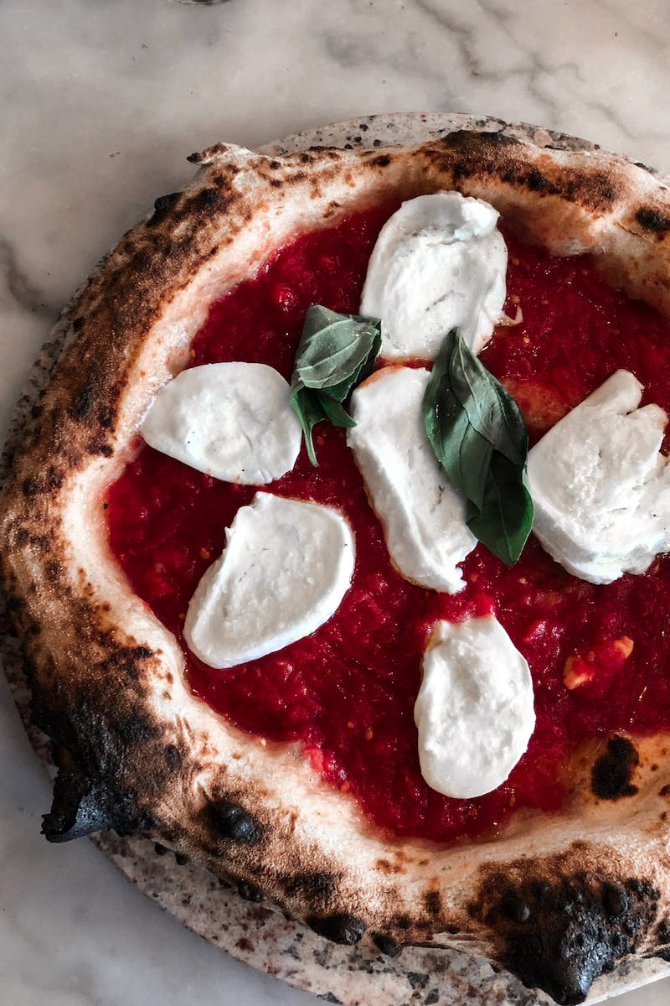
Slice of Pizza
• Savor the cheesy goodness of a hot slice of pizza
• A classic favorite enjoyed by people of all ages
• Melted cheese on top of a crispy crust
• A delightful combination of flavors and textures
Photo by Pexels

Slide 6
Fresh Orange Juice
• Say goodbye to fizzy drinks with freshly squeezed orange juice
• A refreshing beverage packed with vitamin C
• A natural, tangy sweetness that quenches your thirst
• A healthier alternative with no artificial additives
Photo by Pexels

Slide 7
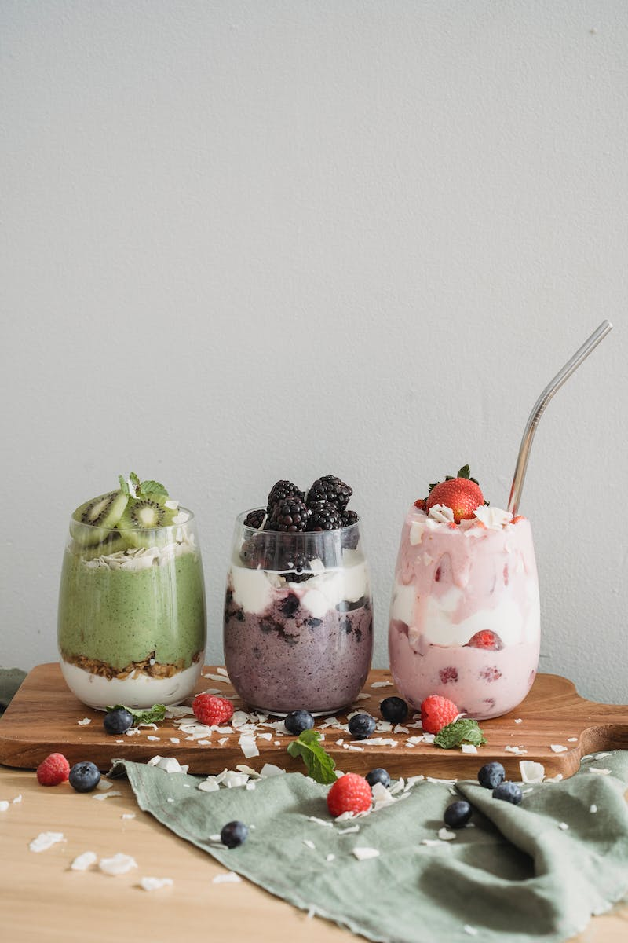
Strawberry Yogurt
• Enjoy the creamy goodness of strawberry yogurt
• A delicious and nutritious option for a snack
• Smooth and velvety with a burst of fruity flavor
• Packed with probiotics and essential nutrients
Photo by Pexels

Slide 8
Healthy Cereal Bar
• Find the perfect balance of taste and nutrition in a cereal bar
• A convenient and satisfying option for on-the-go
• Fiber-rich grains combined with dried fruits and nuts
• A guilt-free snack that keeps you energized
Photo by Pexels

Slide 9
Seed Grapes in a Small Jar
• Discover the goodness of seed grapes in a small plastic jar
• A combination of sweet grapes and crunchy seeds
• A delightful snack that provides a variety of textures
• Rich in antioxidants and essential minerals
Photo by Pexels

Slide 10
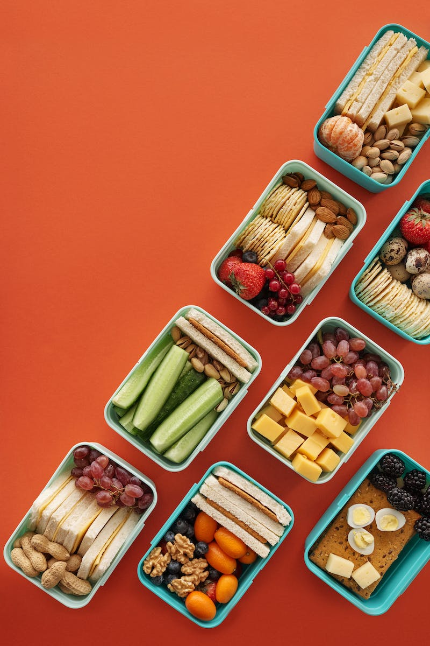
Conclusion
• My lunchbox never disappoints, always filled with tasty treats
• From healthy options like fruits and yogurt to indulgent delights like cupcakes and pizzas
• A balanced selection that caters to different preferences
• Food that is specially made for me and brings me joy
Photo by Pexels

