Slide 1
Unraveling the Intricacies of Atmospheric Phenomena
A Deep Dive into the Complexities of our Skies

Slide 2
Understanding Atmosphere in a New Light
• Multiple layers make up the Earth's atmosphere
• Composed of gases and suspended particles
• Critical for climate regulation
• Serves as a shield against harmful radiation
Photo by Pexels

Slide 3
Greenhouse Effect: A Balancing Act
• The greenhouse effect is essential for maintaining Earth's temperature
• Certain gases trap heat in the atmosphere
• Human activities contribute to an imbalance
• Resulting in global warming and climate change
Photo by Pexels

Slide 4
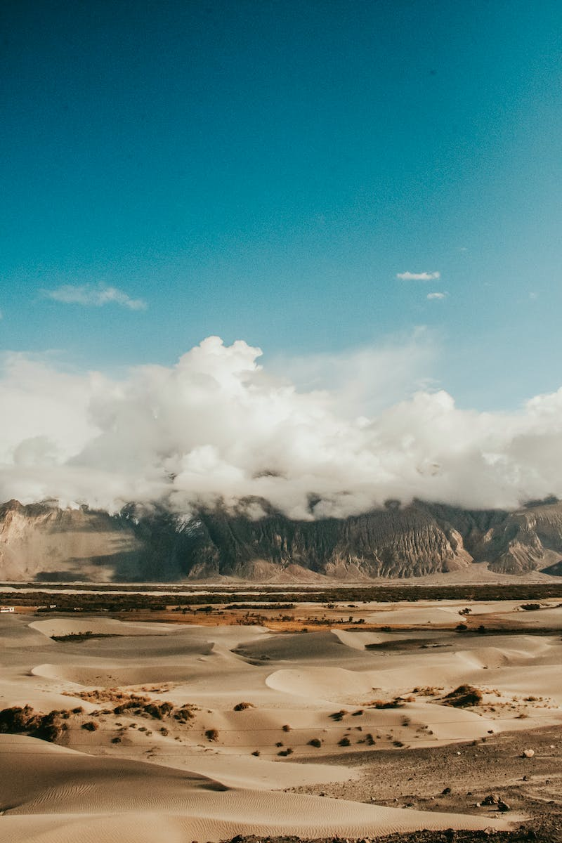
The Dance of Clouds
• Clouds form through the process of condensation
• Varying cloud types indicate different atmospheric conditions
• Play a role in weather patterns and precipitation
• Complex interplay between temperature, humidity, and air currents
Photo by Pexels

Slide 5
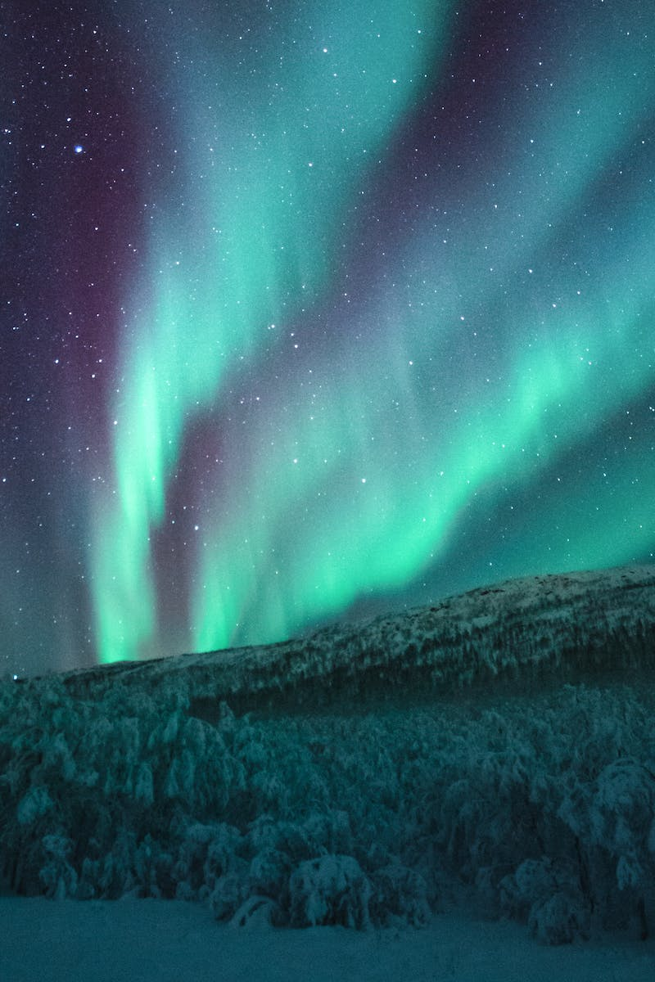
Unveiling the Mystery of Aurora Borealis
• Aurora Borealis, or Northern Lights, are mesmerizing atmospheric phenomena
• Result from interactions between solar winds and Earth's magnetic field
• Occur primarily in polar regions
• Vary in colors and intensity
Photo by Pexels

Slide 6
Aligning with Clean Air Policies
• Air pollution poses severe health and environmental risks
• Numerous initiatives aim to mitigate air pollution
• Promoting cleaner energy sources and sustainable practices
• Enhancing air quality monitoring and regulations
Photo by Pexels

