Slide 1
Outcomes Based Education: Shifting the Focus from Content to Outcome
A student-centered approach towards meaningful learning

Slide 2
Introduction
• Welcome to our assessment of student learning one class.
• Presented by Mr. Jackets and Go.
• Defining the simple term education.
• Historical perspective of education as a pouring in process.
Photo by Pexels

Slide 3
Evolution of Education
• The teacher's role as a facilitator of knowledge.
• Changing perspective in education due to technology.
• Transition from sage on the stage to guide on the side.
• Teacher assistance in organization, interpretation, and validation of facts and information.
Photo by Pexels

Slide 4
Outcomes Based Education (OB)
• Definition and characteristics of OB.
• Student-centered approach focusing on learning outcomes.
• Faculty responsibility in teaching and assessing program outcomes.
• Meaningful data to guide improvement in instruction and assessment.
Photo by Pexels

Slide 5
Characteristics of OB
• Student-centered: Placing students at the center of the educational process.
• Faculty-driven: Encouraging faculty responsibility and student participation.
• Meaningful: Providing data for valid and continuous improvement.
Photo by Pexels

Slide 6
Implementation of OB
• Procedure for subject/course-level implementation of OB.
• Identification of educational objectives.
• Listing of learning outcomes for each objective.
• Drafting outcomes assessment procedure.
Photo by Pexels

Slide 7
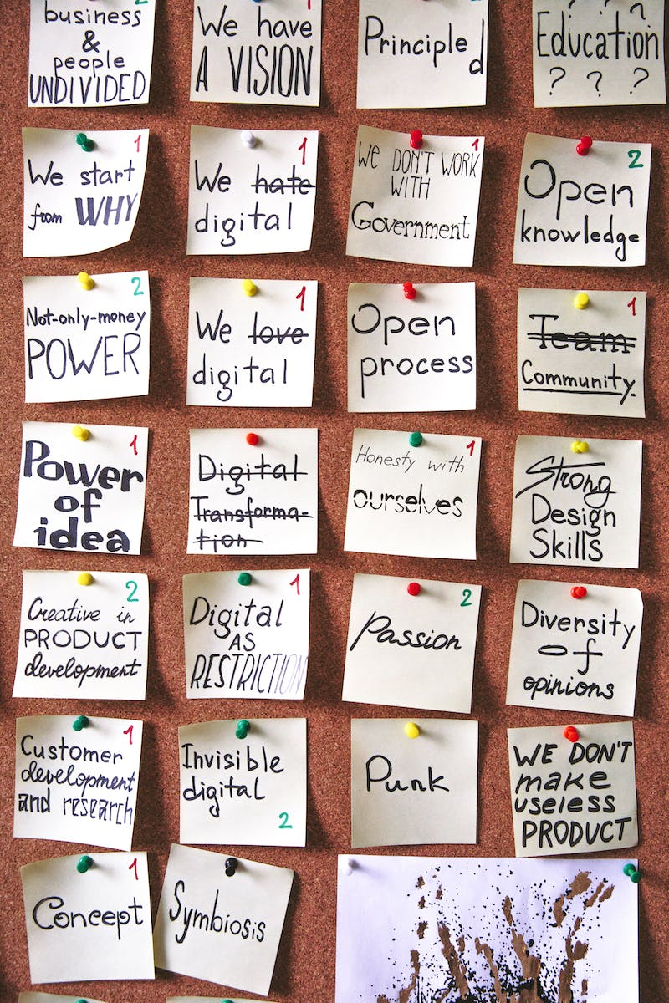
Educational Objectives
• Definition and importance of educational objectives.
• Broad goals and desired student outcomes.
• Stated from the teacher's perspective.
• Examples: develop, provide, enhance, and inc.
Photo by Pexels

Slide 8
Learning Outcomes
• The need for specific and measurable learning outcomes.
• Concrete active verbs for stating learning outcomes.
• Taxonomy of educational objectives by Benjamin Bloom.
• Cognitive, psychomotor, and affective domains.
Photo by Pexels

Slide 9
Outcomes Assessment
• Procedure for assessing learning outcomes.
• Gathering data to measure student achievement.
• Selection of assessment tools and timing of assessments.
Photo by Pexels

Slide 10
Recap
• Shifting the focus from content to outcome.
• The three characteristics of OB.
• Implementation procedure and educational objectives.
• The taxonomy of educational objectives.
• Summary and conclusion.
Photo by Pexels

Slide 11
Closing
• Thank you for your time and effort!
• This concludes our session on outcomes-based education.
• Good luck and have a nice day!
Photo by Pexels

