Slide 1
The Polyglot Secret: Discovering the Joy of Language Learning
Unlocking the Methods and Mindset of Polyglots

Slide 2
Introduction
• Polyglots are people who speak multiple languages fluently
• Learning languages is often seen as difficult and time-consuming
• Polyglots have unique methods and approaches to language learning
• The common factor among polyglots is their enjoyment of the language learning process

Slide 3
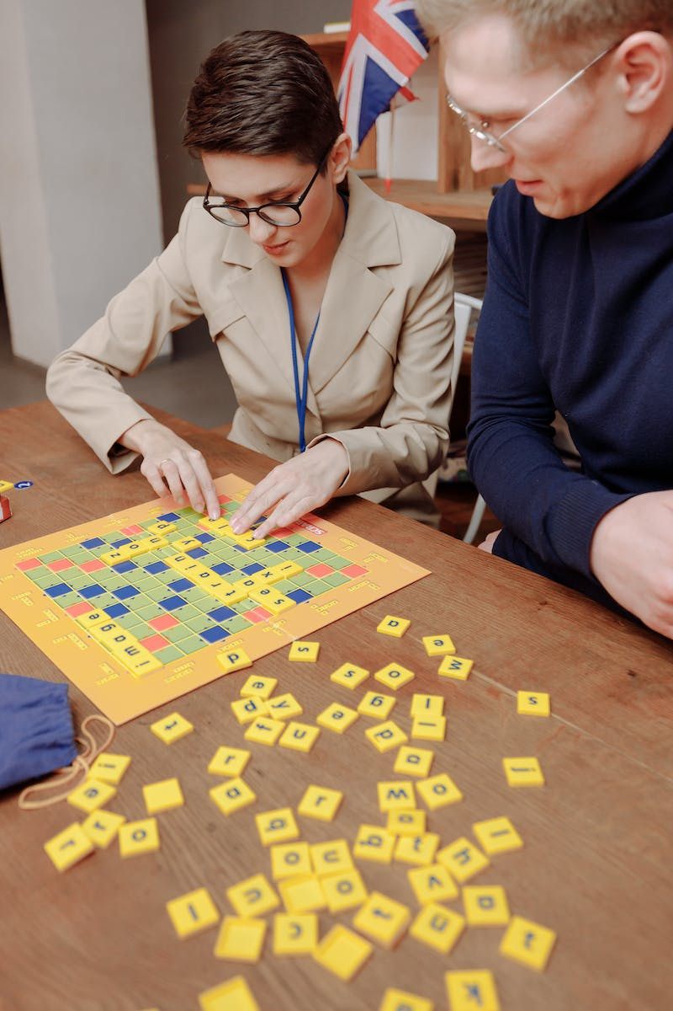
Methods of Polyglots
• Polyglots use various methods to learn languages
• Some polyglots start speaking from day one and learn through conversations
• Others focus on indicating sounds or learning the most frequent words
• Each polyglot has their own unique approach, but all achieve fluency
Photo by Pexels

Slide 4
Enjoyment in Language Learning
• Polyglots find enjoyment in the language learning process
• They use materials and content they are interested in
• Reading favorite books, watching favorite TV shows in the target language
• By turning language learning into a fun and enjoyable activity, polyglots stay motivated
Photo by Pexels

Slide 5
Effective Methods
• Polyglots employ effective methods for language learning
• Using spaced repetition systems and mnemonic techniques
• Exploring various apps, websites, and resources available
• Learning vocabulary and grammar in a systematic and efficient way
Photo by Pexels

Slide 6
Creating a System
• Polyglots create a system for their language learning
• Allocating dedicated time for practice and revision
• Incorporating language learning into daily routines
• Setting goals and sticking to a structured learning plan
Photo by Pexels

Slide 7
Patience and Persistence
• Language learning requires patience and persistence
• Fluency cannot be achieved overnight
• Making small but consistent progress leads to visible improvements
• Celebrating milestones and staying motivated
Photo by Pexels

Slide 8
Unlocking Language Potential
• Anyone can become a polyglot with the right methods and mindset
• Language talent is not limited to a select few
• Finding enjoyable methods and using effective techniques can lead to language success
• Language learning is within reach for everyone
Photo by Pexels

Slide 9
Conclusion
• Enjoyment and effective methods are key to language learning
• Create a system and allocate dedicated time for learning
• Develop patience and persistence for long-term progress
• Language learning success is achievable for anyone
Photo by Pexels

