Slide 1
The Composition of Paint
Exploring the Three Main Components and their Functions

Slide 2
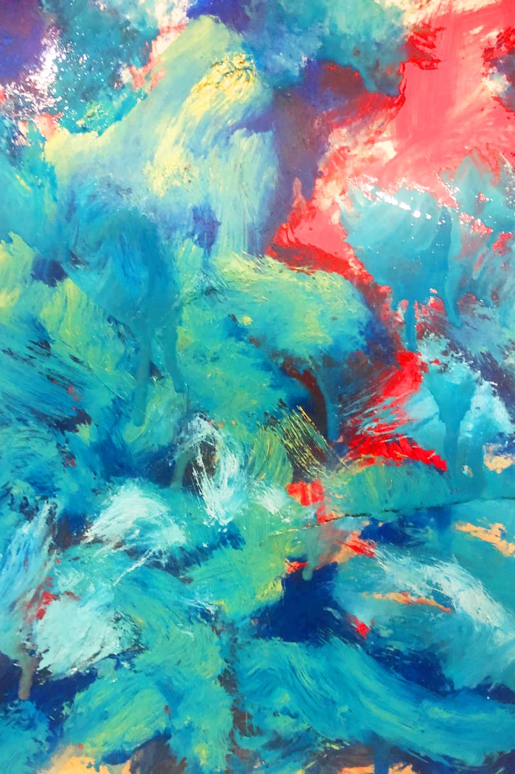
Chapter One: Introduction to Paint
• Paints and coatings have similar compositions
• They are liquid compositions that form films upon drying
• Films can be clear or opaque
• Coatings are widely used for protection and decoration
Photo by Pexels

Slide 3
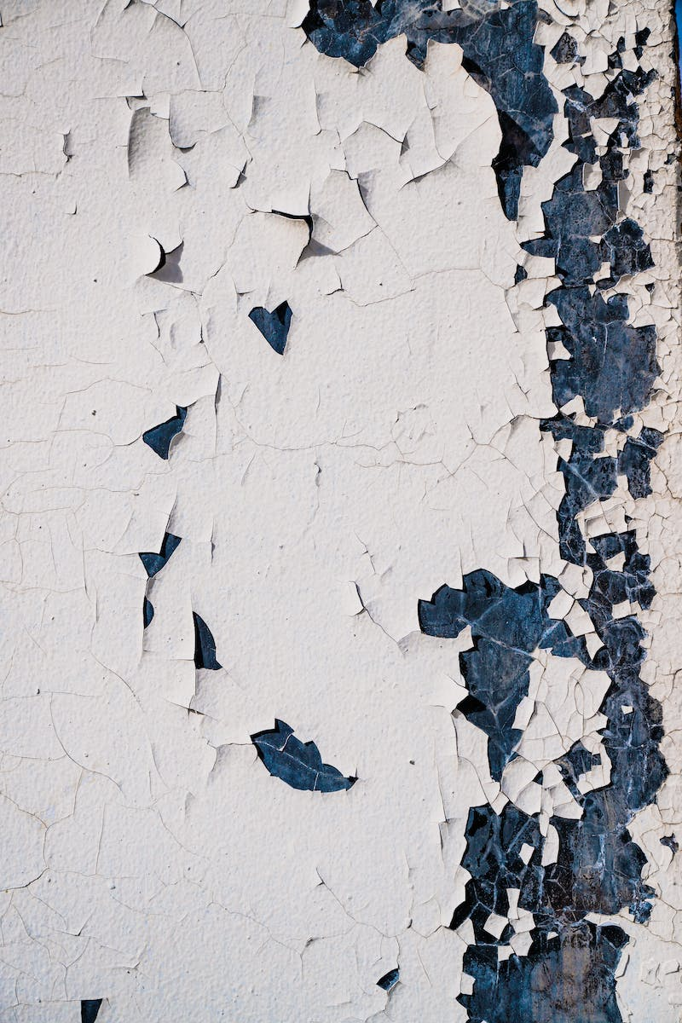
Main Components of Paint
• Binder: Gives the paint its protective and decorative properties
• Pigment: Provides color, hiding power, and improved corrosion resistance
• Solvent: Controls the viscosity and aids in drying
Photo by Pexels

Slide 4
Classification of Coatings
• Based on use and application
• Based on processing: water-based, oil-based, or powder
• Based on dry behavior
• Based on chemical nature of the binder
Photo by Pexels

Slide 5
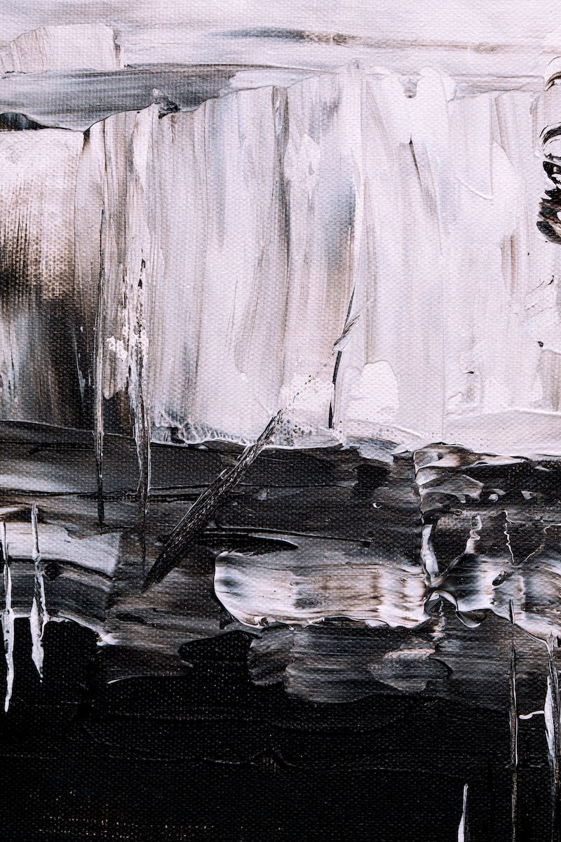
Pigments and Dyes
• Pigments are fine solid particles, while dyes are transparent
• Pigments provide color, hiding power, and improved durability
• Dyes are used for transparent and colored surfaces
Photo by Pexels

Slide 6
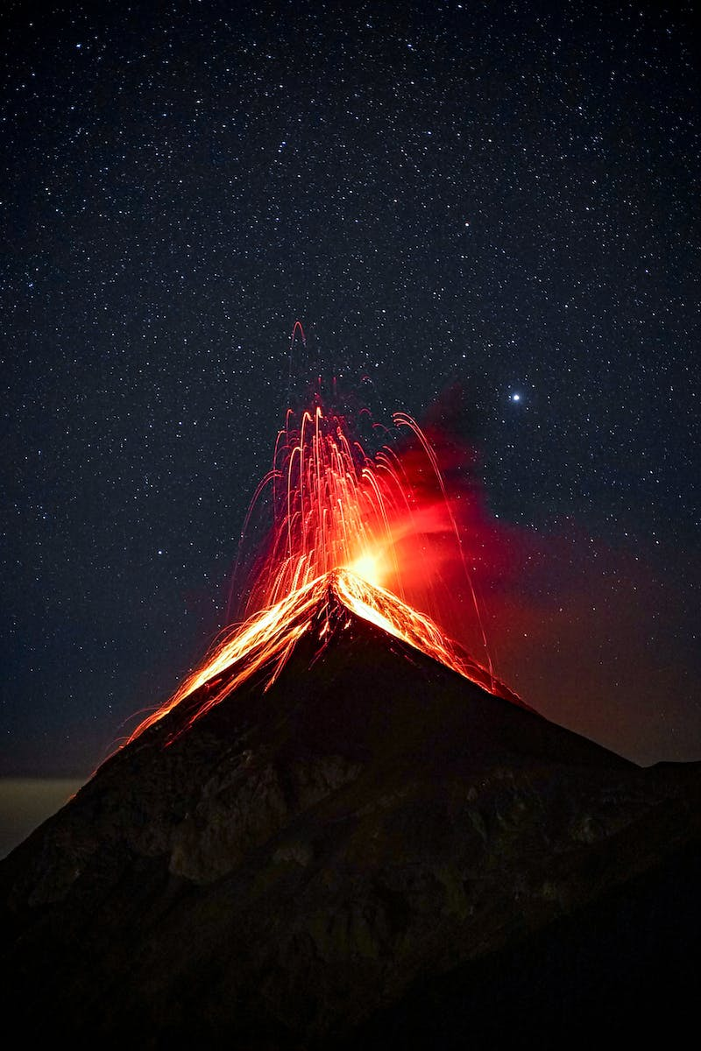
Factors Affecting Hiding Power
• Particle size of the pigment affects hiding power
• Finely ground pigments provide better hiding power
• Extended pigments are used to reduce costs
Photo by Pexels

Slide 7
Color Hue
• Hue refers to the variation in color
• Different hues can be derived from the same color family
• Hue can be identified by comparing shades of a color
Photo by Pexels

