Slide 1


The Power of Nukkad Natak
Exploring Political Expression Through Street Theatre in Dharavi Slums

Slide 2


Table of content
1
Exploring Nukkad Natak: The Art of Street Performance
2
Nukkad Natak: A Historical Journey
3
Cultural Significance of Street Theatre
4
Nukkad Natak: A Powerful Tool for Political Motivations
5
Dharavi: The Stage of Change
6
Exploring Powerful Themes

Slide 3
Table of content
7
Techniques Used in Performance: Engaging the Audience
8
Nukkad Natak: Amplifying Voices
9
Challenges Faced by Performers
10
Future of Nukkad Natak

Slide 4

Exploring Nukkad Natak: The Art of Street Performance
Nukkad Natak, a vibrant form of street theater, serves as a powerful medium for social commentary, effectively engaging diverse audiences in urban and rural landscapes.
Rooted in Indian culture, Nukkad Natak reflects local traditions, languages, and issues, making it a unique blend of entertainment and education for communities across India.
The performances often take place in public spaces, bringing together actors and spectators, fostering a sense of unity and shared experience in the heart of the community.
Through humor, drama, and music, Nukkad Natak addresses pressing social issues, inspiring change and raising awareness while preserving the rich heritage of Indian performing arts.

Slide 5

Nukkad Natak: A Historical Journey
1980s
1980s-1990s
1990s
2000s onwards
Origin in the 1980s
Societal Issues Highlighted
Political Themes Explored
Enduring Legacy
Nukkad Natak, or street theatre, originated in the 1980s as a powerful medium of expression. It served as a reflection of societal issues and political themes, engaging communities through performance...
During the late 1980s and early 1990s, Nukkad Natak addressed pressing societal issues such as poverty, corruption, and social injustice. These performances became a platform for marginalized voices, allowing them...
As political climates shifted in the 1990s, Nukkad Natak began to explore political themes, critiquing government policies and advocating for democratic values. The street theatre became an essential tool for...
The legacy of Nukkad Natak continues into the 2000s and beyond, influencing contemporary street theatre and activism. It remains a vital form of cultural expression that connects generations, empowering individuals...

Slide 6
Cultural Significance of Street Theatre
Street theatre serves as a vital cultural expression, reflecting community values and societal issues, thereby fostering a connection among urban audiences.
It effectively engages diverse audiences by utilizing relatable themes, humor, and storytelling, making complex messages easily digestible for all.
The interactive nature of street theatre encourages audience participation, enhancing the experience and ensuring the conveyed messages resonate more profoundly.
In urban settings, street theatre acts as a platform for marginalized voices, promoting social change and cultural awareness through powerful performances.

Slide 7


Nukkad Natak: A Powerful Tool for Political Motivations
Nukkad Natak effectively engages the community by presenting political messages in an entertaining and relatable way.
It fosters social justice awareness through accessible storytelling, encouraging public discourse on critical issues.
This form of theatre can mobilize support for political causes by inspiring audiences to take action in their communities.
The effectiveness of Nukkad Natak can vary based on the artists' skills and the audience's receptiveness.
Sometimes, political motivations may overshadow artistic expression, leading to biased or one-sided portrayals.
There is a risk of trivializing serious issues if not handled with sensitivity, potentially alienating some audience members.

Slide 8
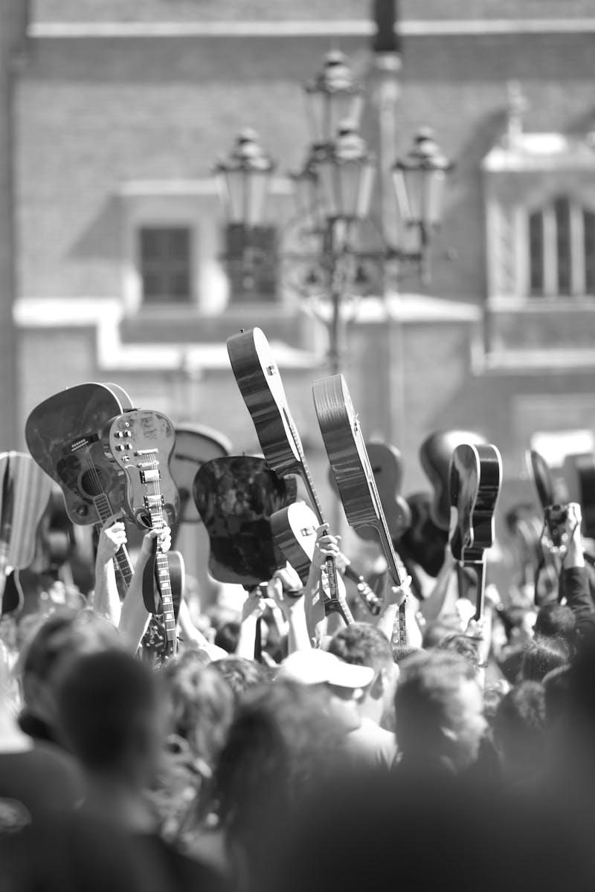
Dharavi: The Stage of Change
Dharavi is a densely populated urban slum in Mumbai, India, known for its vibrant culture and diverse communities. Street performances here serve as a powerful medium for expression.
Local street artists tackle pressing social issues through their performances, including poverty, sanitation, and education. These shows engage the community and promote awareness.
The vibrant street performances in Dharavi not only entertain but also inspire change, encouraging the audience to reflect on their local environment and societal challenges.
Through art and storytelling, Dharavi's performers create a unique space for dialogue, fostering community solidarity and resilience in the face of adversity.
Photo by Pexels

Slide 9
Exploring Powerful Themes
Poverty stands as a predominant theme, reflecting socio-economic disparities and the urgent need for solutions to uplift marginalized communities.
Communal harmony emphasizes the importance of unity and collaboration among diverse groups, fostering understanding and peaceful coexistence in society.
Government accountability highlights the responsibilities of political leaders, advocating transparency and ethical governance to serve the public effectively.
These themes intertwine and resonate across various narratives, shaping societal discussions and inspiring change towards a just and equitable world.

Slide 10
Techniques Used in Performance: Engaging the Audience
Improvisation allows actors to adapt and connect with their audience through spontaneous creativity, enhancing the overall experience.
Incorporating music creates an emotional impact and sets the mood, making performances more engaging and memorable for viewers.
Audience interaction fosters a sense of involvement and investment, drawing viewers deeper into the narrative and performance.
Improvisation may lead to unpredictable outcomes, which can challenge the consistency of the performance and the storyline.
Relying too heavily on music can overshadow the narrative, causing viewers to focus more on sound than on the plot.
Audience interaction can sometimes disrupt the flow of the performance, leading to confusion or disengagement among some viewers.

Slide 11
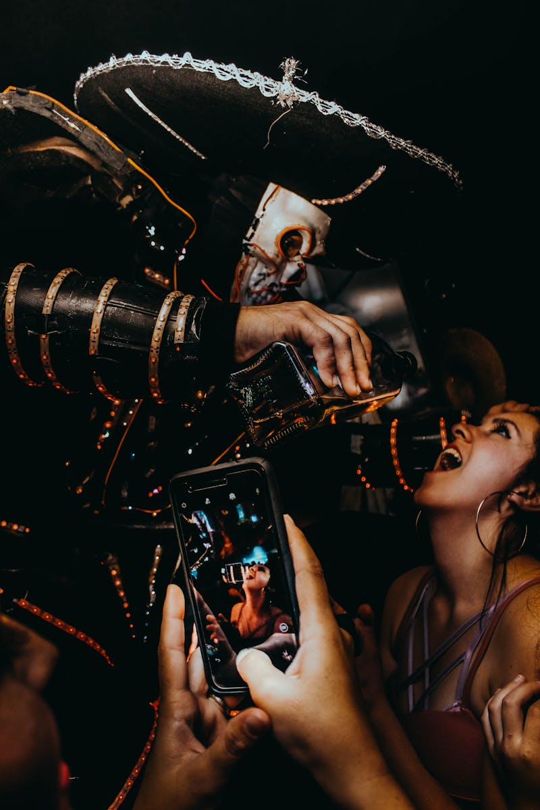
Nukkad Natak: Amplifying Voices
Nukkad Natak is a powerful form of street theater that engages communities and stimulates dialogue around pressing social issues, fostering a sense of unity.
Through performances, Nukkad Natak raises awareness on critical topics like health, education, and social justice, encouraging collective action and community solutions.
The immersive nature of Nukkad Natak allows audiences to reflect on their own experiences, creating a personal connection to the issues presented.
By involving diverse community members, Nukkad Natak not only entertains but also empowers individuals to become advocates for change, transforming passive viewers into active participants.
Photo by Pexels

Slide 12
Challenges Faced by Performers
Censorship can lead to increased creativity as performers find innovative ways to express their messages within restrictions.
Addressing funding issues cultivates resilience and resourcefulness, encouraging performers to explore alternative funding sources and collaborations.
Public resentment can foster community engagement and dialogue, prompting performers to connect deeper with their audiences and understand their perspectives.
Censorship limits artistic expression, hindering performers from communicating their true message and stifling creativity.
Funding issues can lead to project cancellations or compromises, resulting in reduced quality of work and missed opportunities.
Public resentment may create a hostile environment, discouraging performers and affecting their mental health and motivation.

Slide 13
Future of Nukkad Natak
2025
2027
2029
Digital Integration
Audience Engagement
Innovative Collaborations
As we move into a tech-savvy future, Nukkad Natak will embrace digital platforms. Virtual reality and augmented reality can enhance the storytelling experience, making performances more interactive for audiences, while...
With the rise of social media, street theatre can reach global audiences. Live-streaming performances and engaging with viewers online will allow artists to gather feedback and create a more connected...
Collaborations with tech companies can lead to innovative sets and stage designs. This fusion of art and technology will not only modernize the performances but also attract a younger demographic...

