Slide 1
The Shape of Earth - A Journey of Discovery
Exploring the Curiosity and Beliefs Surrounding Earth's Shape

Slide 2
Introduction
• Greetings to all physics and physical experiment enthusiasts!
• Curiosity about the shape of the Earth and flat Earth beliefs
• Questioning personal convictions and the desire to understand
• Embarking on a journey to explore the reasons behind belief in Earth's shape
Photo by Pexels

Slide 3
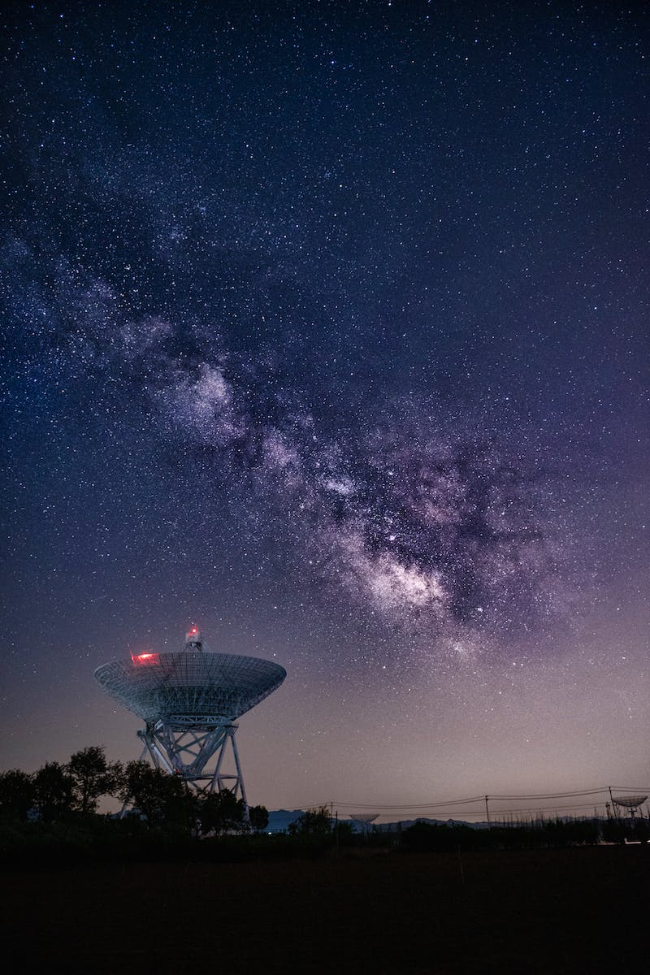
Experience and Observation
• Learning through direct experience
• Lack of personal experience regarding Earth's shape
• Relying on experiences of others
• Challenges of basing knowledge solely on experience
Photo by Pexels

Slide 4
Belief and Indoctrination
• Early introduction to the Earth's spherical shape
• Songs, globes, and maps shaping beliefs
• The power of indoctrination
• The influence of childhood beliefs

Slide 5
Trust and Skepticism
• The significance of trust
• Trusting the information received from teachers and books
• Avoiding skepticism due to trust
• Believing in a conspiracy theory
Photo by Pexels

Slide 6
Opinions and Arguments
• Living among diverse opinions
• The value of expressing and defending opinions
• The back-and-forth nature of arguments
• Recognizing the importance of opinions as a step towards knowledge
Photo by Pexels

Slide 7
Knowledge and Unification
• The multifaceted nature of knowledge
• Perceiving the interconnectedness of different aspects
• Understanding Earth's shape through various fields
• The role of celestial mechanics and human exploration in shaping knowledge
Photo by Pexels

Slide 8
Conclusion
• Summarize the exploration of beliefs and knowledge about Earth's shape
• Encourage audience to share their thoughts and perspectives
• Express gratitude for attention and curiosity
• Reiterate the roundness of Earth
Photo by Pexels

