Slide 1
Q Laura: The Exciting Future of AI Conversations
Unleashing Personality and Spice in AI with Q Laura

Slide 2
Introduction
• The current state of AI conversations is cold, boring, and lifeless
• Q Laura aims to add personality and spice to AI interactions
• Traditional fine-tuning takes months and costs millions of dollars
• Enter Q Laura or Low Rank Adapters from Microsoft Research
• The Laura paper shows a reduction in trainable parameters by up to 10,000 times
Photo by Pexels

Slide 3
The Concept of Low Rank Adapters
• Low Rank Adapters lower the dimensionality of pre-trained models
• The weight matrix is represented using two matrices (A and B)
• The dimensions of these matrices are much smaller than the original weight matrix
• The multiplication of matrices A and B reconstructs the original weight matrix
• Fine-tuning with Low Rank Adapters leads to faster training and lesser memory requirements
Photo by Pexels

Slide 4
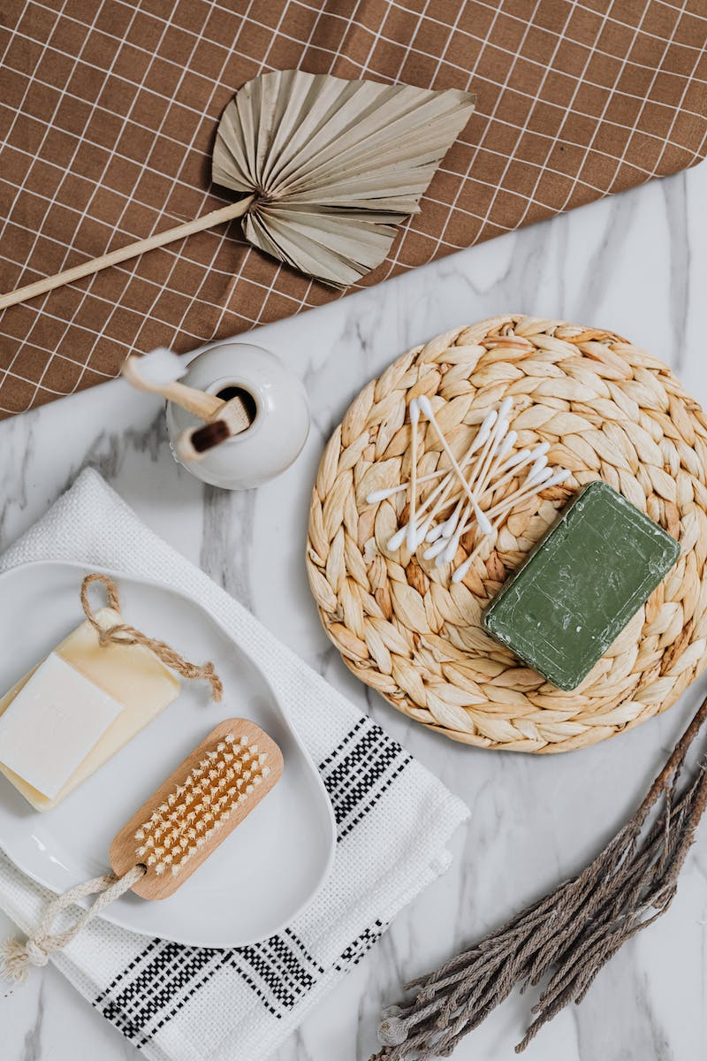
Benefits of Q Laura
• Trainable parameters reduced by up to 10,000 times
• Significantly faster training time compared to traditional fine-tuning
• Less memory required for fine-tuning
• Quantization further reduces the memory and improves efficiency
• Q Laura enables fine-tuning with very few samples
Photo by Pexels

Slide 5
Practical Applications of Q Laura
• Q Laura enables the creation of generative models with personality
• Applications include chatbots, code predictors, and generative text
• Small datasets are sufficient for fine-tuning
• Users can create their own datasets or use existing ones
• Possibilities for Q Laura applications are endless
Photo by Pexels

Slide 6
Creating Q Laura Models with Wall Street Bets Data
• Used Wall Street Bets subreddit data from 2017 as the dataset
• Dataset curated for a more fun and engaging chatbot
• Q Laura fine-tuned on Wall Street Bets data with only 118,500 samples
• Results achieved with minimal effort and fast training time
• Considerations for offensive content and customization of dataset
Photo by Pexels

Slide 7
Advantages of Q Laura Fine-tuning
• Q Laura fine-tuning requires fewer samples compared to traditional methods
• Results achieved with as low as a thousand samples
• Training size can be further reduced with pruning and curation
• Fine-tuning on subreddit data expands the model's character and style
• Q Laura paves the way for more creative and fun AI interactions
Photo by Pexels

Slide 8
The Future of Q Laura
• Q Laura enables the creation of smaller and more efficient models
• Models can be easily swapped and combined using adapters
• A mixture of Q Laura experts offers a wide range of capabilities
• The potential for models running on mobile devices without additional data
• The importance of adding personality and humanity to AI interactions
Photo by Pexels

Slide 9
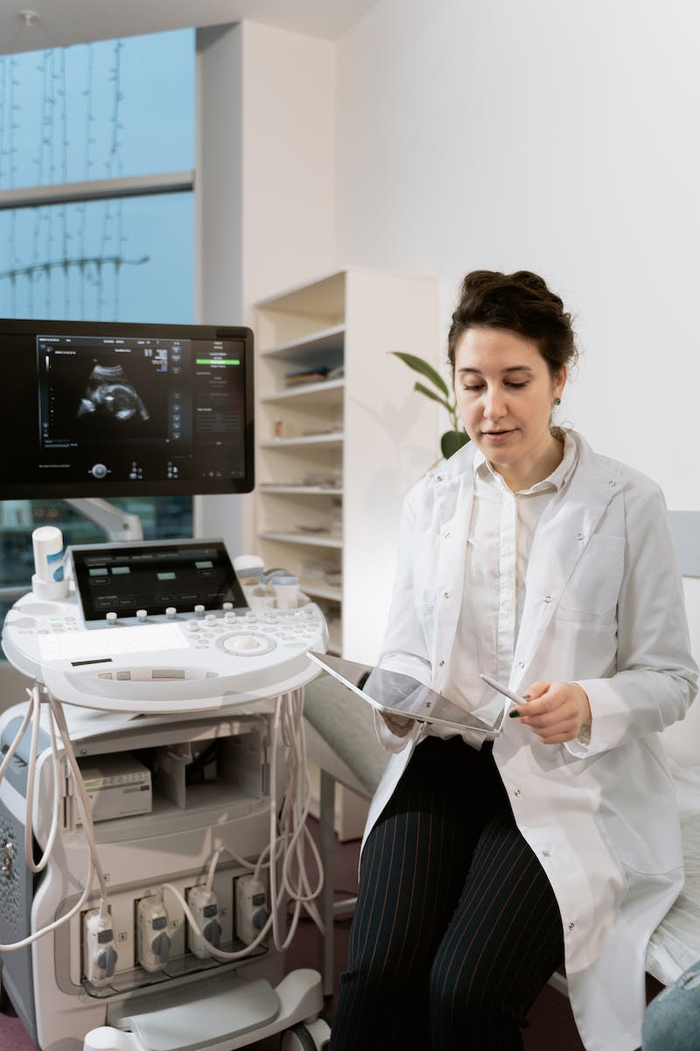
Conclusion
• Q Laura brings personality, spice, and humor to AI conversations
• Training models with Q Laura is faster and more cost-effective
• Smaller models with Q Laura adapters offer diverse and engaging interactions
• Greater focus on fun, creativity, and human-like AI experiences
• Q Laura opens the door to a new era of AI conversational agents
Photo by Pexels

