Slide 1
Automating Classification of Customer Queries
Improving Efficiency and Quality at Alpha Bank's Machine Learning Lab

Slide 2
Introduction
• Presenting the problem of categorizing customer queries at Alpha Bank
• Discussing the challenges and complexities involved in the process
• Highlighting the importance of automating the classification task
• Exploring the benefits of automation for both employees and customers
Photo by Pexels

Slide 3
Classification Process
• Describing the communication process between customers and bank employees
• Explaining the need for a unified classifier and its hierarchical structure
• Highlighting the importance of accurate classification for better decision-making
• Discussing the various thematic categories and their relevance to different banking products
Photo by Pexels

Slide 4
Data Analysis and Reporting
• Analyzing the collected data to generate insights and reports
• Examining the distribution of thematic categories over time
• Identifying trends and anomalies in customer queries
• Exploring the use of data analysis for making informed management decisions
Photo by Pexels

Slide 5
Modeling and Improvement
• Introducing the task of text classification using machine learning
• Exploring different modeling approaches and techniques
• Discussing the challenges faced and possible solutions
• Presenting the results of initial modeling experiments and their implications
Photo by Pexels

Slide 6
Data Annotation and Quality Control
• Describing the process of data annotation by human experts
• Explaining the need for quality control measures
• Discussing the benefits of cross-verification and feedback
• Presenting the results of data annotation and the achieved quality
Photo by Pexels

Slide 7
Incorporating User Feedback
• Addressing the challenge of incorporating user feedback into the classification process
• Exploring the use of customer's existing banking products as features
• Highlighting the impact of feature inclusion on model performance
• Presenting the results and demonstrating the improved accuracy
Photo by Pexels

Slide 8
Pilot Implementation
• Describing the pilot implementation of the automated classification system
• Discussing the results and benefits achieved
• Highlighting the reduction in manual classification workload
• Presenting the improved accuracy in comparison to human operators
Photo by Pexels

Slide 9
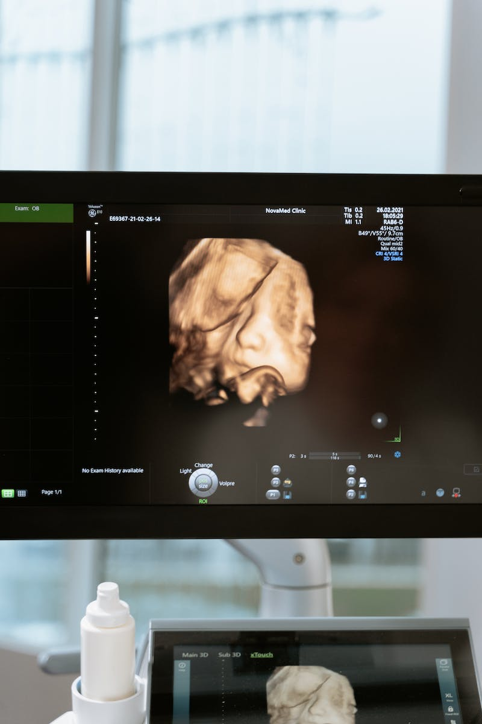
Conclusion
• Summarizing the key points and achievements
• Highlighting the importance of automation in improving efficiency and quality
• Addressing the future scope for further improvements
• Encouraging the adoption of automated classification systems in similar contexts
Photo by Pexels

