Slide 1
Introduction to Six Sigma
History, Concepts, and Implementation

Slide 2
History of Six Sigma
• Six Sigma was invented by Motorola in 1987
• General Electric implemented Six Sigma in all processes
• Managers in General Electric were required to go through Six Sigma training
Photo by Pexels

Slide 3
What is Six Sigma?
• Six Sigma aims for high-performance standards
• The goal is to achieve 3.4 defects per million opportunities
• It involves using half the tolerance to ensure quality
• Three broad approaches: statistical tool, process improvement, and philosophy
Photo by Pexels

Slide 4
Approaches to Six Sigma
• Statistical tool approach aims for less than 3.4 defects per million opportunities
• Process improvement approach using DMAIC (Define, Measure, Analyze, Improve, Control)
• Philosophical approach seeks continuous improvement
• Most organizations implement Six Sigma as statistical tool or process improvement
Photo by Pexels

Slide 5
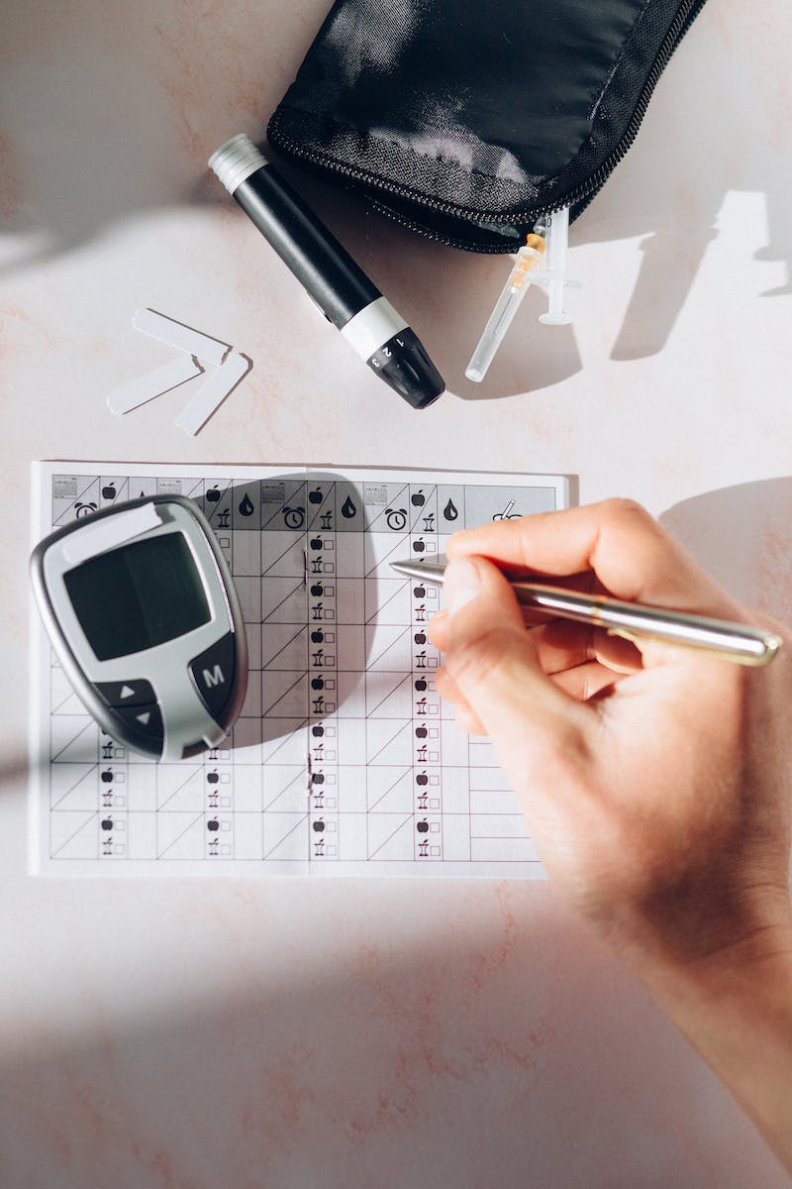
Defect Levels and Sigma Numbers
• Defect levels measured in defects per million opportunities
• Higher defect levels correspond to lower sigma numbers
• 3.4 defects per million opportunities represents Six Sigma performance
• As defect levels increase, sigma levels decrease
Photo by Pexels

Slide 6
DMAIC Approach for Process Improvement
• DMAIC stands for Define, Measure, Analyze, Improve, Control
• Used to improve existing processes
• Identify the problem, measure the current performance, analyze root causes, implement improvements, and establish control measures
Photo by Pexels

Slide 7
DMADV Approach for Process Design
• DMADV stands for Define, Measure, Analyze, Design, Verify
• Used for designing new processes
• Focuses on developing new processes to meet customer requirements
Photo by Pexels

Slide 8
Six Sigma Belts
• White belt - basic understanding of Six Sigma
• Yellow belt - participate in Six Sigma improvement teams
• Green belt - lead small projects or support Black belts
• Black belt - full-time job, lead complex improvement projects
• Master Black belt - trains and mentors other belts
Photo by Pexels

