Slide 1
The Impact of Climate Change on Biodiversity
Exploring the consequences of a warming planet

Slide 2
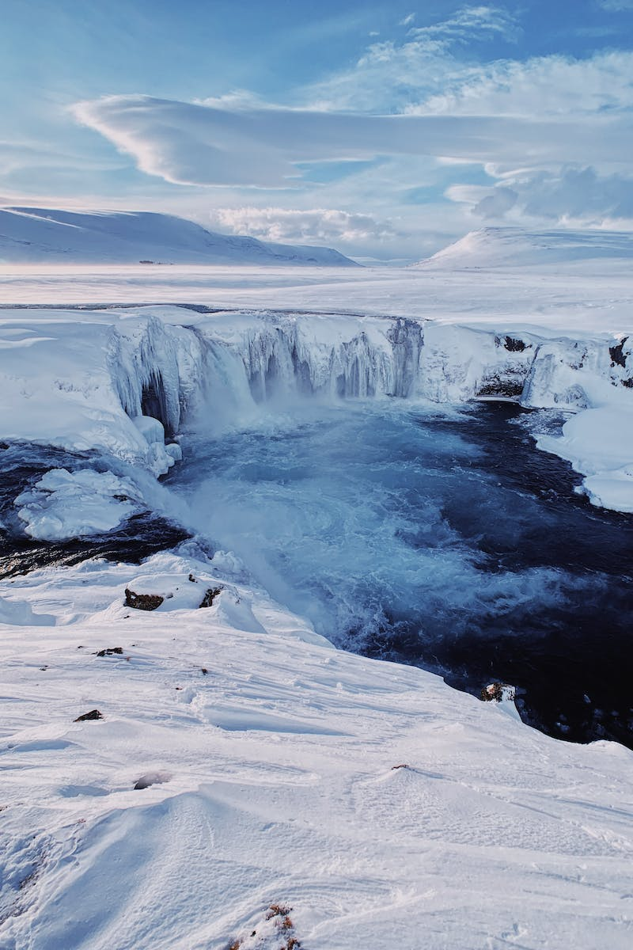
Introduction to Climate Change
• Primary factor: Increase in greenhouse gases
• Caused by human activities
• Rapidly warming Earth's temperature
• Impacts on various ecosystems
Photo by Pexels

Slide 3
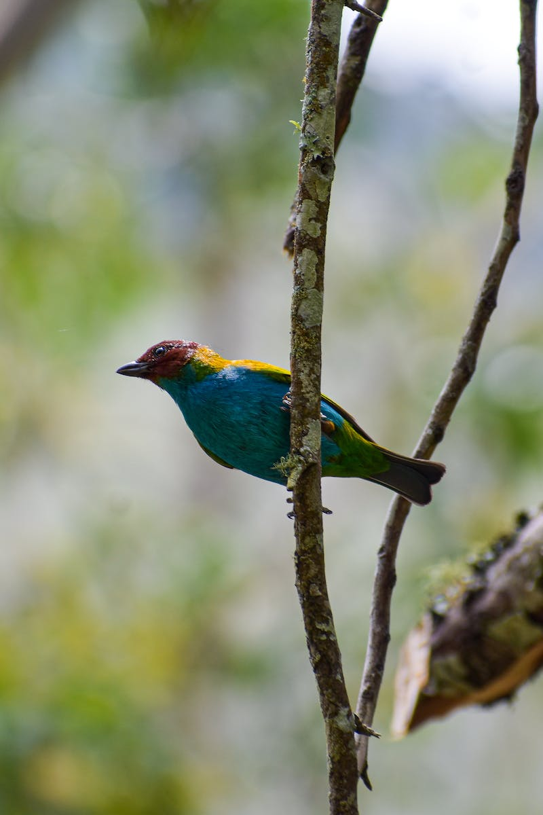
Understanding Biodiversity
• Definition: Variety of life on Earth
• Includes all species and ecosystems
• Essential for ecosystem stability
• Provides ecosystem services
Photo by Pexels

Slide 4
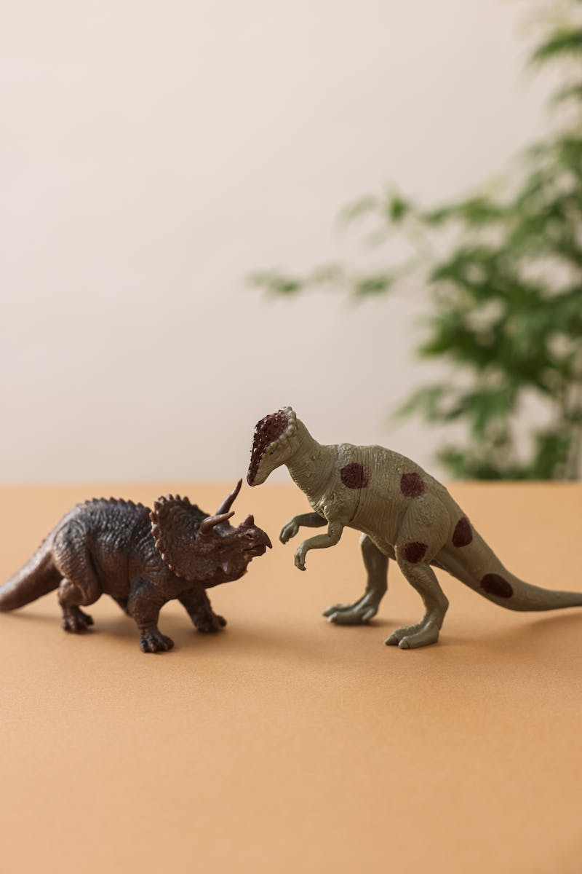
Climate Change and Species Extinction
• Species at risk due to habitat loss
• Changing temperature patterns disrupt breeding
• Loss of food sources and migration patterns
• Increased susceptibility to diseases
Photo by Pexels

Slide 5
Ecosystem Disruption and Climate Change
• Negative effects on food webs
• Altered ecosystems and ecological interactions
• Impacts on pollination and seed dispersion
• Reduced biodiversity and resilience
Photo by Pexels

Slide 6
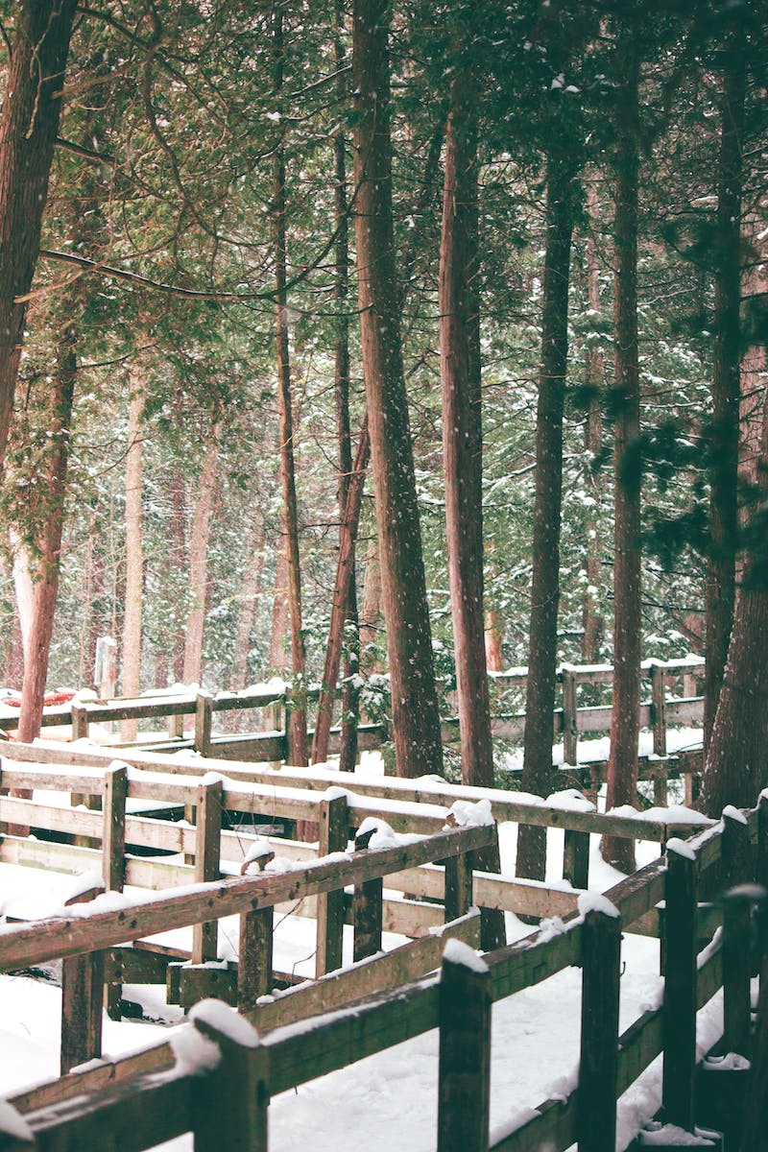
Conservation Strategies
• Mitigation vs. adaptation approaches
• Reducing greenhouse gas emissions
• Preserving critical habitats
• Implementing species-specific conservation plans
• Enhancing ecosystem resilience
Photo by Pexels

