Slide 1
Racism in Brazil: Understanding its Persistence
Exploring the Historical and Contemporary Issues

Slide 2
Introduction
• João Gabriel, Sociology Professor
• Exploring the theme of racism in Brazil
• Addressing misconceptions and analyzing scientifically
• Using data and statistics
• Defining racism as a hierarchy of races and ethnicities
• Highlighting the artificial nature of racial hierarchies
Photo by Pexels

Slide 3
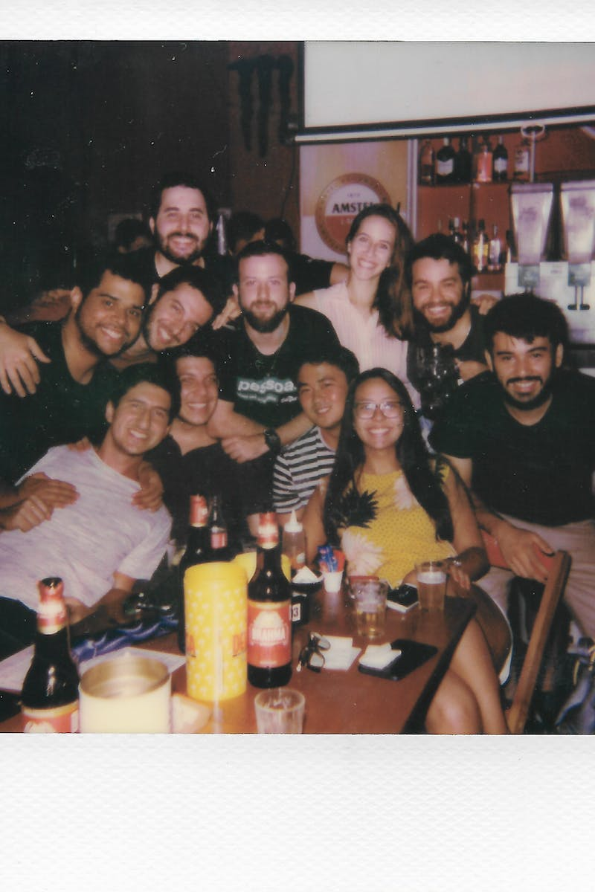
Historical Context
• Deodoro da Fonseca's decree in 1891
• Encouraging European immigration
• Excluding Africans and Asians
• The influence of Gilberto Freyre
• Assimilationist racism post-abolition
• Legislative history of racial discrimination
Photo by Pexels

Slide 4
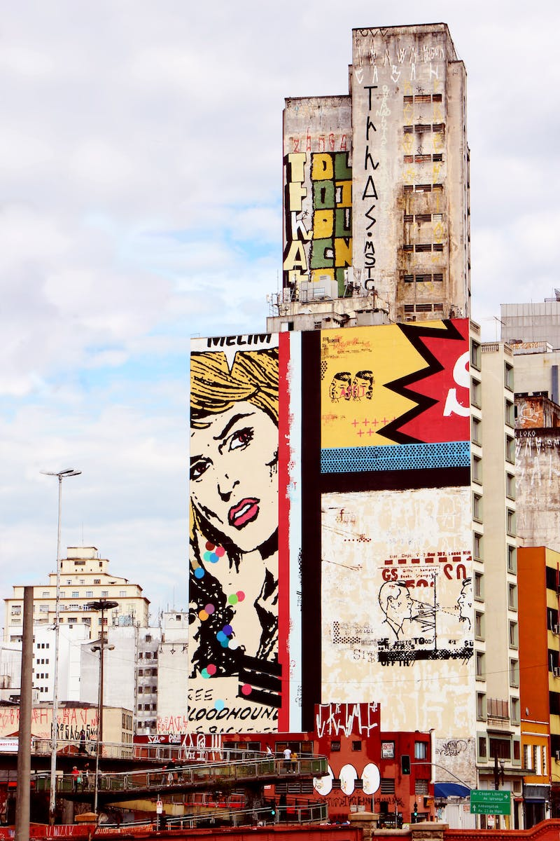
Current Reality
• Subtle and mixed nature of racism
• Legislation against racial insults
• The Law of Racism (Lei 7.716)
• Societal legitimization of racism
• Role of humor, school, and public figures
• The need to address the roots of racism
Photo by Pexels

Slide 5
Historical Factors
• Legacy of slavery
• Persistent mentality of slavery
• Residual forms of discrimination
• Inequality in labor and domestic work
• Exclusion and assimilation of black population
• Historical theories justifying racial inferiority
Photo by Pexels

Slide 6
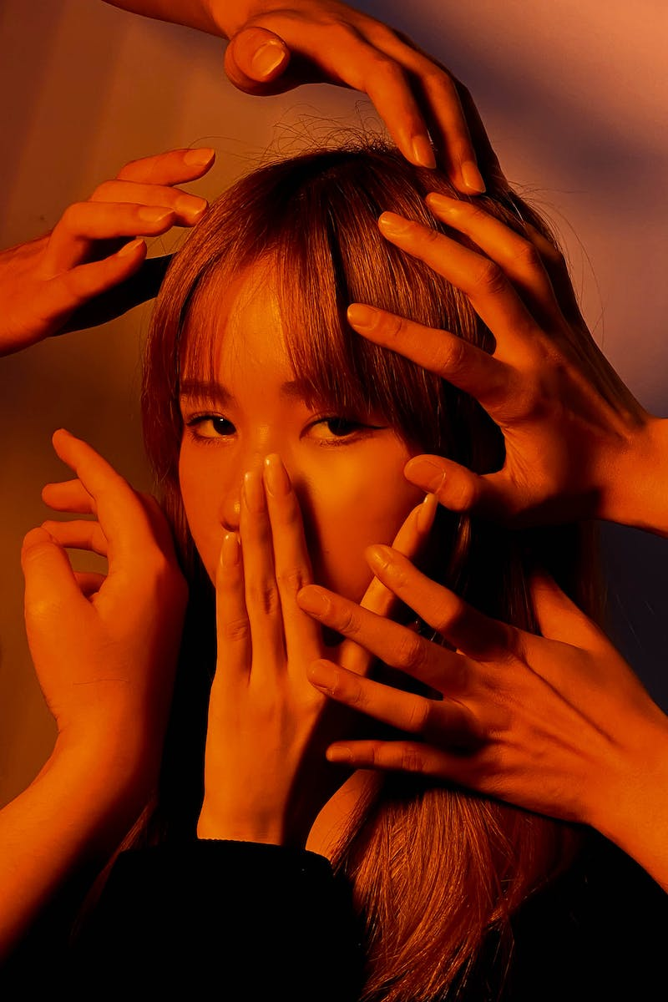
Contemporary Issues
• High rates of violence against black population
• Economic disparities and income inequality
• Limited access to education and university
• Increase in femicide cases against black women
• Police violence and racial profiling
• Data from reliable sources: Atlas of Violence, IPEA, PNAD
Photo by Pexels

Slide 7
Ending Racism
• Understanding the persistence of racism
• Challenging societal norms and stereotypes
• Promoting inclusivity and diversity
• Advocating for equal rights and opportunities
• Educating the population about racial issues
• The ongoing fight against racism
Photo by Pexels

Slide 8
Conclusion
• Racism as a societal issue
• The need for dialogue and action
• Persistence of racism in the 21st century
• Creating a more equal and inclusive society
Photo by Pexels

