Slide 1
The Impact of Technology on Society
Exploring the Role of Technology in Shaping Our Lives

Slide 2
Introduction
• Technology has become an indispensable part of our lives.
• It has revolutionized the way we communicate, work, and live.
• This presentation delves into the profound impact of technology on society.
• Join us on this journey to explore the positive and negative aspects of technological advancements.
Photo by Pexels

Slide 3
The Power of Connectivity
• The internet has connected people worldwide like never before.
• Social media platforms have revolutionized the way we communicate and share information.
• Globalization and cultural exchange have been facilitated through interconnected technologies.
• However, concerns regarding privacy and online surveillance have also emerged.
Photo by Pexels

Slide 4
Automation: Transforming Industries
• Automation and artificial intelligence are reshaping industries and workforce.
• Efficiency gains and increased productivity are realized through automation.
• However, concerns about job displacement and economic inequality arise.
• The need for upskilling and retraining becomes vital in the era of automation.
Photo by Pexels

Slide 5
Emerging Technologies: Boon or Bane?
• Emerging technologies such as artificial intelligence, blockchain, and virtual reality are revolutionizing various sectors.
• Applications in healthcare, finance, and education hold great potential.
• However, ethical concerns and the digital divide need to be addressed.
• The responsible and equitable adoption of these technologies is crucial.
Photo by Pexels

Slide 6
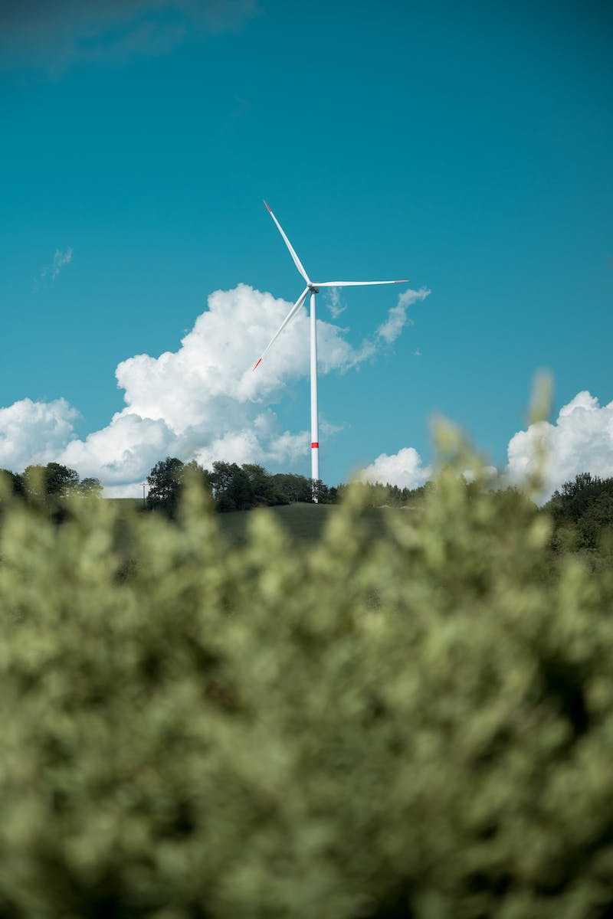
Sustainable Technology: Towards a Greener Future
• The urgency of environmental sustainability demands the development of green technologies.
• Renewable energy sources and eco-friendly practices are gaining prominence.
• Technological innovations can help combat climate change and create a sustainable future.
• Collaboration between industries, governments, and individuals is key.
Photo by Pexels

Slide 7
Conclusion
• Technology has the power to shape our society in profound ways.
• It offers immense opportunities but also presents challenges.
• As we move forward, it is crucial to harness technology's potential for the greater good.
• Let us embrace technology responsibly, ensuring its benefits are shared by all.
Photo by Pexels

