Slide 1
The Journey and Lessons of Airbnb
From a Small Idea to a Global Phenomenon

Slide 2
Introduction
• Airbnb's journey from a small idea to a global success story
• Overview of Brian Chesky, founder and CEO of Airbnb
• Reflection on the challenges of the COVID-19 pandemic
• Questions and concerns about the future of Airbnb
Photo by Pexels

Slide 3
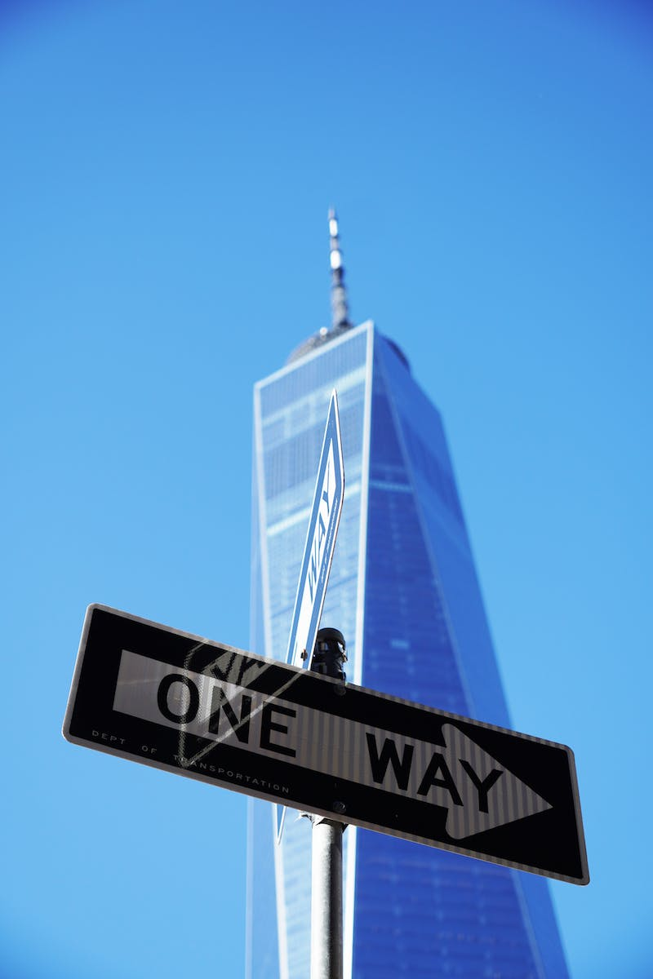
The Early Days
• Brian Chesky's background and early interests
• The inception of Airbnb as a way to pay rent
• Unforeseen success of Airbnb as millions started using the platform
• Lessons on starting with a small idea and building something vast
Photo by Pexels

Slide 4
Navigating Challenges
• Impact of the COVID-19 pandemic on Airbnb's business
• Difficult decisions made during the crisis
• The letter Brian Chesky wrote to the entire company
• Emotions and reflections on the journey
Photo by Pexels

Slide 5
The Core Identity
• The importance of early experiences shaping one's core self
• Brian Chesky's childhood interest in art and design
• The impact of industrial design education on running a tech company
• Lessons on staying true to one's identity and values
Photo by Pexels

Slide 6
Escaping and Fitting In
• Brian Chesky's desire to design a world he could escape to
• Feelings of being different and seeking a sense of belonging
• The impact of childhood challenges and anxieties
• Reflections on finding one's way home and creating a sense of belonging
Photo by Pexels

Slide 7
The Loneliness of Leadership
• The inherent loneliness of leadership
• Transitions from a close-knit team to a formal organization
• The challenges of isolation and the impact on leadership
• Importance of seeking connection and staying connected
Photo by Pexels

Slide 8
The Addiction to Work
• The addictive nature of work and its productivity
• Seeking conditional love and the need for validation
• Understanding addiction as a substitute for love
• Reevaluating motivations and finding intrinsic value
Photo by Pexels

Slide 9
Regrets and Reflections
• Regrets of not spending enough time with loved ones
• The desire to create a family and leave a legacy
• Gratitude for the journey and love for the experiences
• Importance of focusing on relationships and purpose
Photo by Pexels

Slide 10
The Power of Creativity
• Influence of Walt Disney and Steve Jobs as creative entrepreneurs
• Creating something beyond numbers and embracing creativity
• Empowering creative people and the importance of design
• The need to preserve and nurture childhood curiosity
Photo by Pexels

Slide 11
Conclusion
• Summarize the journey and lessons of Airbnb
• Encourage reflection on personal values and connections
• Highlight the importance of starting small and adapting
• Emphasize the impact of creativity and purpose in life
Photo by Pexels

