Slide 1
Enhancing Network Connectivity with Delta Routers
Optimizing Connections for Improved Performance

Slide 2
Introduction to Delta Routers
• Delta routers are an essential component of network connectivity.
• They enable efficient data transmission between devices.
• These routers can be made of either metallic or plastic materials.
• Delta routers are equipped with advanced features and support various connection types.
Photo by Pexels

Slide 3
The Importance of Connection Quality
• Having a reliable and high-quality connection is crucial for optimal performance.
• Poor connection quality can lead to slow internet speeds and frequent interruptions.
• Delta routers prioritize internet traffic based on various factors.
• This ensures that critical services and applications receive preferential treatment.
• Improved connection quality translates to better user experience and productivity.
Photo by Pexels

Slide 4
Advanced Firewall and Security Features
• Delta routers offer advanced firewall capabilities to protect the network.
• Firewall settings can be configured to allow or deny specific types of traffic.
• Pass-through connections ensure seamless integration with existing network infrastructure.
• Group-based terminal control allows for fine-grained access management.
• Passwords and encryption play a crucial role in ensuring network security.
Photo by Pexels

Slide 5
Optimizing Internet Speed and Bandwidth
• Delta routers offer features to optimize internet speed and bandwidth utilization.
• Quality of Service (QoS) settings ensure priority is given to critical applications.
• Administrative controls allow for fine-tuning network performance.
• These routers also support advanced traffic management techniques.
• Overall, Delta routers help maximize internet performance and minimize latency.
Photo by Pexels

Slide 6
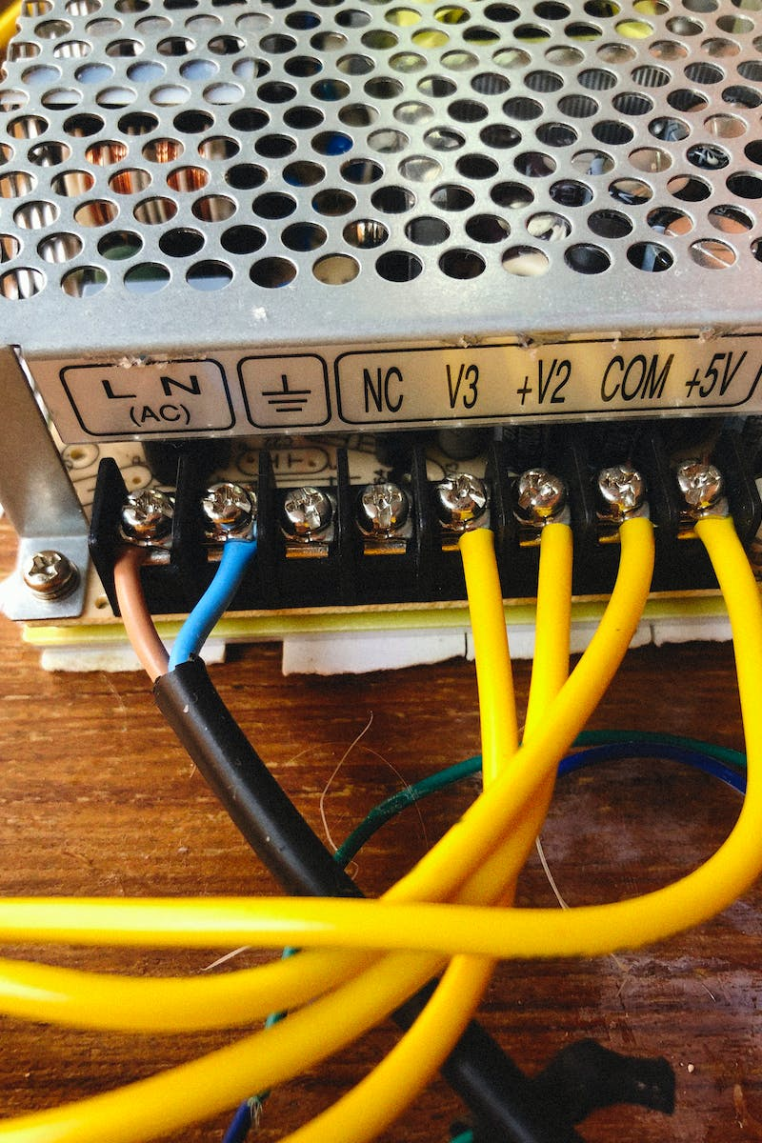
Future-Proofing Network Infrastructure
• Delta routers are designed to accommodate future network requirements.
• They support the latest technologies and protocols for seamless compatibility.
• These routers can be easily upgraded or expanded to meet growing demands.
• Flexible settings and configurations ensure adaptability to evolving network landscapes.
• Investing in Delta routers helps future-proof your network infrastructure.
Photo by Pexels

Slide 7
Conclusion
• Delta routers offer advanced features and capabilities to enhance network connectivity.
• With their robust security, optimized performance, and future-proof design, they are an ideal choice for various applications.
• Investing in Delta routers ensures reliable and high-quality network connections.
• Upgrade your network infrastructure with Delta routers for improved productivity and user experience.
Photo by Pexels

