Slide 1
The Miracle of the Andes: A Story of Survival
The harrowing true account of a plane crash in the Andes and the incredible strength and resilience of the survivors

Slide 2
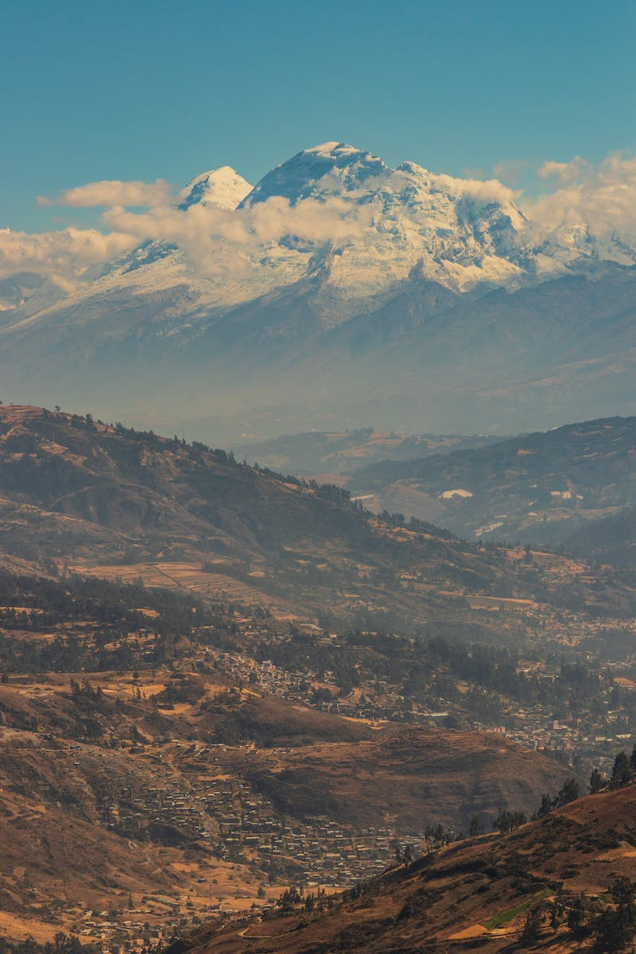
Introduction
• On October 19, 1972, a chartered plane carrying 45 passengers crashed in the Andes Mountains
• Initially given up for dead, the survivors defied all odds in their fight for survival
• This became known as the miracle of the Andes
• Through incredible resilience, they overcame unimaginable challenges
Photo by Pexels

Slide 3
The Crash and Immediate Challenges
• The plane crashed due to an immediate loss of power and altitude
• The passengers had to quickly adapt to their new reality in the harsh Andes environment
• Survivors faced severe injuries, cold temperatures, and extreme isolation
• Rescue efforts were hindered by the remote and treacherous crash site
Photo by Pexels

Slide 4
The Struggle for Survival
• The survivors had to ration their limited food and water supplies
• They faced extreme cold, altitude sickness, and dehydration
• To stay warm, they used various innovative methods, such as making sleeping bags from insulation
• Despite their dire circumstances, they never lost hope and supported each other
Photo by Pexels

Slide 5
Survivors' Journey to Rescue
• After 59 days, a group of survivors decided to embark on a dangerous trek to find help
• Navigating treacherous mountain terrain, they eventually crossed the Andes into Chile
• They encountered an Ecuadorean shepherd, who provided vital assistance and contacted authorities
• Search and rescue teams worked tirelessly to locate and evacuate the survivors
Photo by Pexels

Slide 6
The Aftermath and Legacy
• The survivors' rescue captured international attention and admiration
• Their story of hope, resilience, and the strength of the human spirit inspired millions
• Lessons learned from their ordeal have informed safety protocols in aviation
• The survivors continue to share their story, reminding us of the power of determination
Photo by Pexels

