Slide 1
Learn Backstroke Swimming
Master the technique and stay safe in the water

Slide 2
Introduction
• Welcome and greetings
• Overview of the lesson
• Importance of learning backstroke swimming
• Goals of the lesson
Photo by Pexels

Slide 3
Basic Movements
• Sliding motion
• Leg movements
• Arm movements
• Breathing technique
Photo by Pexels

Slide 4
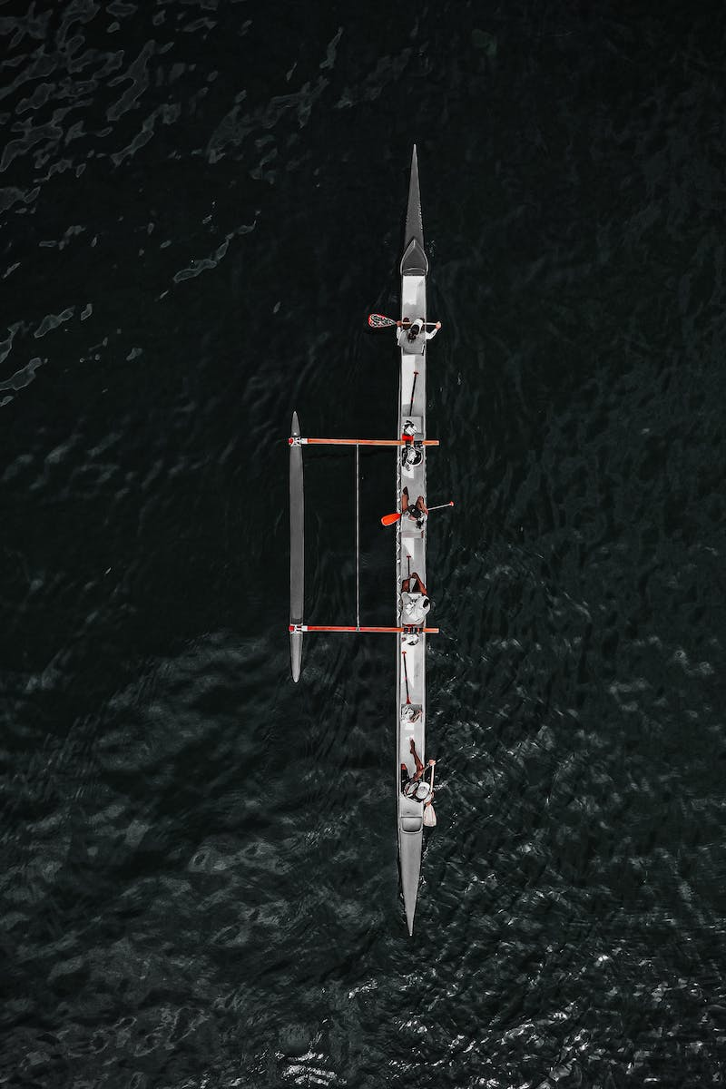
Practicing the Technique
• Combining leg and arm movements
• Coordinating movements
• Breathing synchronization
• Refining the technique
Photo by Pexels

Slide 5
Water Safety
• Self-rescue techniques
• Assisted rescue techniques
• Preventing accidents
• Equipment and precautions
Photo by Pexels

Slide 6
Summary and Conclusion
• Review of backstroke swimming technique
• Reminder of safety practices
• Encouragement to practice
• Wrap up and closing remarks

