Slide 1
Drugs Used for Diabetes
Understanding the Mechanisms and Side Effects

Slide 2
Introduction to Diabetes Mellitus
• Diabetes mellitus is a chronic disorder characterized by high blood glucose levels.
• There are two commonly encountered types: type 1 and type 2.
• Type 1 is characterized by insulin-producing cell destruction, leading to inadequate insulin production.
• Type 2 is characterized by insulin resistance and gradual insulin deficiency.
Photo by Pexels

Slide 3
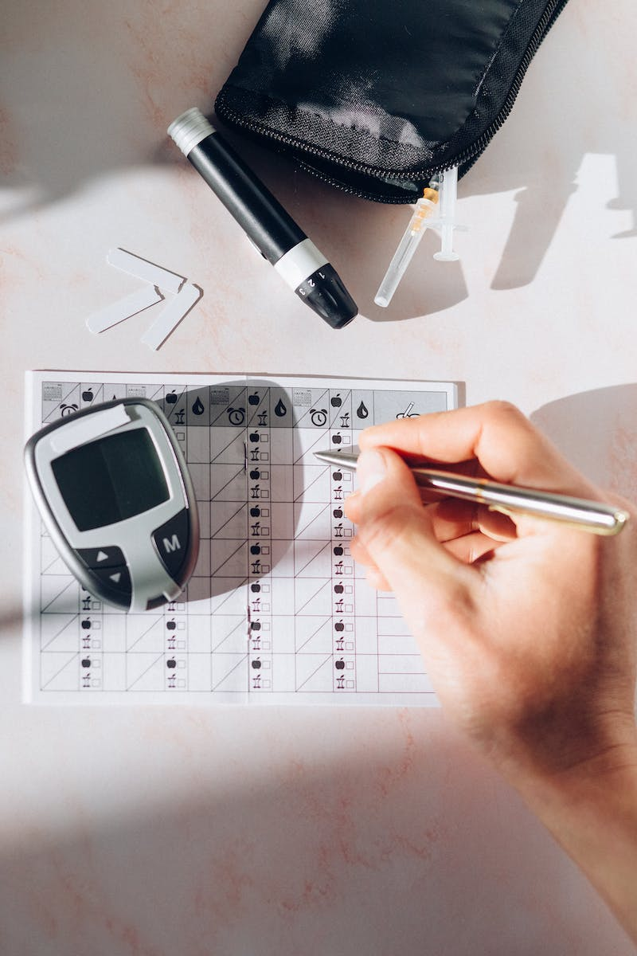
The Role of Insulin
• Insulin is a peptide hormone that stimulates glucose uptake by cells.
• It allows glucose to be used immediately for energy or stored as glycogen.
• Insulin production is triggered by rising blood glucose levels.
• Insulin deficiency or resistance leads to high blood glucose levels.
Photo by Pexels

Slide 4
Insulin and Its Analogs
• Insulin preparations can be divided into three major categories based on onset and duration of action: rapid-acting, short-acting, and long-acting.
• Insulin analogs with altered amino acid sequences have been developed for different action profiles.
• Rapid-acting insulins, such as insulin Lispro, act quickly with a shorter duration.
• Long-acting insulins, like insulin Degludec, have a slow onset and last beyond 24 hours.
Photo by Pexels

Slide 5
Side Effects of Insulin
• The most common side effect of insulin is hypoglycemia (low blood glucose).
• Lipodystrophy, the development of abnormal fat deposits at injection sites, can also occur.
• Patients should be aware of these side effects and monitor their blood glucose levels.
Photo by Pexels

Slide 6
Synthetic Amylin
• Amylin is a peptide hormone that delays gastric emptying and suppresses glucagon secretion.
• Synthetic amylin, like Pramlintide, can reduce insulin doses for diabetes treatment.
• However, it may still cause hypoglycemia and has side effects like nausea and weight loss.
Photo by Pexels

Slide 7
Incretin Mimetics
• Incretins are metabolic hormones that stimulate insulin production.
• GLP-1 mimetics, like Exenatide and Liraglutide, are resistant to inactivation by DPP-4 enzyme.
• GLP-1 mimetics also slow gastric emptying and promote weight loss.
• However, they may have side effects like gastrointestinal problems and an increased risk of pancreatitis.

Slide 8
Overview of Oral Antidiabetic Agents
• Oral antidiabetic agents can be categorized into different classes with distinct mechanisms of action.
• These agents provide alternative treatment options for diabetes management.
• Classes include DPP-4 inhibitors, sulfonylureas, glinides, biguanides, thiazolidinediones, SGLT-2 inhibitors, and alpha-glucosidase inhibitors.
Photo by Pexels

Slide 9
DPP-4 Inhibitors
• DPP-4 inhibitors enhance the effects of incretin hormones by inhibiting the DPP-4 enzyme.
• This leads to increased insulin secretion, decreased gastric emptying, and reduced glucagon release.
• Common DPP-4 inhibitors include Alogliptin, Linagliptin, Saxagliptin, and Sitagliptin.
• Side effects are similar to GLP-1 mimetics, such as nasopharyngitis and headache.
Photo by Pexels

Slide 10
Sulfonylureas
• Sulfonylureas stimulate insulin secretion by binding to ATP-sensitive potassium channels.
• This triggers membrane depolarization, calcium influx, and insulin release.
• Examples of sulfonylureas include Glimepiride, Glyburide, and Glipizide.
• Side effects may include hypoglycemia and weight gain.

Slide 11
Glinides
• Glinides also stimulate insulin secretion, but through a different site and kinetics than sulfonylureas.
• They have a more rapid onset and shorter duration of action.
• Examples of glinides include Nateglinide and Repaglinide.
• Common side effects are hypoglycemia and weight gain, although the risk may be lower than with sulfonylureas.

Slide 12
Biguanides
• Biguanides, like Metformin, primarily reduce hepatic glucose production.
• They also slow intestinal absorption of glucose and increase insulin sensitivity.
• Metformin is the only biguanide currently available.
• Common side effects of Metformin include gastrointestinal symptoms and the risk of lactic acidosis in certain patients.

Slide 13
Thiazolidinediones
• Thiazolidinediones selectively activate PPAR-gamma, a nuclear receptor involved in glucose and lipid metabolism.
• Activation of PPAR-gamma enhances insulin sensitivity and inhibits hepatic glucose production.
• Examples of thiazolidinediones are Pioglitazone and Rosiglitazone.
• Side effects include weight gain, fluid retention, and potential hepatotoxicity.

Slide 14
SGLT-2 Inhibitors
• SGLT-2 inhibitors inhibit glucose reabsorption in the kidneys, leading to increased urinary glucose excretion.
• This reduces blood glucose levels, contributes to osmotic diuresis, and may lead to weight loss.
• Examples of SGLT-2 inhibitors are Canagliflozin and Dapagliflozin.
• Side effects include increased thirst, higher risk of urinary tract and genital infections.
Photo by Pexels

Slide 15
Alpha-Glucosidase Inhibitors
• Alpha-glucosidase inhibitors block the enzyme responsible for carbohydrate breakdown in the intestines.
• This delays glucose absorption and reduces postprandial glucose levels.
• Acarbose and Miglitol are examples of alpha-glucosidase inhibitors.
• Common side effects include gastrointestinal symptoms.
Photo by Pexels

Slide 16
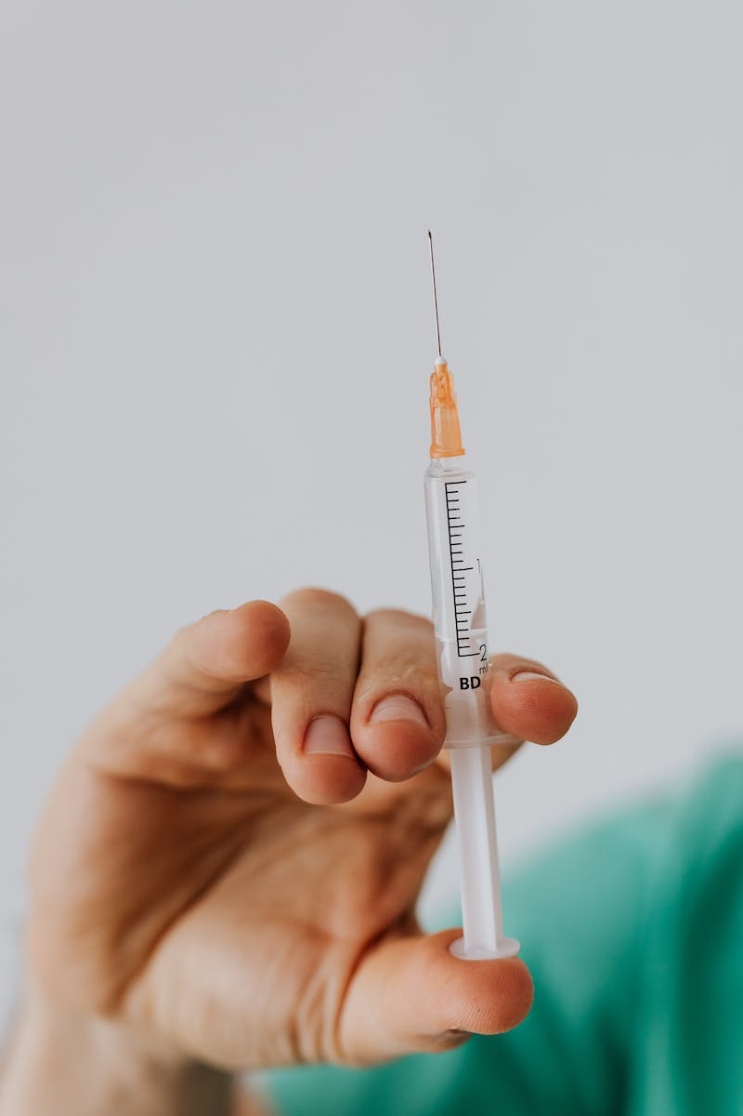
Conclusion
• Understanding the different classes of drugs used for diabetes is crucial for effective management.
• Each class has its unique mechanisms of action and potential side effects.
• Individualized treatment plans should be based on patient characteristics and needs.
• Regular monitoring and consultation with healthcare providers are important for optimal diabetes care.
Photo by Pexels

