Slide 1
Exploring the World of Poultry Farming
A journey into the production and breeding of poultry animals

Slide 2
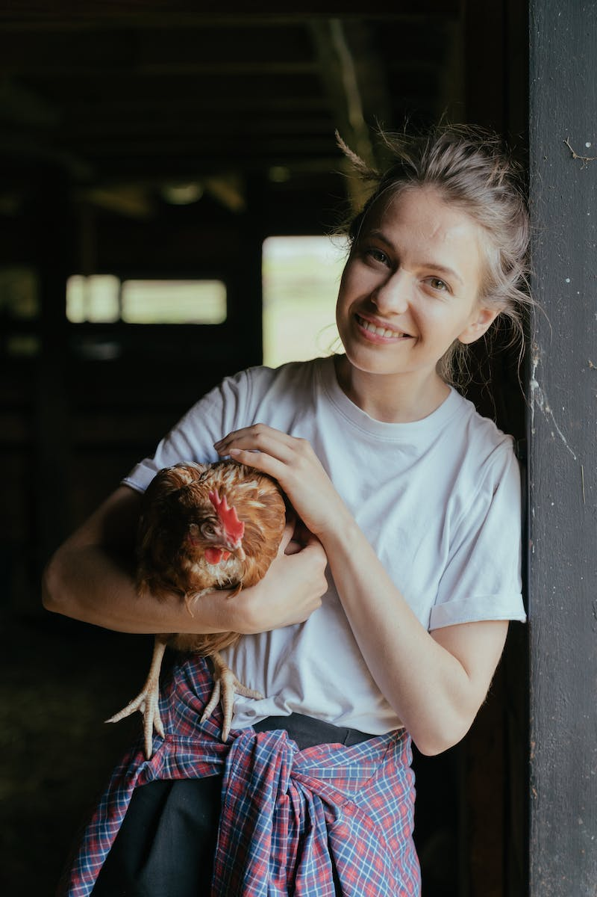
Welcome to Magnet Pains
• Introduction to poultry farming
• Overview of animal husbandry practices
• Importance of poultry farming for chicken meat production
Photo by Pexels

Slide 3
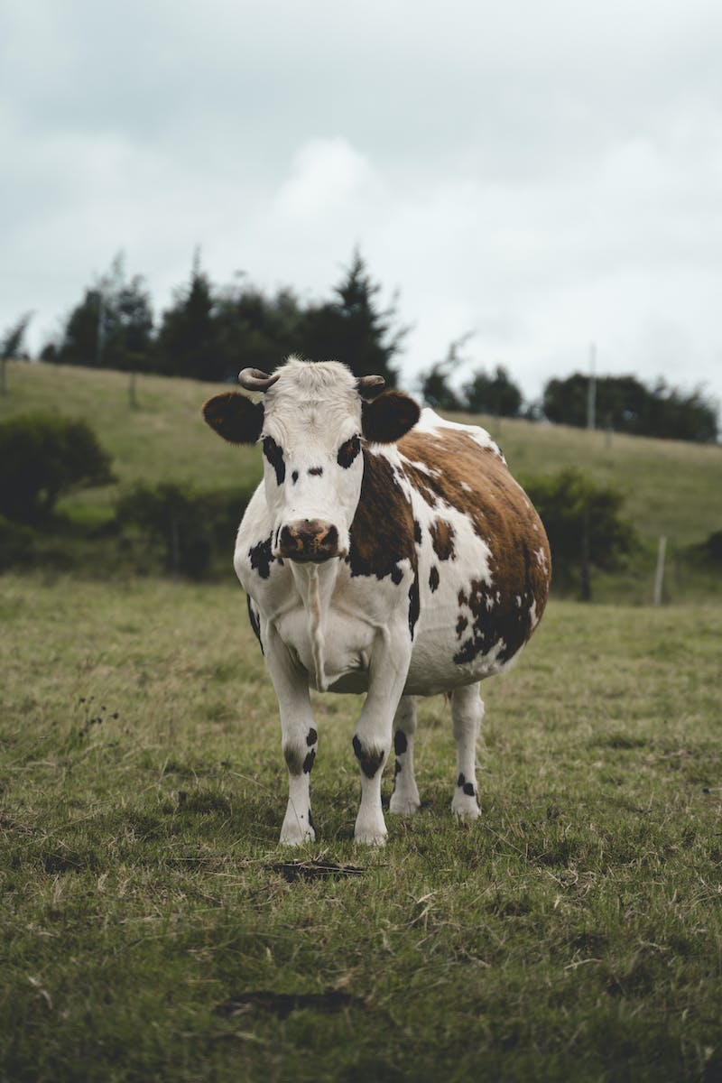
Cattle Farming for Milk Purposes
• Categorization of cattle based on their purpose
• Milk animals
• Broad animals
Photo by Pexels

Slide 4
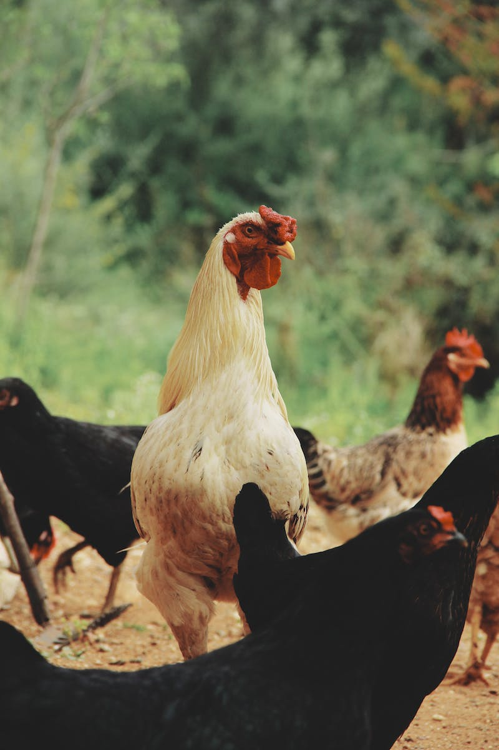
Diversity in Poultry Animals
• Categorization of poultry animals
• Poultry eggs
• Chicken meat production
Photo by Pexels

Slide 5
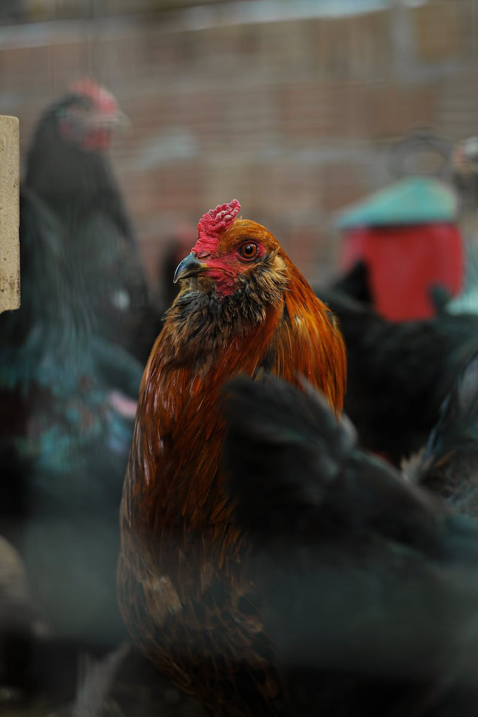
Breeding for Desired Qualities
• Importance of breeding in poultry farming
• Desired qualities in poultry animals
• Production temperature resistance
Photo by Pexels

Slide 6
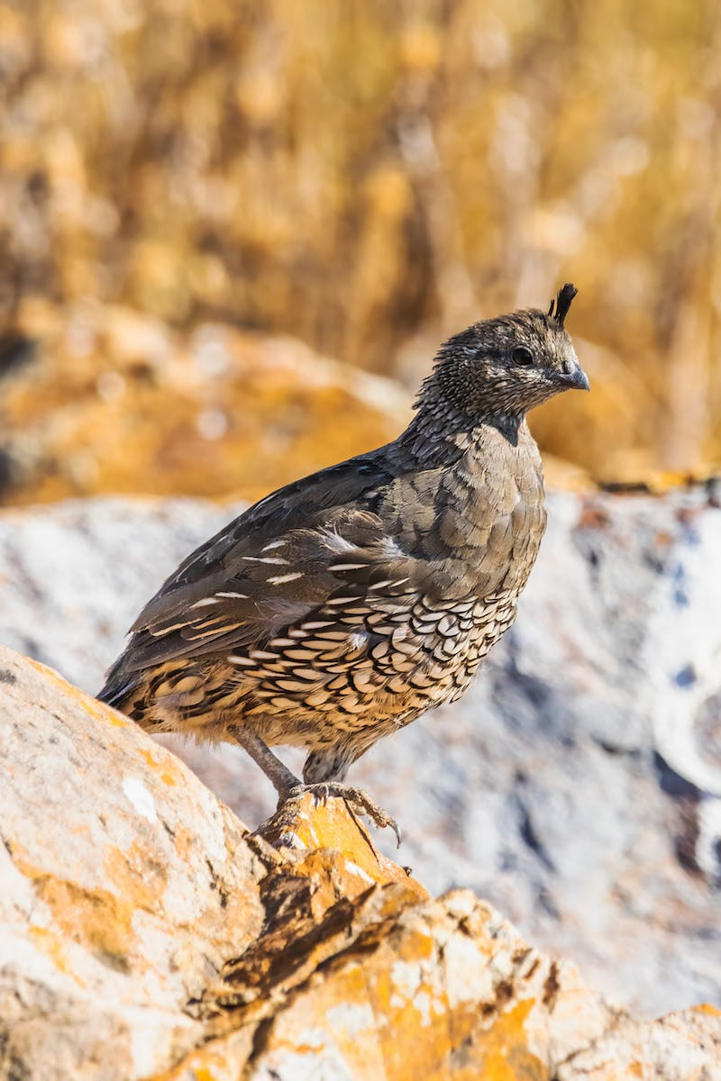
Improvement through Cross-Programs
• Cross-breeding indigenous and foreign poultry animals
• Variety improvement for desirable traits
Photo by Pexels

Slide 7
Plant Breeding for Increased Production
• Importance of plant breeding in poultry farming
• Desirable qualities in plants for feed production
• Integration with egg production
Photo by Pexels

Slide 8
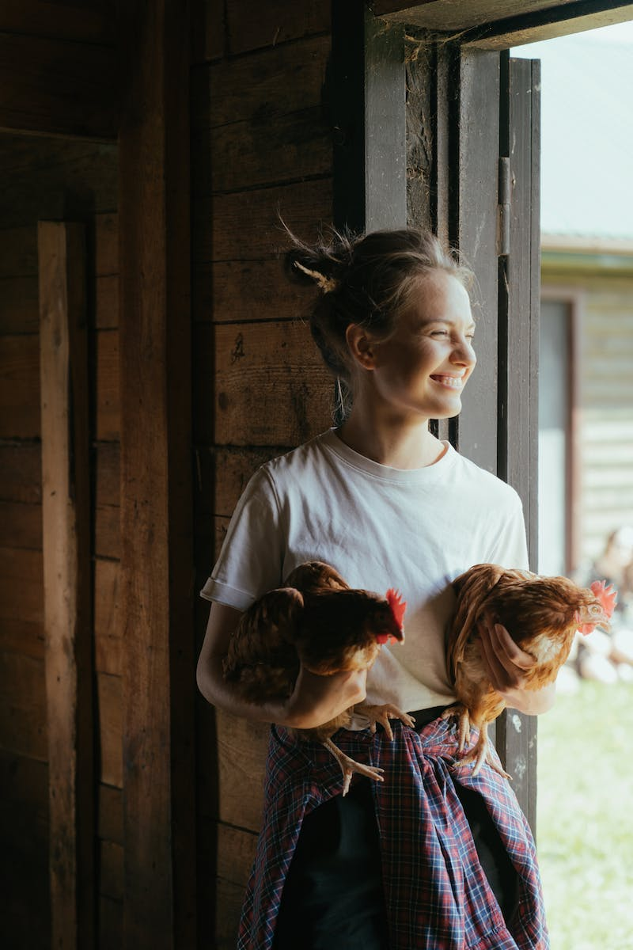
Key Steps in Poultry Farming
• Feeding and disease control
• Complete course and skill manual
• Transportation and resources
Photo by Pexels

Slide 9
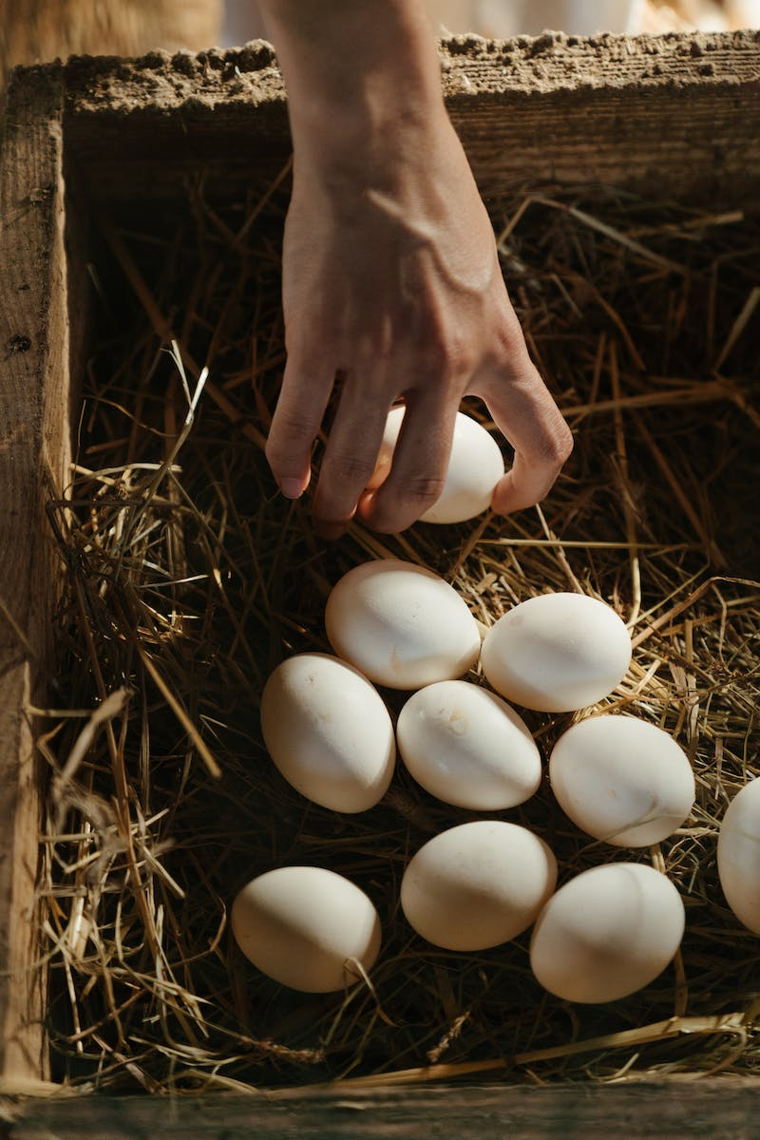
Conclusion
• Summary of key points
• Availability of additional resources
Photo by Pexels

