Slide 1
The Hidden Gem of Kur'yanovo
Exploring the Unique Architecture and Charm of a Moscow District

Slide 2
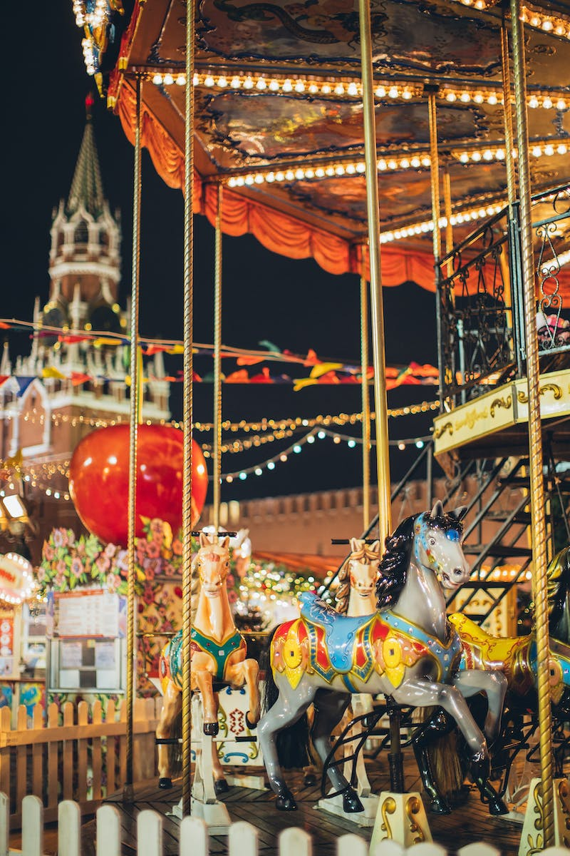
Introduction
• Kur'yanovo: a hidden gem in southeast Moscow
• Post-World War II era of low-rise buildings and attention to detail
• A comfortable and attractive environment for residents
• The often overlooked Kur'yanovo district in the southeast
• Located just 20 minutes by bus from Pechatniki metro station
• Escape the bustling city and explore this tranquil enclave
Photo by Pexels

Slide 3
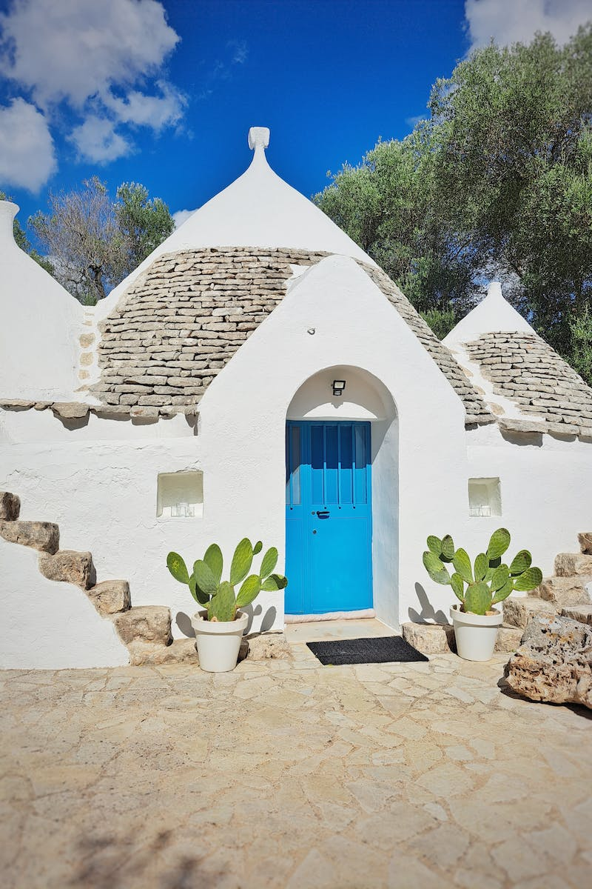
History of Kur'yanovo
• Established in the early Soviet era as an agricultural village
• Moved residents to Shcherbinsky experimental railway circle
• Renamed to Novokur'yanovo and administratively part of Yuzhnoye Butovo district
• Development of the district with the construction of the aerations station
• Utilized prisoners from the Kur'yanovo labor camp
• Skilled workforce and attention to design and comfort
Photo by Pexels

Slide 4
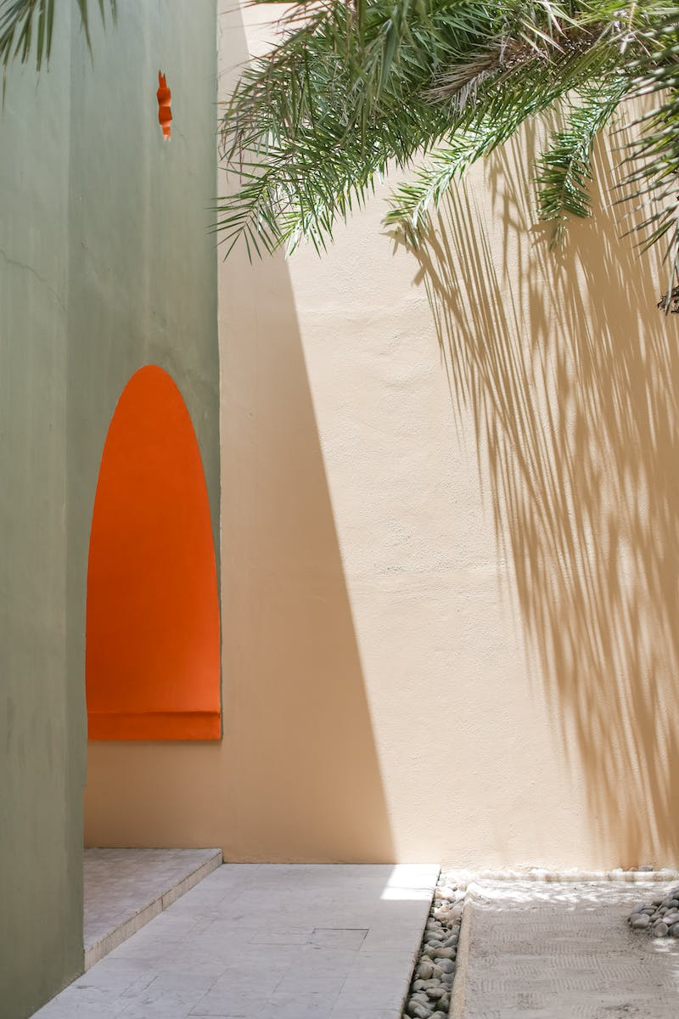
Architectural Features
• High-quality and distinctive architecture
• Two-story and later six to eight-story Stalinist buildings
• Impeccable decor and attention to detail
• Abundance of trees and greenery
• Comfortable and aesthetic living environment
• Notable district for its well-planned and designed buildings
Photo by Pexels

Slide 5
Infrastructure and Amenities
• Well-planned infrastructure to support the community
• Multiple shops, pharmacy, kindergarten, school, hospital
• Creation of a vibrant and functional community
• Referred to as a personal garden where dreams come true
• Access to basic amenities without leaving the district
Photo by Pexels

Slide 6
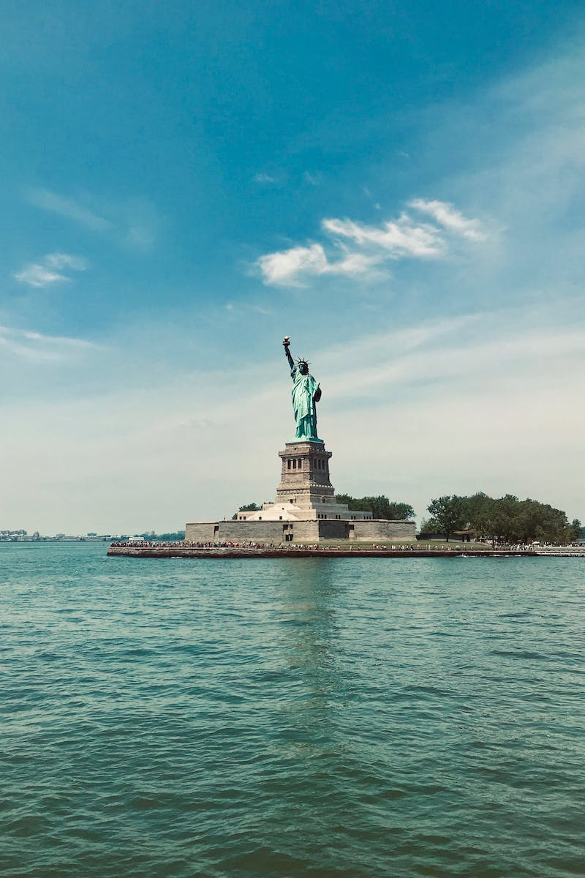
Cultural and Historical Significance
• Cultural center and heart of the district: DK aeration
• Architectural resemblance to the All-Union Agricultural Exhibition
• Preserved historical elements like the Soviet emblem from 1951
• Venue for rock concerts and festivals in the 1980s
• Favorite filming location for Russian movies and series
• Unique and recognizable district beyond Moscow borders
Photo by Pexels

Slide 7
Nature and Green Spaces
• Abundance of trees, fruit trees, and blossoms
• Thoughtful planning of streets and pathways
• Small lanes reduce traffic and enhance pedestrian experience
• Maintaining a green and lush environment
• A harmonious blend of architecture and nature
• A serene oasis away from the bustling city
Photo by Pexels

Slide 8
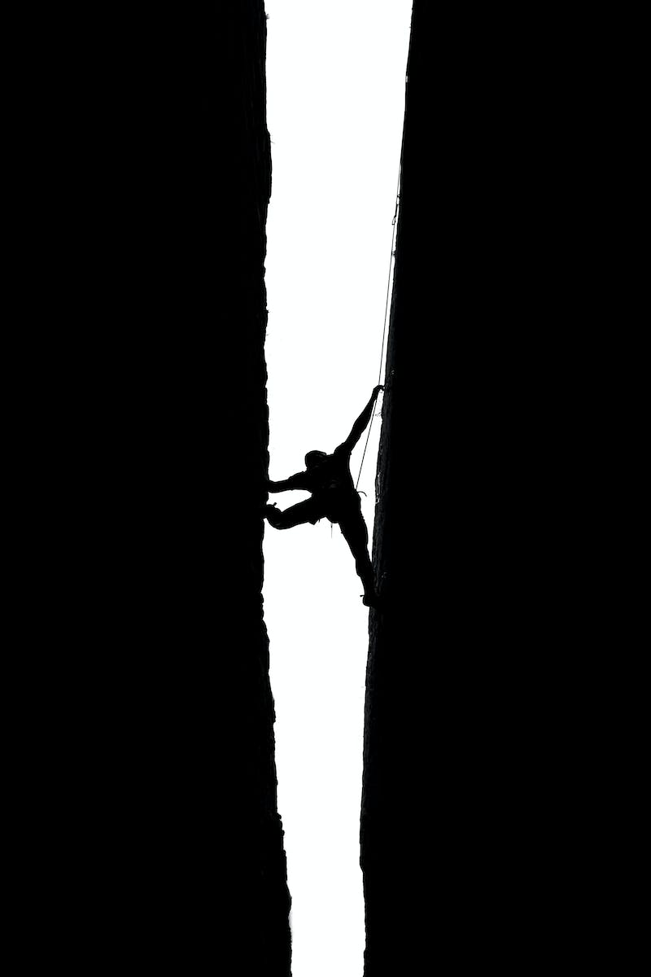
Challenges and Future Developments
• Arrival of large chain supermarkets
• Loss of original architectural elements and character
• Limited storage space in Soviet housing
• Thoughtful design of separate storage sheds
• Preservation of unique elements like street lamps
• Strive to maintain the charm and uniqueness of Kur'yanovo
Photo by Pexels

Slide 9
Conclusion
• Kur'yanovo: a hidden gem in Moscow
• Unique architectural charm and attention to detail
• Tranquil and vibrant district with diverse amenities
• Cultural and historical significance in film and history
• A green oasis within the city
• Preserving the character and beauty of Kur'yanovo
Photo by Pexels

