Slide 1
The Secret to Accumulating Wealth
Learn how to grow your fortune and create financial security

Slide 2
Introduction
• Meet Arkad, a young man working as a scribe
• Desire to understand wealth accumulation
• Determined to uncover the secret
• Struggles to make ends meet
Photo by Pexels

Slide 3
An Unexpected Opportunity
• Arkad receives a time-limited manuscript request from a wealthy moneylender named Algimish
• Agrees to complete the task in exchange for knowledge on wealth accumulation
• Works tirelessly through the night to finish the manuscript
Photo by Pexels

Slide 4
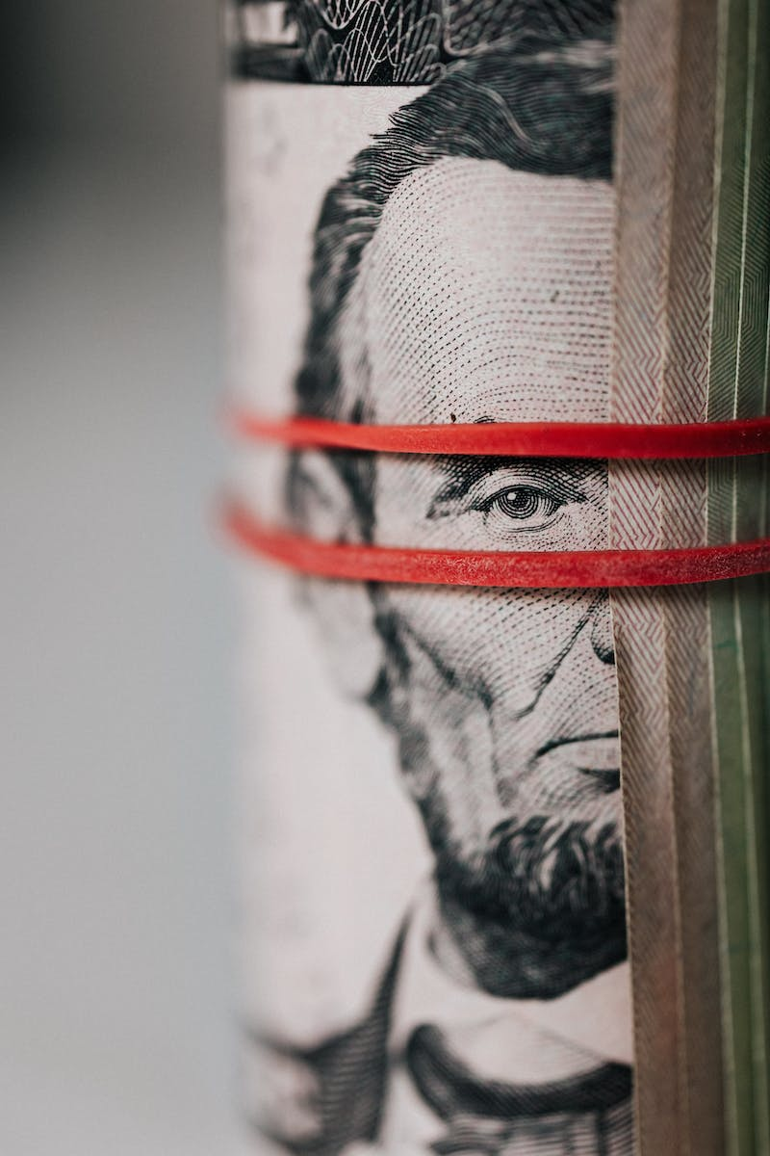
The Secret of Wealth
• Algimish reveals his secret to wealth: saving a portion of earnings
• Explains that everything Arkad earns should not be spent but saved
• Encourages Arkad to pay himself first with at least 10% of earnings
• Compares saved money to employees working for Arkad
Photo by Pexels

Slide 5
The Tree of Wealth
• Wealth is compared to a tree growing from the first saved coin
• Emphasize the importance of planting the seed of savings
• Advise Arkad to nurture and protect his savings to grow his wealth
Photo by Pexels

Slide 6
Conclusion
• Summarize the key points of the presentation
• Empower the audience to change their mindset towards savings
• Encourage regular savings and wise financial management
Photo by Pexels

