Slide 1
Separating Salt and Water: A Lesson for Science Minded Learners
Understanding the Process and Application of Separation Techniques

Slide 2
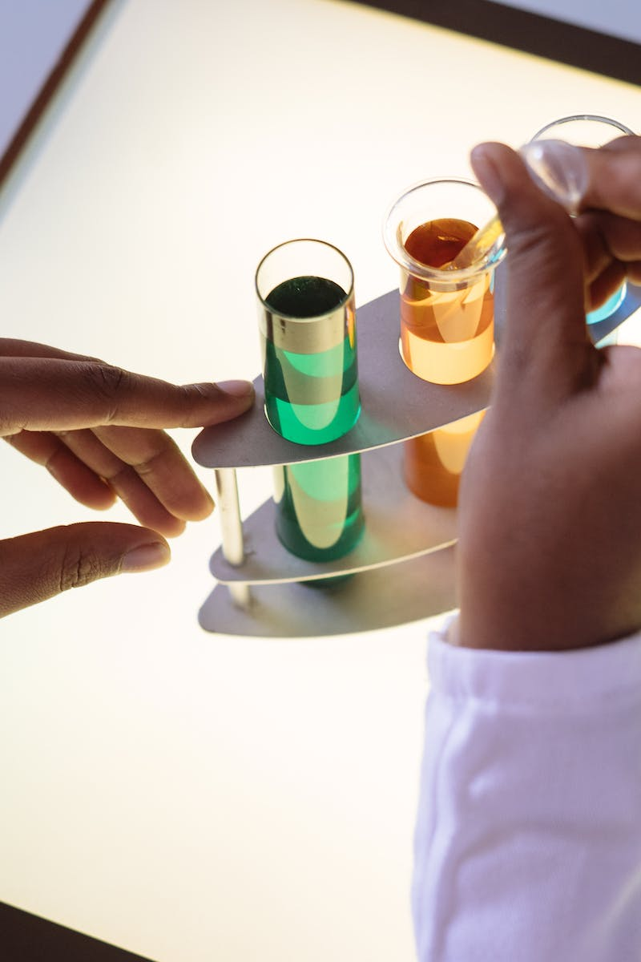
Introduction
• Welcome, Science Minded Learners!
• Are you ready to learn something new today?
• Let's explore the process of separating salt and water!
• Understanding this process will expand your knowledge and application of science.
Photo by Pexels

Slide 3
The Salty Taste of Seawater
• Have you ever been to the beach and tasted the seawater while swimming?
• It tastes salty, right?
• That's because seawater is a solution of salt and water.
• But how can we separate these components?
Photo by Pexels

Slide 4
Collecting Salt from Seawater
• In the picture, you can see two men collecting salt.
• But where did they get it from?
• The two men collected seawater and placed it in an open space under extreme heat and blowers.
• This process results in the separation of salt from water.
Photo by Pexels

Slide 5
Separation Techniques
• When separating salt and water, we have a few options:
• a) Evaporation
• b) Filtration
• c) Distillation
• d) Magnets
• Each technique serves a different purpose and is used in specific situations.
Photo by Pexels

Slide 6
Assignment: Identifying Treatment
• For your assignment, science-minded learners, read the sentence carefully.
• Identify which treatment should be used based on the given conditions.
• Apply your knowledge of separation techniques to solve the problem.
• Remember to think critically and analyze the situation.
Photo by Pexels

Slide 7
Conclusion
• Great job, Science Minded Learners!
• You have learned about the process of separating salt and water.
• Continue to apply your knowledge in various scientific experiments and real-life situations.
• Thank you for your attention!
• See you again next time.
Photo by Pexels

