Slide 1
The Impact of Designers on Car Popularity
Exploring the Role of Designers in the Automotive Industry

Slide 2
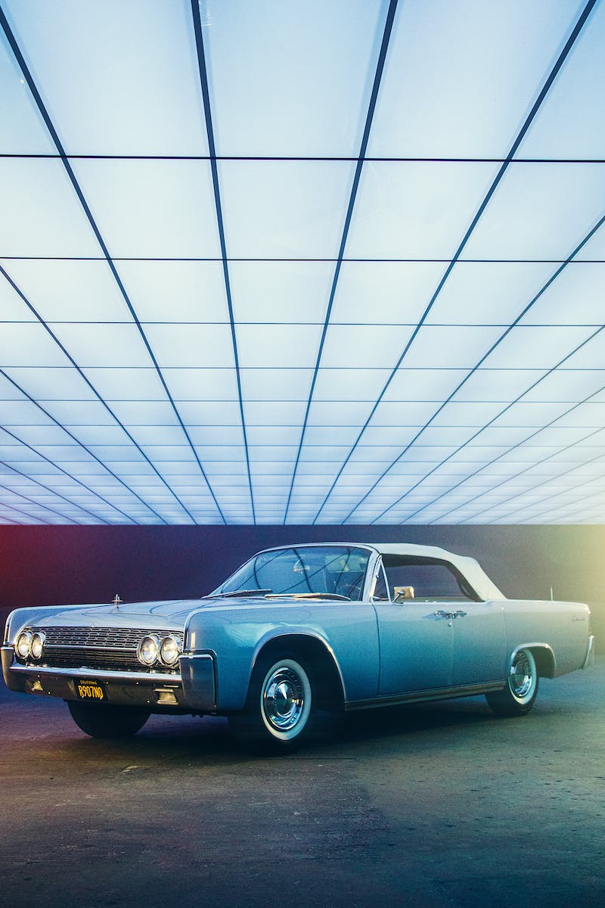
Introduction
• Designer as a crucial factor in car population
• Net sort of just cut out share of the market
• Exploring the influence of designers in car design
• Understanding their impact on car popularity
Photo by Pexels

Slide 3
Chrysler Building: A Design Icon
• Highlighting the iconic status of the Chrysler Building
• Barely standing - a testament to its timeless design
• Draw parallels between architecture and car design
• Emphasizing the significance of good design
Photo by Pexels

Slide 4
The Influence of Design on Car Popularity
• Analyzing the relationship between car design and popularity
• Explore how aesthetics impact consumer preferences
• Case studies of successful car designs
• The importance of differentiating through design
Photo by Pexels

Slide 5
The Role of Designers in Shaping Car Design
• Exploring the role of designers in the automotive industry
• Their impact on shaping car aesthetics
• How designers balance creativity and practicality
• Understanding the collaboration between designers and engineers
Photo by Pexels

