Slide 1
The Discovery of Penicillin: Revolutionizing Medicine
Alexander Fleming's Accidental Breakthrough

Slide 2
Introduction
• On 28 September 1928, Alexander Fleming made a groundbreaking discovery
• Accidentally found the world's first antibiotic, penicillin
• Laid the foundation for a revolution in modern medicine
• Accidental discovery while returning from a family holiday

Slide 3
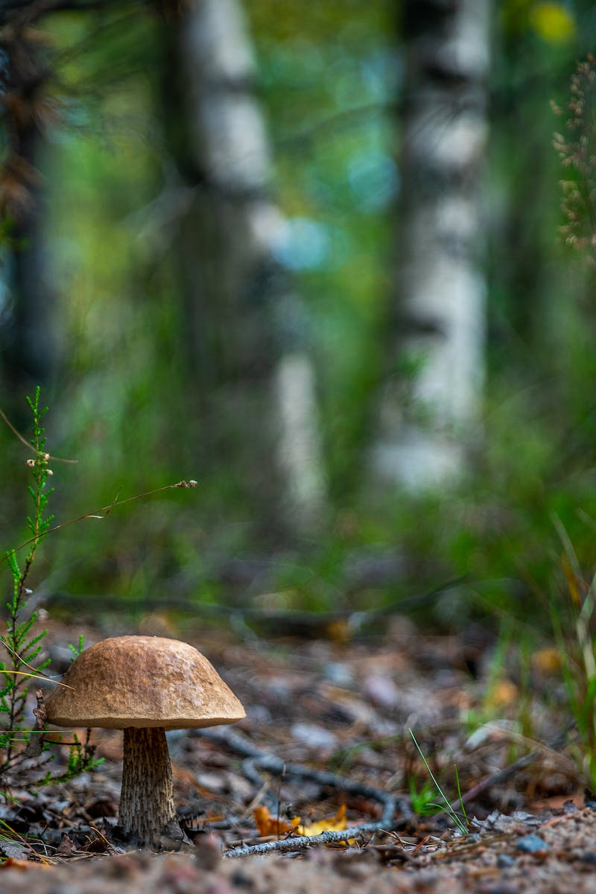
Contaminated Petri Dish
• Fleming discovered a petri dish contaminated with an unidentified fungus
• Bacteria around the fungus were destroyed while others survived
• Curiosity sparked further investigation
• Identified the fungus as penicillium
Photo by Pexels

Slide 4
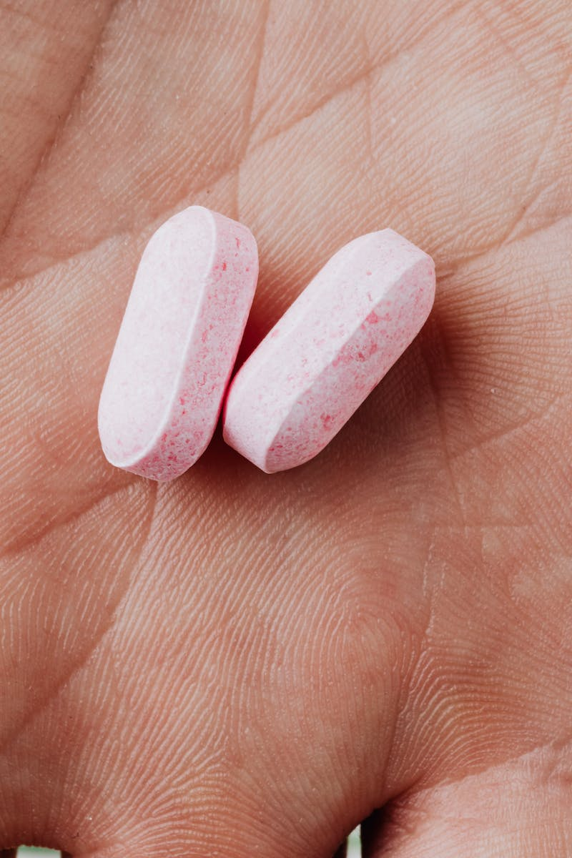
Antibiotic Properties Discovered
• Laboratory tests confirmed the ability of penicillin to destroy disease-causing bacteria
• Potential for medical use and treatment
• Unable to cultivate the fungus or isolate the active ingredient
• Dependence on subsequent scientists for further development
Photo by Pexels

Slide 5
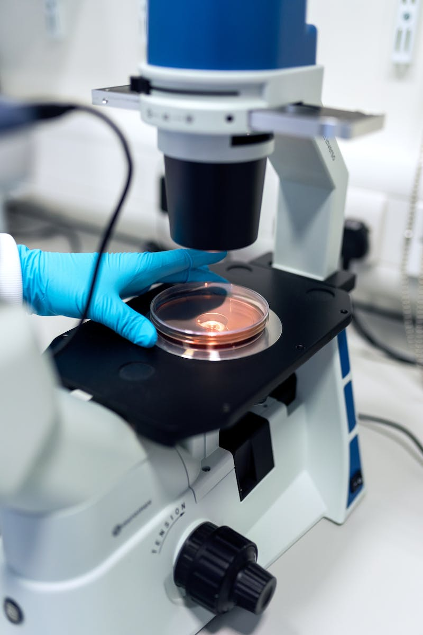
Limited Recognition
• Fleming originally referred to the discovery as 'mould juice'
• Received little attention or enthusiasm from the medical establishment
• Change in the 1940s with research by Howard Florey and Ernst Boris Chain
• Profile of penicillin increased, leading to mass-production for Allied casualties in World War II
Photo by Pexels

Slide 6
Fleming's Humility
• Fleming downplayed his contribution to penicillin's development
• Referred to the 'Fleming myth' surrounding the drug
• Acknowledged the work of subsequent scientists
• Earned the right to name the active substance due to his identification of its antibiotic properties
Photo by Pexels

