Slide 1
The Power of Artificial Intelligence
Unlocking the Potential of AI

Slide 2
Introduction to Artificial Intelligence
• AI is a branch of computer science that aims to create intelligent machines.
• Machine learning and deep learning are subsets of AI.
• AI has applications in various fields like healthcare, finance, and transportation.
• AI has the potential to revolutionize industries and improve our daily lives.
Photo by Pexels

Slide 3
Advancements in Machine Learning
• Machine learning enables computers to learn and make decisions without being explicitly programmed.
• Supervised learning, unsupervised learning, and reinforcement learning are common machine learning techniques.
• Advancements in machine learning algorithms have led to breakthroughs in natural language processing, computer vision, and predictive analytics.
• Companies like Google and Facebook heavily utilize machine learning in their products and services.
Photo by Pexels

Slide 4
Deep Learning and Neural Networks
• Deep learning is a subset of machine learning that focuses on neural networks.
• Neural networks mimic the structure and function of the human brain.
• Deep learning has achieved remarkable results in image and speech recognition.
• Techniques like convolutional neural networks and recurrent neural networks have revolutionized deep learning.
Photo by Pexels

Slide 5
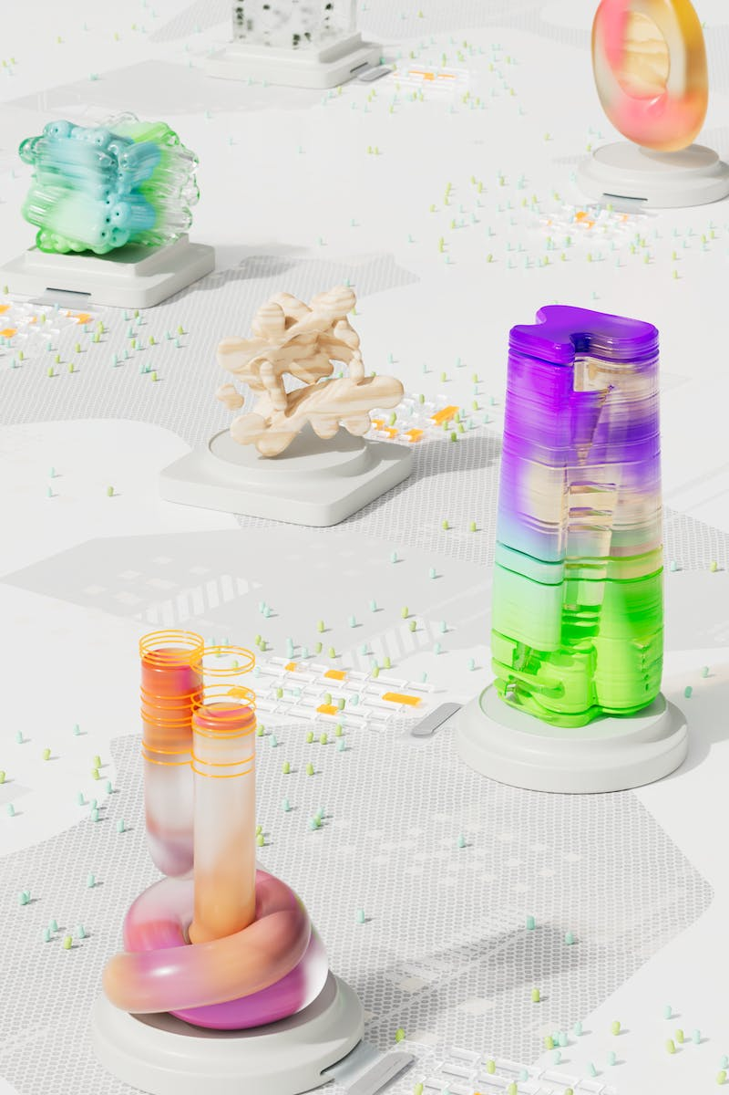
Ethical and Social Implications of AI
• AI raises ethical concerns regarding privacy, job displacement, and bias.
• Algorithms can perpetuate discrimination and reinforce existing biases.
• Transparency and accountability are crucial in AI development and deployment.
• Regulation and ethical frameworks need to be established to mitigate potential risks.
Photo by Pexels

Slide 6
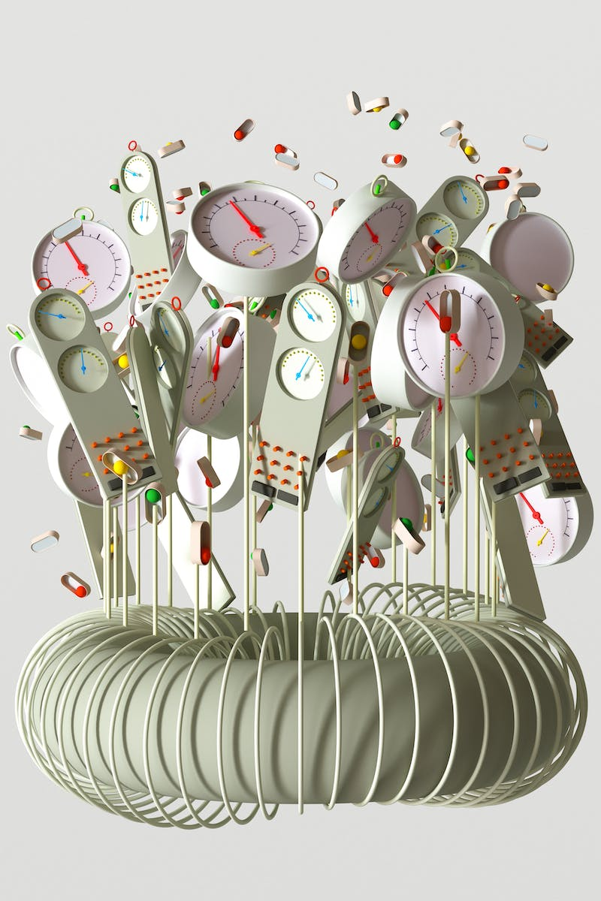
Future Trends in AI
• AI is expected to continue advancing rapidly in the near future.
• Increased automation and integration of AI into everyday life are expected.
• AI-driven technologies like autonomous vehicles and virtual assistants have immense potential.
• The need for human-machine collaboration and responsible AI development will rise.
Photo by Pexels

