Slide 1
The Challenges of Driving on Short Streets
An Exploration of the Problems Faced by Drivers

Slide 2
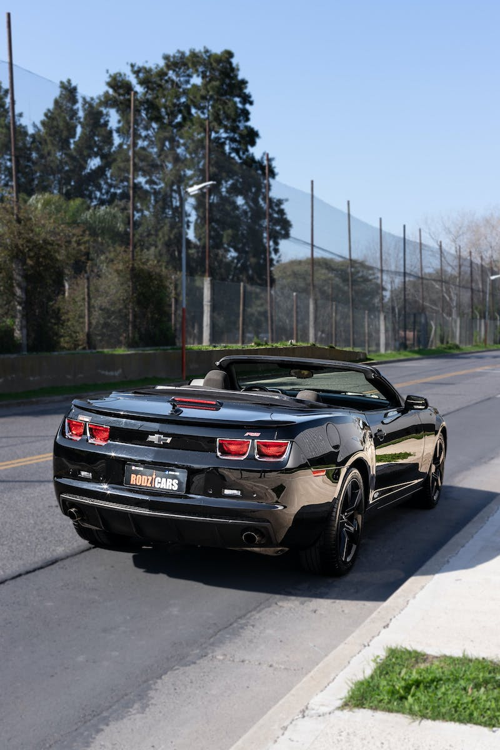
Introduction
• Short streets present unique challenges for drivers
• Limited space for maneuvering
• Increased risk of accidents
• Difficulty finding parking
Photo by Pexels

Slide 3
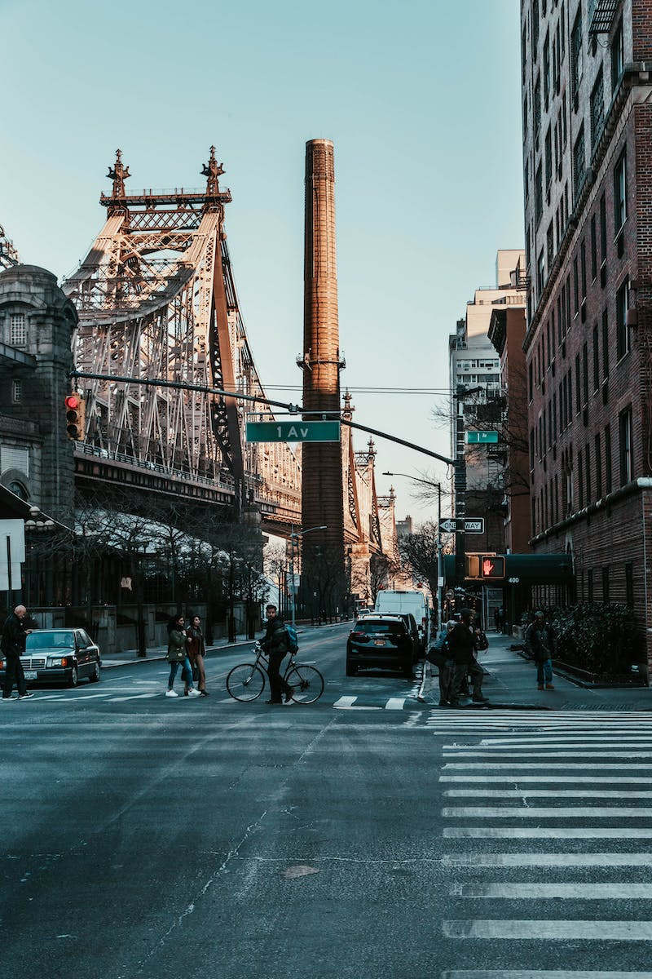
Traffic Congestion
• Short streets often have heavy traffic congestion
• Limited capacity for vehicles
• Frequent traffic jams
• Increased travel time
Photo by Pexels

Slide 4
Parking Difficulties
• Finding parking on short streets can be a challenge
• Limited parking spaces available
• High demand from residents and businesses
• Potential for parking violations
Photo by Pexels

Slide 5
Safety Concerns
• Limited visibility on short streets
• Increased risk of accidents
• Difficulty for pedestrians to cross
• Cyclist and pedestrian conflicts
Photo by Pexels

Slide 6
Conclusion
• Short streets pose numerous challenges for drivers
• Awareness and caution essential for navigating safely
• Urban planning can play a role in addressing these challenges
• Considerations for future road designs
Photo by Pexels

