Slide 1
Unlocking Flavor: Mastering Fusel Alcohols
A Deep Dive into Formation, Control, and Impact on Alcoholic Beverages

Slide 2
Table of Contents
1
Fusel Alcohols: Unsung Flavor Heroes
2
Fusel Alcohols: Flavor's Edge
3
Ehrlich Pathway: Amino Acid Alchemy
4
Pyruvate's Path: Beyond Lactate
5
Fusel Alcohols: Amino Acid Origins
6
Fusel Alcohol Formation

Slide 3
Table of Contents
7
Distillation Defined: Refining Spirits
8
Fusel Fortress: Fermentation Control
9
Balancing Act: Flavor vs. Industrial Efficiency
10
Fusel Flavor Frontiers

Slide 4
Fusel Alcohols: Unsung Flavor Heroes
1
What are Fusels?
2
Formation Factors
They are higher alcohols formed during fermentation, impacting aroma and taste significantly beyond ethanol.
Yeast strain, temperature, and nutrient availability heavily influence the production of these complex alcohols.
3
Sensory Impact
4
Balance is Key
They contribute diverse flavors, from fruity and floral to solvent-like, influencing overall beverage quality.
Optimal concentrations enhance complexity, but excess can lead to harshness and unpleasant aftertastes; moderation matters.

Slide 5
Fusel Alcohols: Flavor's Edge
Contribute to complex flavor profiles, adding depth and character to alcoholic beverages like beer, wine, and spirits.
Provide desirable aromas, ranging from fruity and floral to spicy and malty, enhancing the sensory experience.
Can enhance the overall mouthfeel and body of the beverage, contributing to a richer and more satisfying experience.
High concentrations can lead to harsh, solvent-like flavors, negatively impacting the drink's overall palatability and enjoyment.
Excessive fusel alcohol levels are associated with unpleasant aftereffects, contributing to hangovers and headaches after consumption.
Uncontrolled fermentation and distillation processes can result in the overproduction of these compounds, leading to quality issues.

Slide 6
Ehrlich Pathway: Amino Acid Alchemy
The Ehrlich Pathway transforms amino acids into flavorful higher alcohols in yeast. A key process for flavor.
First step: transamination. Amino acids transfer their amino group to a keto acid to begin transformation.
Next is decarboxylation. Carbon dioxide is removed, altering the molecule's structure and characteristics significantly.
The final step: reduction. This process produces the desired higher alcohols, adding distinct flavors.

Slide 7
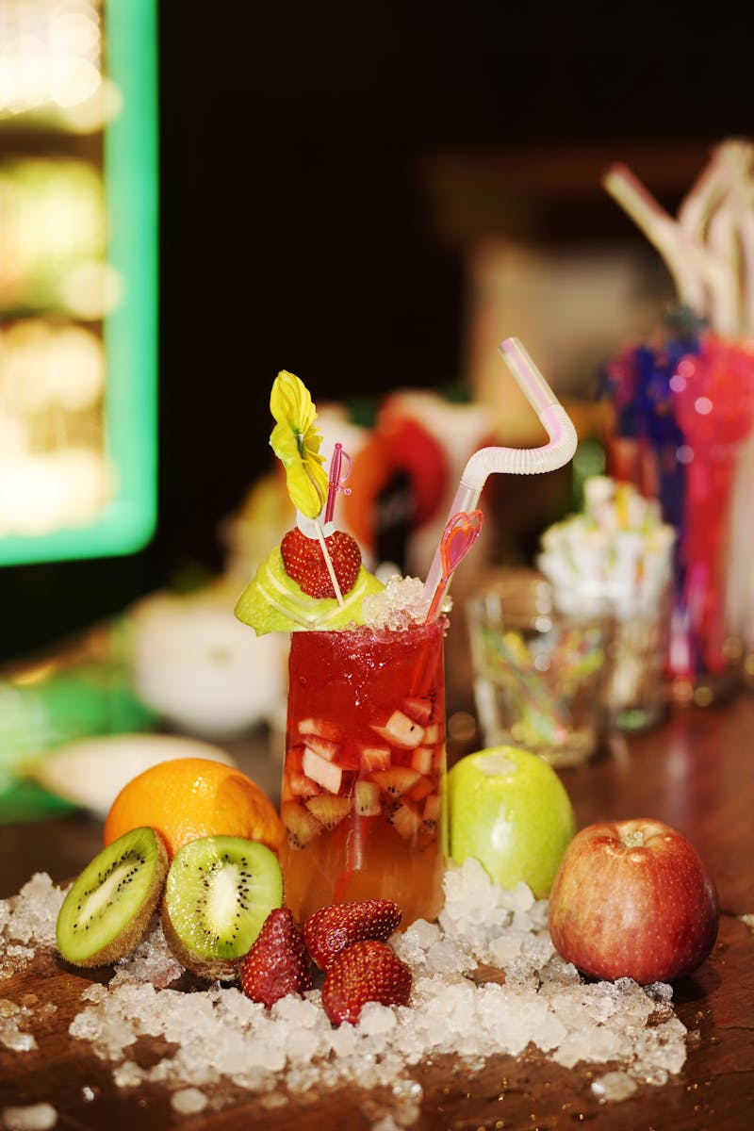
Pyruvate's Path: Beyond Lactate
Pyruvate, a key metabolic intermediate, faces multiple fates depending on cellular conditions and enzymatic machinery available.
The Ehrlich pathway utilizes pyruvate-derived keto acids, transforming them into fusel alcohols, particularly under nutrient limitation.
Nitrogen limitation increases fusel alcohol production as cells scavenge carbon from amino acids, ultimately derived from pyruvate.
Fusel alcohols contribute to the complex flavors of fermented beverages, influencing aroma, mouthfeel, and overall quality attributes.
Photo by Google

Slide 8
Fusel Alcohols: Amino Acid Origins
Derived from Leucine, Isoamyl Alcohol contributes banana-like aroma notes and is a key higher alcohol in fermentation processes.
Valine is the amino acid precursor to Isobutanol, impacting spirit's malt and solvent-like flavors, and contributes to complexity.
Phenylethanol originates from Phenylalanine, imparting floral, rose-like aromas and delicate sweetness to the distilled beverage.
Formed from Threonine and Pyruvate, Propanol contributes sharp and sometimes harsh characteristics to the overall spirit profile.

Slide 9
Fusel Alcohol Formation
Fermentation is the origin point; it's where fusel alcohols are initially synthesized by yeast activity.
Temperature is key. Elevated temperatures generally favor increased production of fusel alcohols during fermentation.
Yeast strain significantly impacts fusel alcohol profiles. Certain strains are inherently higher producers.
The Carbon/Nitrogen ratio is crucial. Imbalances can stress yeast, leading to increased fusel alcohol creation.

Slide 10
Distillation Defined: Refining Spirits
Distillation separates liquids by exploiting differences in their boiling points – a fundamental separation technique.
It's about separating the desirable components from undesirable ones, enhancing the purity of the final product.
Harnessing boiling points is key; different compounds vaporize at distinct temperatures for effective separation.
Fractional distillation allows precise isolation, particularly important for managing fusel alcohol concentrations.

Slide 11
Fusel Fortress: Fermentation Control
1
Temperature Taming
2
Nitrogen Needs
Strategic temperature management during fermentation is key to limiting undesirable fusel alcohol production. Steady controls are crucial.
Optimizing nitrogen levels ensures healthy yeast metabolism, preventing stress and thus reducing fusel alcohol formation overall.
3
Yeast Vanguard
4
Monitoring Mastery
Careful yeast selection plays a pivotal role. Choosing strains that minimize fusel alcohol production is paramount.
Regular monitoring of fermentation progress allows for timely adjustments, preventing fusel alcohol spikes before they even happen.

Slide 12
Balancing Act: Flavor vs. Industrial Efficiency
Enhanced flavor profiles can lead to premium product differentiation and higher market value, appealing to discerning consumers.
Careful fusel alcohol management unlocks unique aromatic compounds, adding complexity and depth to the beverage's character.
Strategic control can highlight desirable flavor notes, creating a signature taste that sets the product apart from competitors.
Overly aggressive fusel alcohol reduction can strip away essential flavor components, resulting in a bland or characterless product.
Focusing solely on fusel control might inadvertently impact other crucial fermentation byproducts, negatively affecting overall quality.
Implementing strict controls can increase production costs due to specialized equipment, monitoring, and process adjustments.

Slide 13
Fusel Flavor Frontiers
2015
2018
2021
2024
Early Enzyme Insights
Yeast Engineering Emerges
Process Control Refined
AI-Driven Optimization
Initial research focused on understanding the enzymatic pathways involved in fusel alcohol production. Scientists began exploring the role of specific enzymes in yeast metabolism and their influence on the final...
The first successful attempts at engineering yeast strains with modified fusel alcohol production were documented. Researchers demonstrated the potential to selectively reduce or enhance the formation of specific fusel alcohols,...
Advanced process control strategies, including real-time monitoring and feedback loops, were implemented to optimize fermentation conditions. These strategies enabled precise control over temperature, pH, and nutrient availability, further enhancing the...
Artificial intelligence and machine learning algorithms are now being applied to predict and optimize fusel alcohol profiles in real-time. These advanced tools allow for dynamic adjustments to fermentation parameters, resulting...

