Slide 1
The Hidden World of Aviation Technicians
Uncovering the Secrets of Aircraft Maintenance

Slide 2
Introduction: Aviation Technicians
• Aviation technicians are the unsung heroes of the aviation industry
• They are responsible for fixing passenger-related issues
• The 'Swiss Cheese' theory explains the importance of their role
• Aviation is like a huge zoo, with various specialties
Photo by Pexels

Slide 3
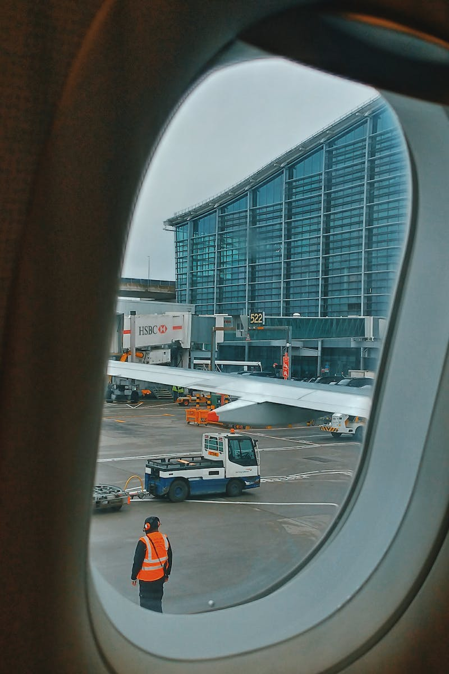
Meet Artem, An Aviation Technician
• Artem comes from a family with a strong aviation background
• He prepares aircraft for takeoff, conducting inspections and maintenance
• His responsibilities include visual inspections, refueling, and data updates
• Sometimes he faces challenging workloads and frustration
Photo by Pexels

Slide 4
Specialization in Avionic Systems
• Some technicians specialize in avionic systems
• This involves electrical components and navigation equipment
• They handle generators, autopilots, and communication systems
• Their work ensures the safety and functionality of the aircraft
Photo by Pexels

Slide 5
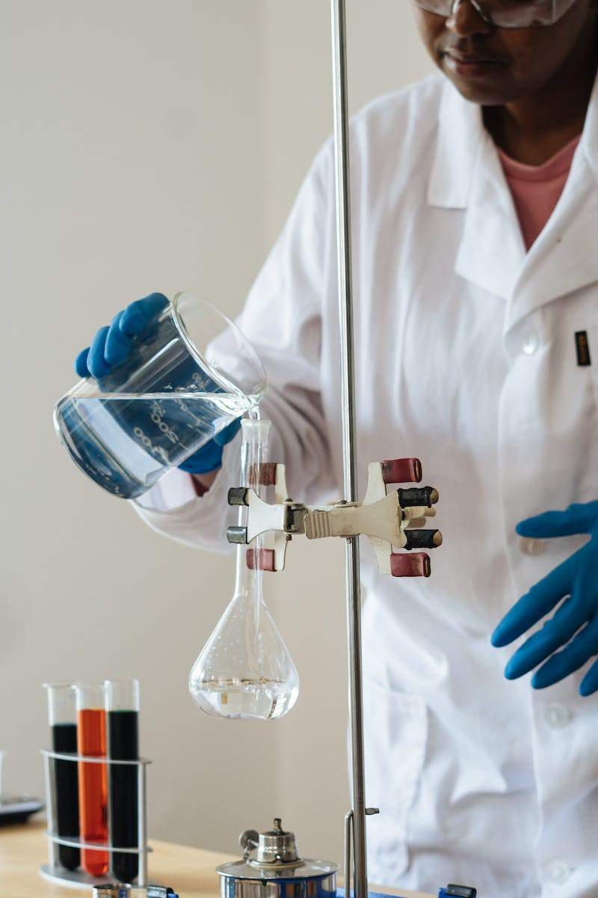
A Day in the Life of an Aviation Technician
• The day starts with a standard routine and briefings
• Technicians receive work assignments and proceed to the aircraft
• They may work on multiple planes within a 12-hour shift
• Challenges include repairing damaged passenger amenities
Photo by Pexels

Slide 6
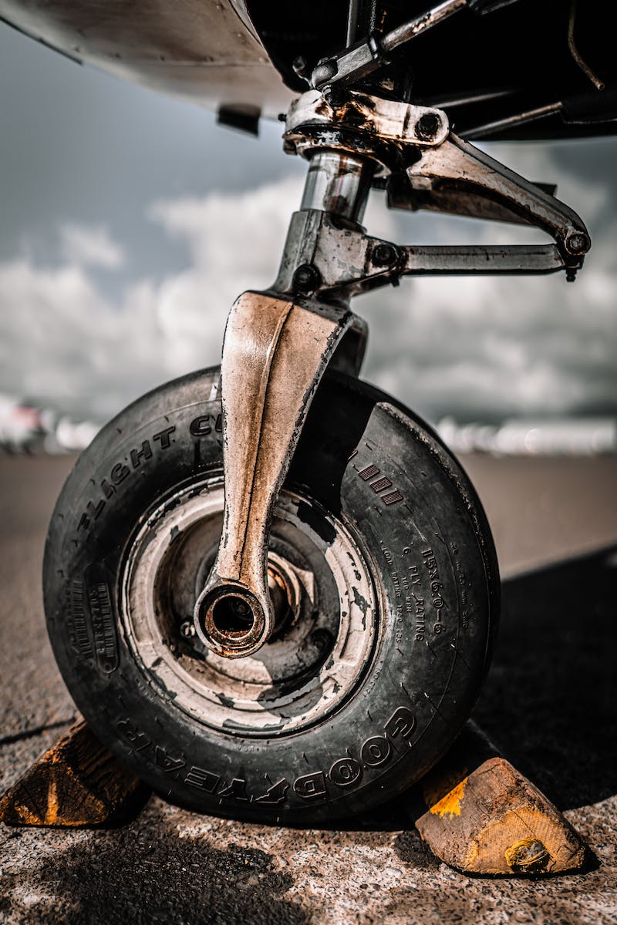
Safety and Maintenance
• Technicians follow strict safety guidelines and protocols
• They have specific timeframes for maintenance tasks
• However, additional issues and passenger feedback can extend the timeline
• Minimizing defects that do not affect flight safety is important
Photo by Pexels

Slide 7
The Swiss Cheese Theory and Preventing Disasters
• The Swiss Cheese Theory explains the causes of aviation disasters
• Each 'hole' or flaw in the system can lead to catastrophic outcomes
• Aviation technicians play a crucial role in preventing accidents
• Systems are designed to minimize failures and ensure safety
Photo by Pexels

Slide 8
Aviation Technician Slang
• Aviation technicians have their own unique slang
• Aircraft fuselage and engine specialists are humorously called 'elephants'
• Electrical system specialists are referred to as 'monkeys'
• Interior specialists are playfully called 'pigs'
Photo by Pexels

Slide 9
Becoming an Aviation Technician
• Becoming an aviation technician involves specialized training
• Training includes exams, internships, and official certifications
• Technicians specialize in specific aircraft types
• Balancing work on different aircraft types requires additional training
Photo by Pexels

Slide 10
Conclusion: A Rewarding Career
• Working as an aviation technician offers long-term career prospects
• Technicians are essential for safe and efficient aircraft operations
• The job requires resilience and adaptability to challenging conditions
• Aviation technicians play a crucial role behind the scenes
Photo by Pexels

