Slide 1
10 Styles to Transform Your Images with Mid-Journey
Discover amazing effects using different styles

Slide 2
Nature Punk
• Add cool nature elements to images
• Create unique effects with vines and sticks
• Examples: woman's face, Michael Jackson, Darth Vader, Pikachu
• Image Search: naturepunk
• Source URL:

Slide 3
Stained Glass Portrait
• Create a stained glass effect on portraits
• Simulate the look of a window made of stained glass
• Examples: woman's face, Darth Vader, waterfall in nature
• Image Search: stainedglassportrait
• Source URL:

Slide 4
Hydro Dip
• Create a splattery paint effect
• Simulate the look of dipping an object in paint and water
• Examples: woman's face, Pikachu, dog with sunglasses
• Image Search: hydrodip
• Source URL:

Slide 5
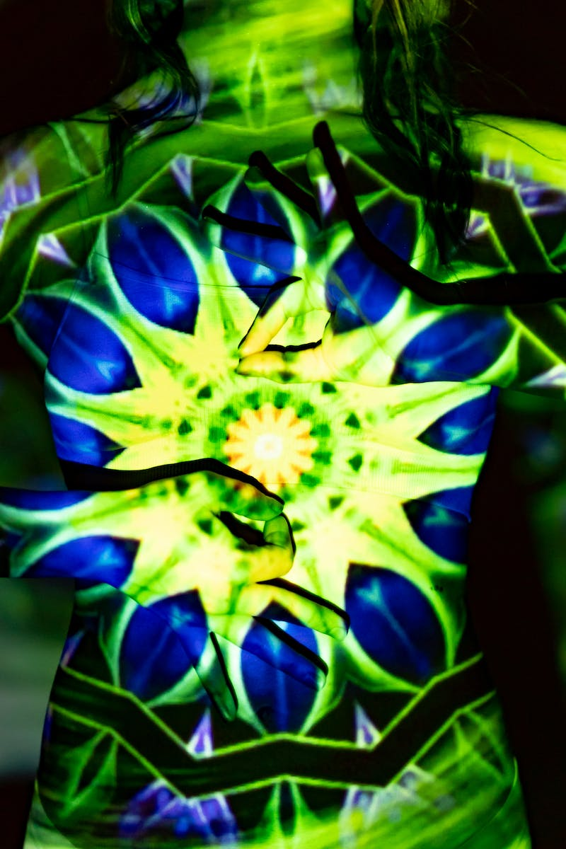
Fractal
• Create a never-ending pattern effect
• Add a unique and interesting look with fractal patterns
• Examples: woman's face, Modern Family Home, Pikachu
• Image Search: fractal
• Source URL:
Photo by Pexels

Slide 6
Simpsons Cartoon Style
• Transform images into the iconic Simpsons cartoon style
• Create fun and familiar cartoon characters
• Examples: woman's face, Modern Family Home, Darth Vader
• Image Search: simpsonscartoonstyle
• Source URL:

Slide 7
Vinyl Sticker
• Give images a sticker-like appearance
• Simulate the look of printed stickers that can be placed on various surfaces
• Examples: woman's face, futuristic car, Terminator
• Image Search: vinylsticker
• Source URL:

Slide 8
Zentangle
• Add intricate black and white line work
• Create unique patterns with a Zentangle style
• Examples: woman's face, Samurai, Modern Family Home
• Image Search: zentangle
• Source URL:

Slide 9
Megalophobia
• Evoke the fear of intensely large objects
• Create images with a sense of scale and intensity
• Examples: woman's face, Pikachu, Samurai standing in front of Mount Fuji
• Image Search: megalophobia
• Source URL:

Slide 10
Geometric Shape Design
• Transform images into artistic geometric designs
• Create visually appealing compositions with geometric shapes
• Examples: Michael Jackson, Pikachu, waterfall in nature
• Image Search: geometricshapedesign
• Source URL:

Slide 11
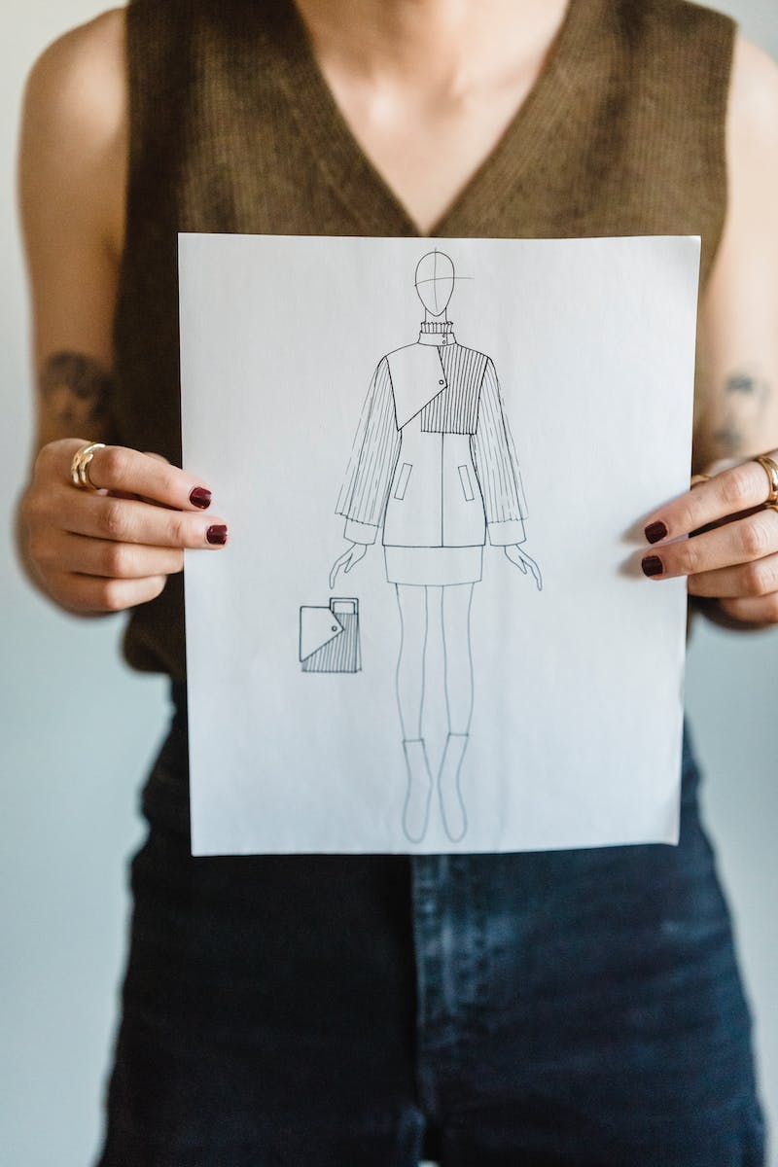
Blueprint
• Give images a blueprint-like appearance
• Simulate the look of technical drawings
• Examples: dog with sunglasses, Pikachu, Darth Vader
• Image Search: blueprint
• Source URL:
Photo by Pexels

