Slide 1
The Impact of Vietnamese Culture
Exploring the Rich Heritage and Traditions

Slide 2
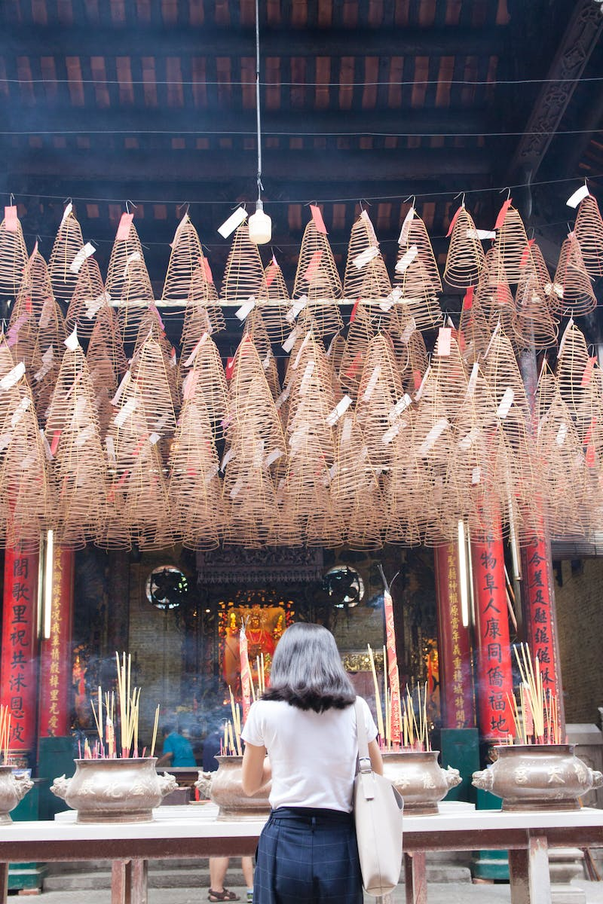
Introduction to Vietnamese Culture
• Vietnam has a diverse and vibrant culture
• Influenced by its long history and unique geography
• Home to rich traditions, art, and cuisine
• Deeply rooted in Confucianism and Buddhism
Photo by Pexels

Slide 3
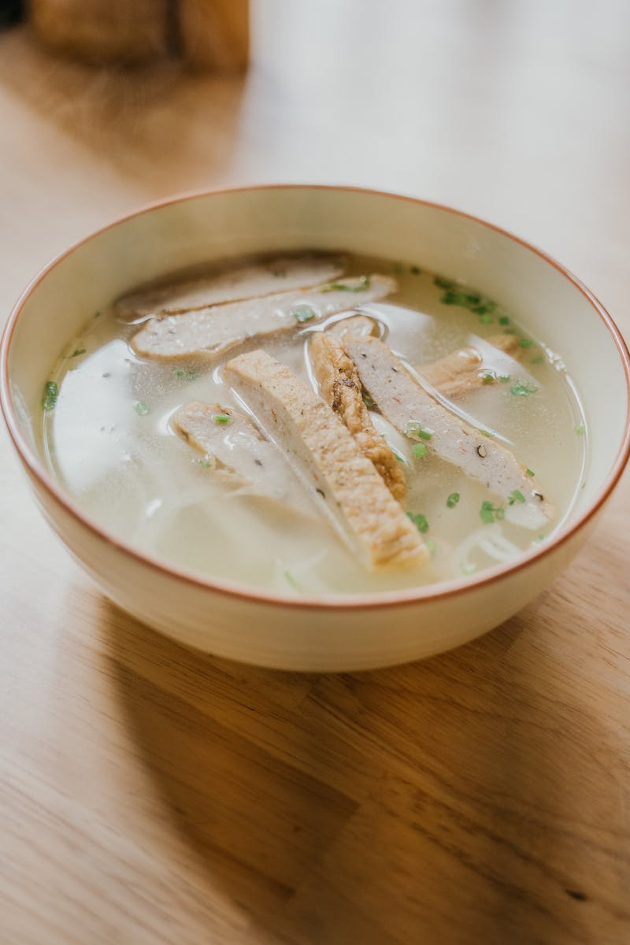
Unveiling Vietnamese Cuisine
• Vietnamese cuisine is renowned for its freshness and balance
• Characterized by the abundant use of herbs, vegetables, and rice
• Famous dishes include pho, banh mi, and spring rolls
• Influenced by Chinese, French, and Southeast Asian flavors
Photo by Pexels

Slide 4
Traditional Festivals and Celebrations
• Vietnamese culture is rich in colorful festivals
• Lunar New Year (Tet) is the most important festival
• Other festivals include Mid-Autumn Festival and Hung Kings' Temple Festival
• Festivals feature dragon dances, traditional music, and fireworks
Photo by Pexels

Slide 5
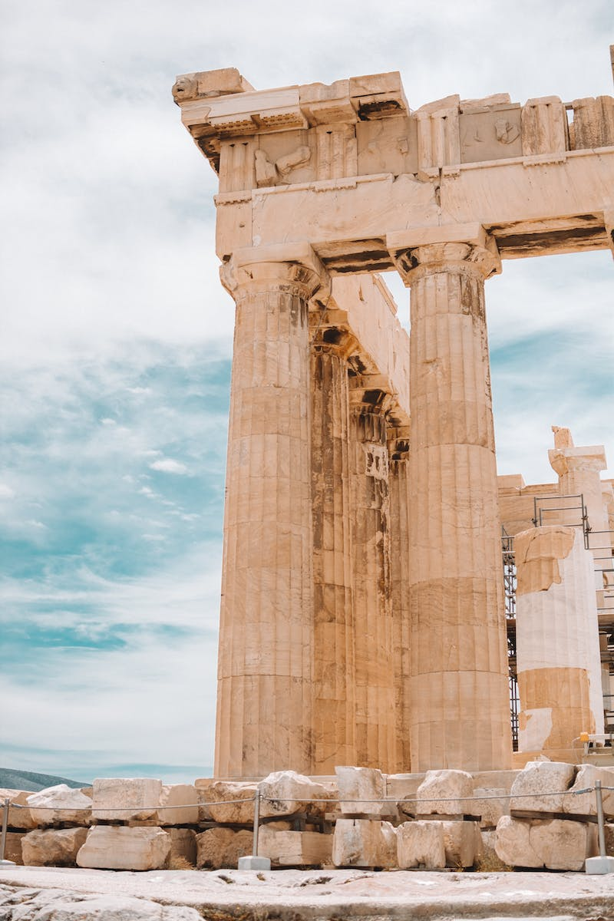
Traditional Arts and Crafts
• Vietnamese culture is renowned for its traditional arts and crafts
• Ao dai is the traditional Vietnamese dress
• Lacquerware, silk weaving, and pottery are popular crafts
• Water puppetry is a unique traditional art form
Photo by Pexels

Slide 6
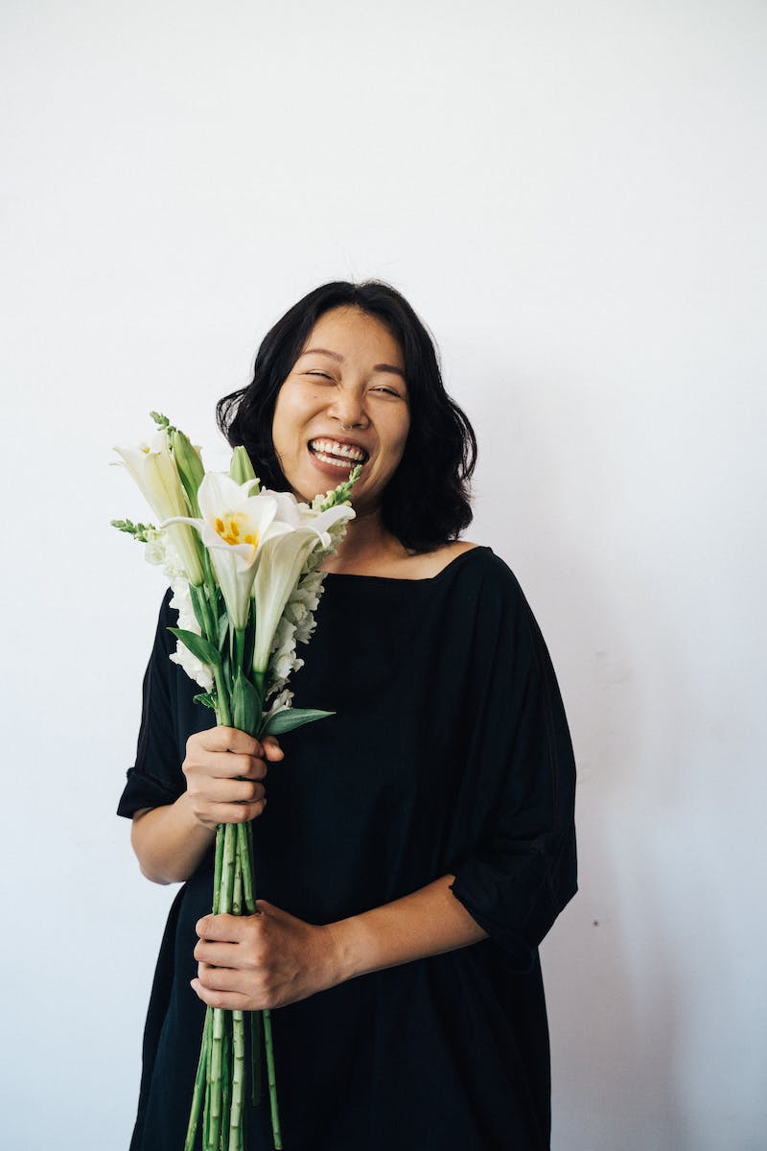
Vietnam's Natural Wonders
• Vietnam is blessed with diverse natural landscapes
• Ha Long Bay is a UNESCO World Heritage Site
• Mekong Delta is known for its lush greenery and floating markets
• Phong Nha-Ke Bang National Park offers stunning caves
Photo by Pexels

