Slide 1
The Dumbest Criminals: Tales of Stupidity and Self-Sabotage
Four Stories that Defy All Logic

Slide 2
Introduction
• - Most criminals are not usually very clever
• - From accidentally self-snitching to calling the police on themselves
• - Here are four of the dumbest criminals
• - Prepare to be amazed by their lack of intelligence
Photo by Pexels

Slide 3
Eric Edwards - Fugitive Turned Snitch
• - Eric Edwards, a fugitive for three days
• - Involved in a shooting and killing of Michael Hudson
• - Edwards decides to turn himself in
• - Implicates his partner Cedric as the shooter
Photo by Pexels

Slide 4
Antoine Sims - McDonald's Fries and a Warrant
• - Antoine Sims calls the police over cold fries
• - Unknowingly reveals he has a warrant for arrest
• - Sims is banned from McDonald's
• - Later caught trying to break into an apartment
Photo by Pexels

Slide 5
Cody Forenkem - Live Streaming Confession
• - Cody Forenkem confesses to a crime while live streaming
• - Claims the victim consented but later contradicts himself
• - Unaware that his confession is being recorded
• - Easily incriminates himself in the crime
Photo by Pexels

Slide 6
Raymond Gates - A Recorded Confession
• - Raymond Gates confesses to a rape during an interrogation
• - Claims the victim consented but contradicts himself
• - Unaware that the incident was recorded on video
• - Shocked when confronted with the evidence
Photo by Pexels

Slide 7
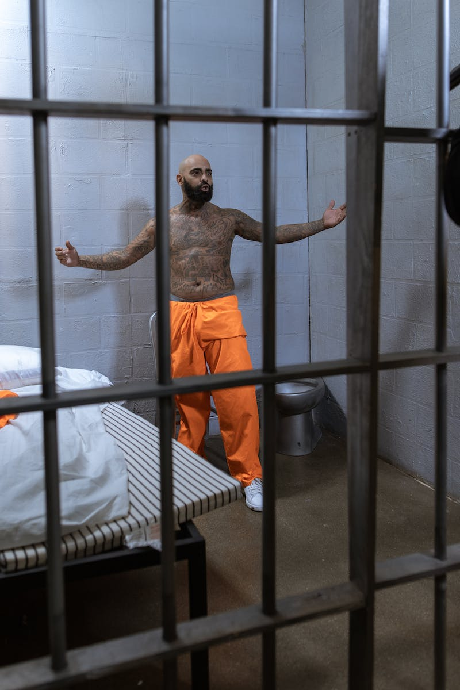
Conclusion
• - These stories prove that criminals can be incredibly dumb
• - Their own actions and words lead to their downfall
• - We can only hope that justice is served in each case
• - Let these stories serve as a reminder of the consequences of stupidity
Photo by Pexels

