Slide 1
The Importance of Economic Leverage
Strategic and Progressive Approaches

Slide 2
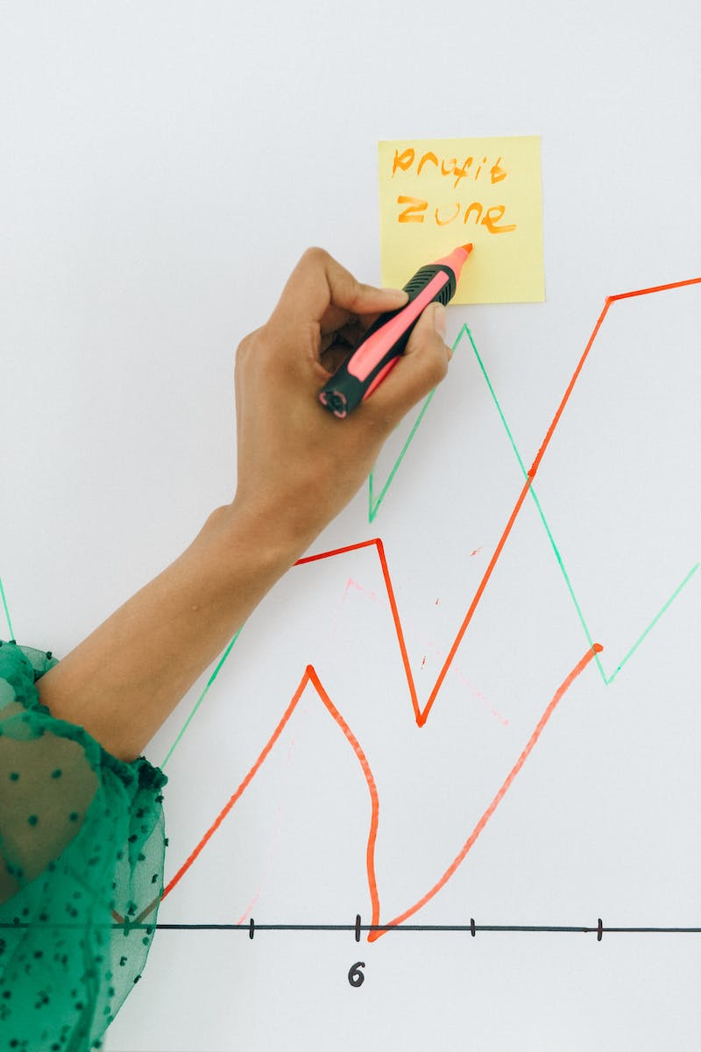
Introduction: Economic Leverage
• Economic leverage refers to the strategic use of resources to achieve desired outcomes
• It involves maximizing the impact of limited resources for maximum gain
• Economic leverage can be a powerful tool for individuals, organizations, and governments
• By understanding and harnessing economic leverage, we can create positive change
Photo by Pexels

Slide 3
Strategic Planning for Economic Leverage
• Strategic planning is crucial for effective economic leverage
• Identify goals and objectives to focus resources on
• Analyze market trends and opportunities
• Develop a comprehensive strategy to optimize leverage potential
Photo by Pexels

Slide 4
Progressive Approaches to Economic Leverage
• Progressive approaches focus on long-term sustainability
• Promote innovation and creativity
• Invest in research and development
• Foster collaboration and partnerships
Photo by Pexels

