Slide 1
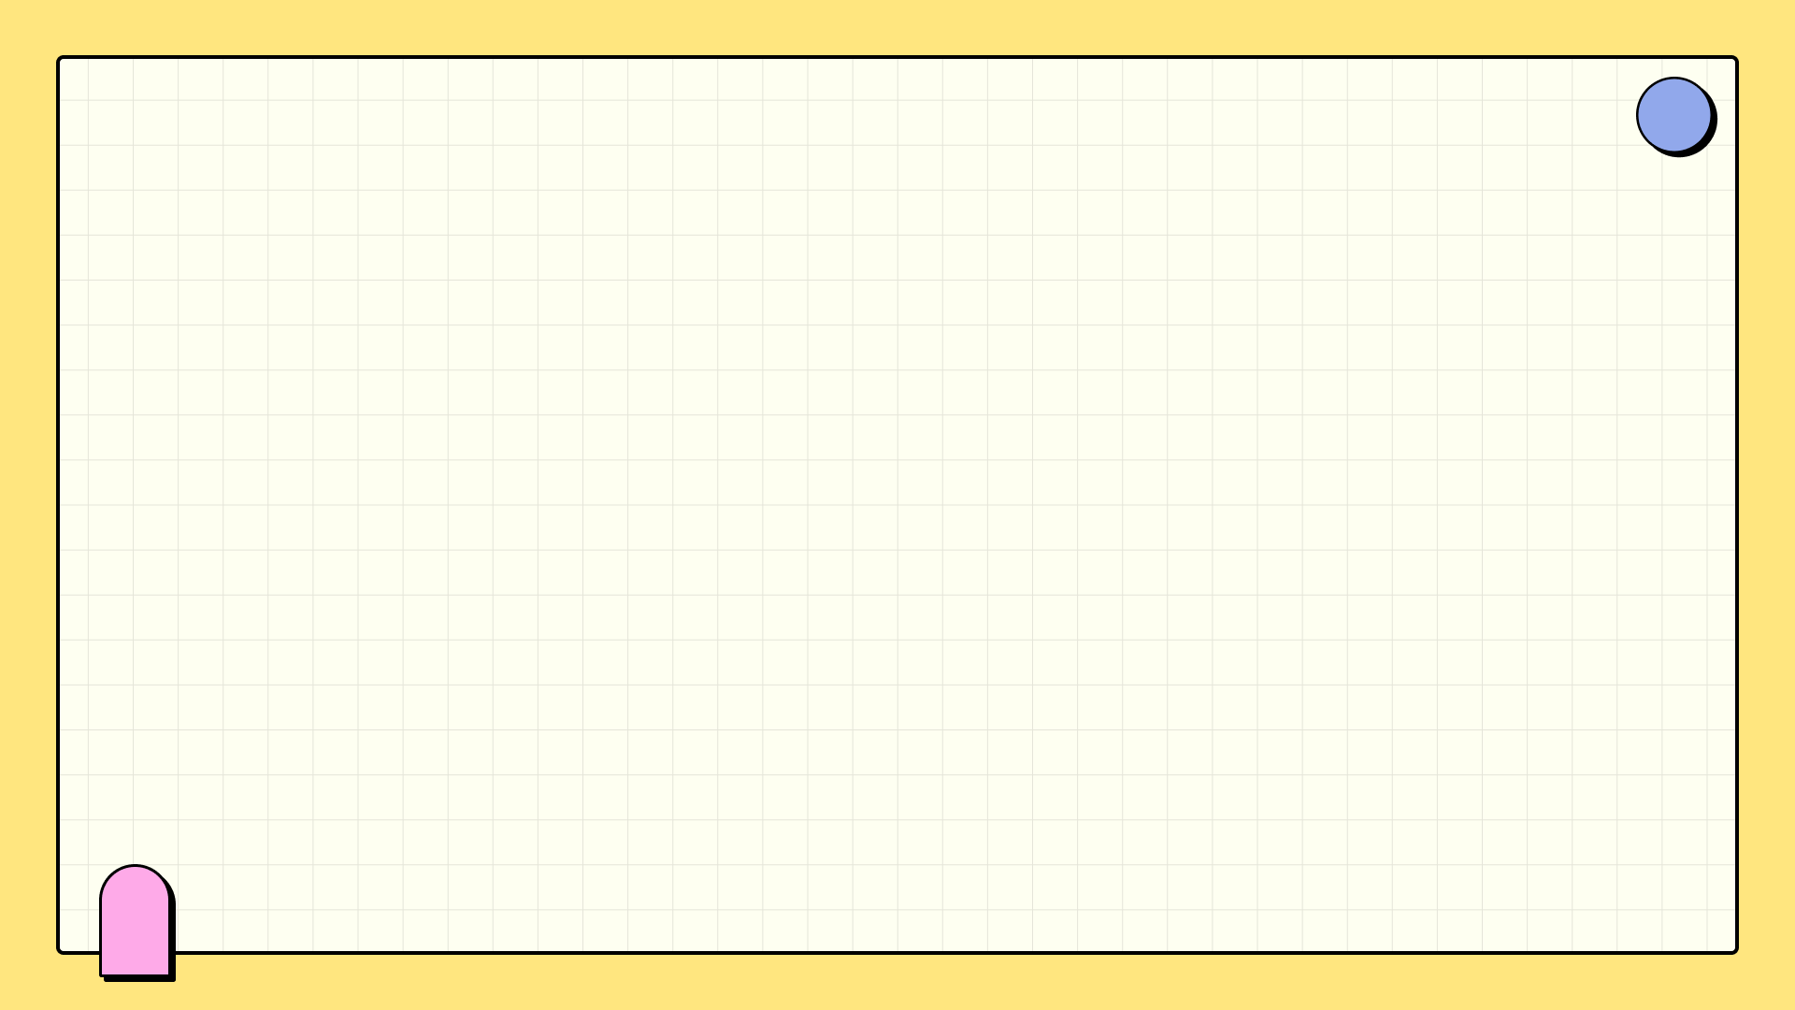

April 2025
Pattern Play Pro: Style Guide
Unlock the secrets to confidently mixing prints and patterns like a fashion expert.

Slide 2
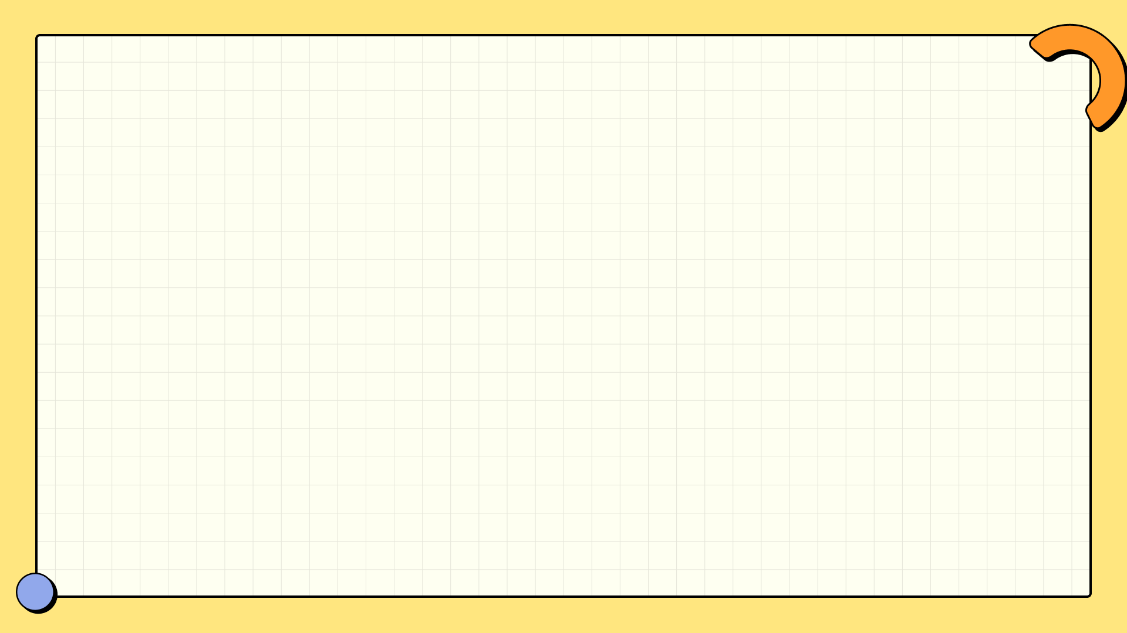

Table of Contents
1
Prints vs. Patterns: Decoding Design
5
Scale Secrets: Design Harmony
2
Pattern Playbook: Harmony in Prints
6
Pattern Clash Catastrophe!
3
Black: The Unifier
7
Pattern Play: Dominance & Accent
4
Color Harmony: United by Hue
8
Blooming Contrasts

Slide 3
Table of Contents
9
Print Mixing: Yay or Nay?
10
Pattern Mixing Mastery

Slide 4
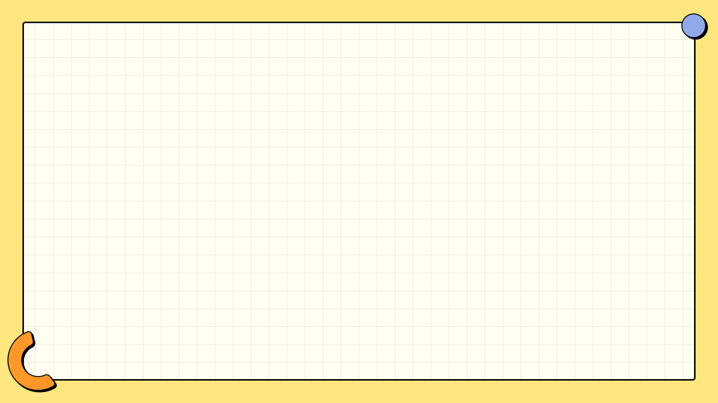
Prints vs. Patterns: Decoding Design
Patterns are inherent to the fabric, created during the weaving or knitting process, repeating seamlessly.
Prints are applied post-fabrication, offering diverse surface decoration, impacting feel and durability.
Patterns rely on continuous, predictable repetition, creating visual texture and often structural integrity.
Prints tell unique stories on the surface, allowing for intricate details and personalized fabric expressions.

Slide 5
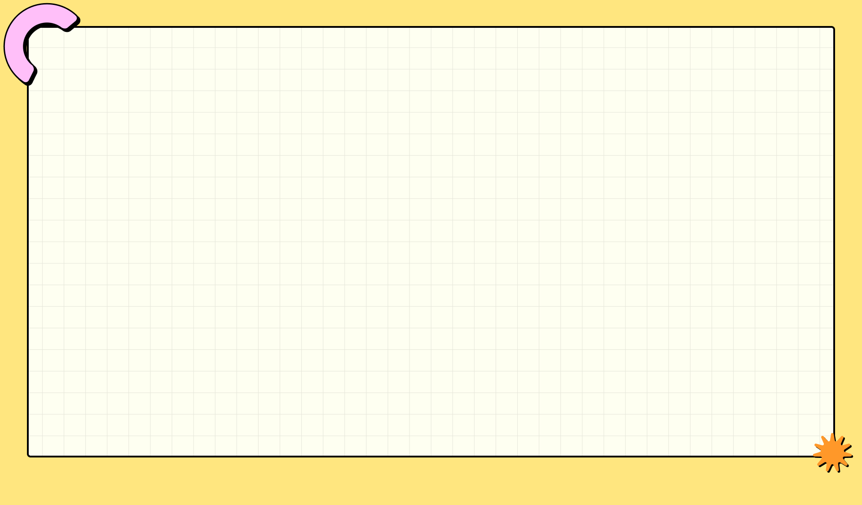
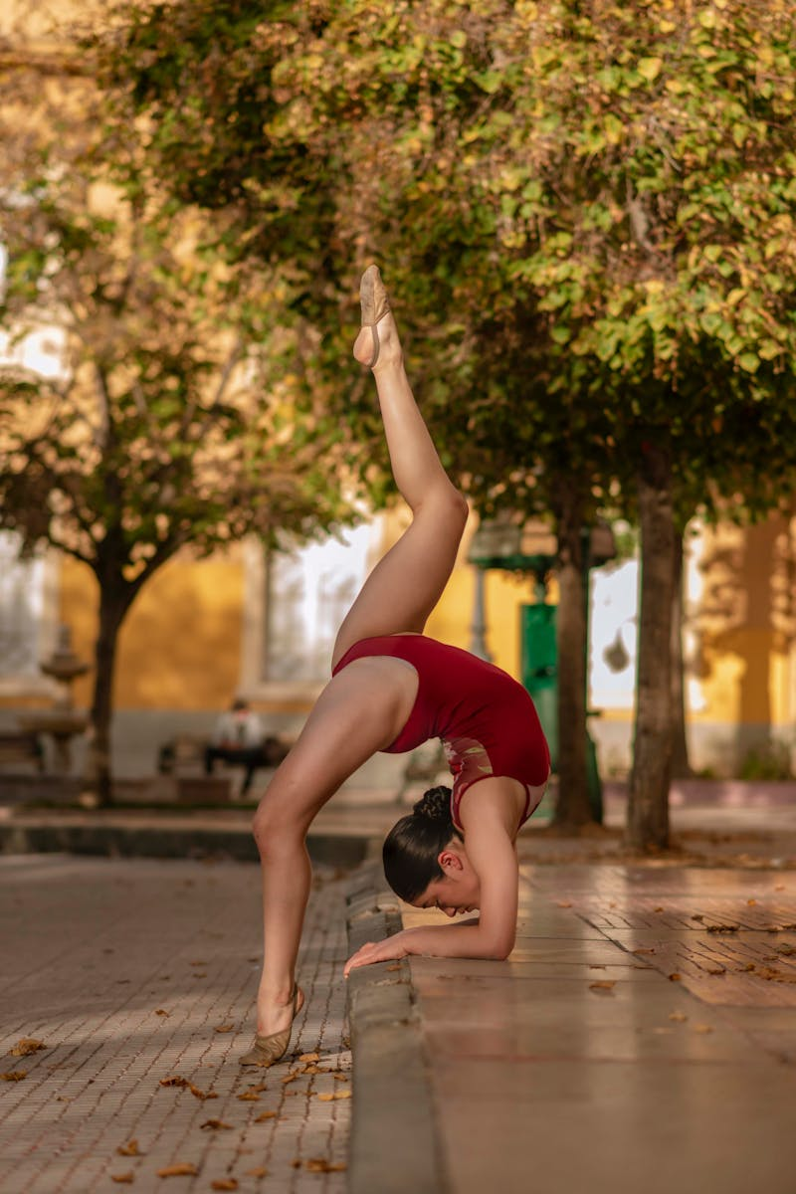
Pattern Playbook: Harmony in Prints
Rule #1: Common Color Harmony. Ensure prints share at least one color to create a visually pleasing and cohesive look.
Leopard and plaid can coexist beautifully! The secret lies in finding common hues that tie the two seemingly disparate patterns together.
Focus on the underlying color palette. Matching hues create a bridge, making even bold combinations feel intentional and stylish.
Don't be afraid to experiment! Subtle color connections can be just as effective as obvious matches, adding depth to your look.

Slide 6
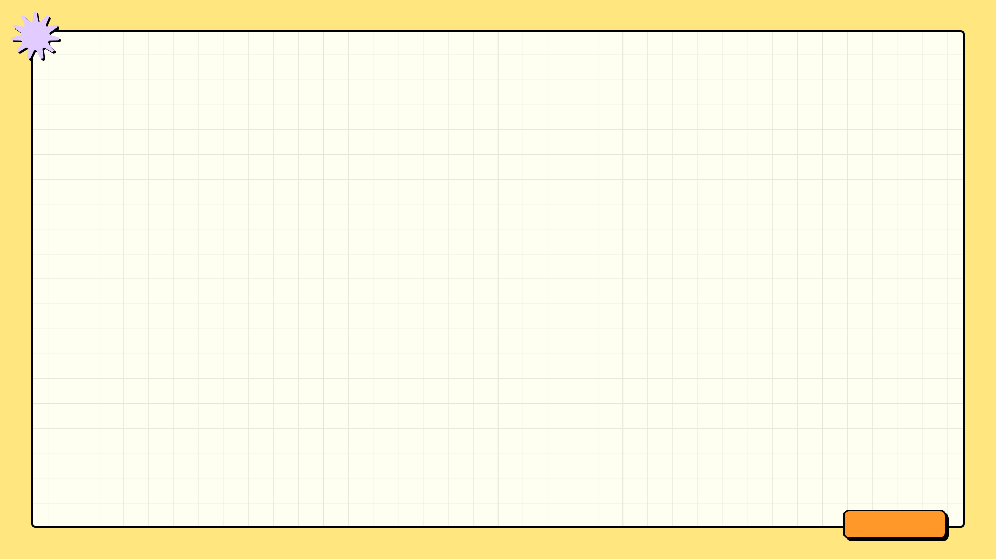



Black: The Unifier
Strong Points
Weak Points
Black anchors busy patterns, preventing visual overload and creating a cohesive, balanced look.
It provides a grounding effect, allowing brighter or more complex patterns to stand out effectively.
Black's neutrality allows it to blend seamlessly with a wide range of colors and pattern styles.
Overuse of black can create a heavy or somber look, especially in warmer seasons or environments.
Black can absorb light, potentially making an outfit appear less vibrant or dimensional, flattening details.
Black can visually shrink the wearer, potentially minimizing curves or creating an unbalanced silhouette.

Slide 7

Color Harmony: United by Hue
Sharing two or more colors in different garments creates a strong visual connection and pulls the entire look together seamlessly.
A snakeskin skirt and a plaid jacket, seemingly disparate, find common ground through shared colors, forming a unified aesthetic.
Common colors act as visual anchors, grounding the outfit and establishing a sense of deliberate coordination, enhancing overall style.
This technique introduces a level of subtle sophistication, showing attention to detail and creating a polished, well-considered ensemble.

Slide 8
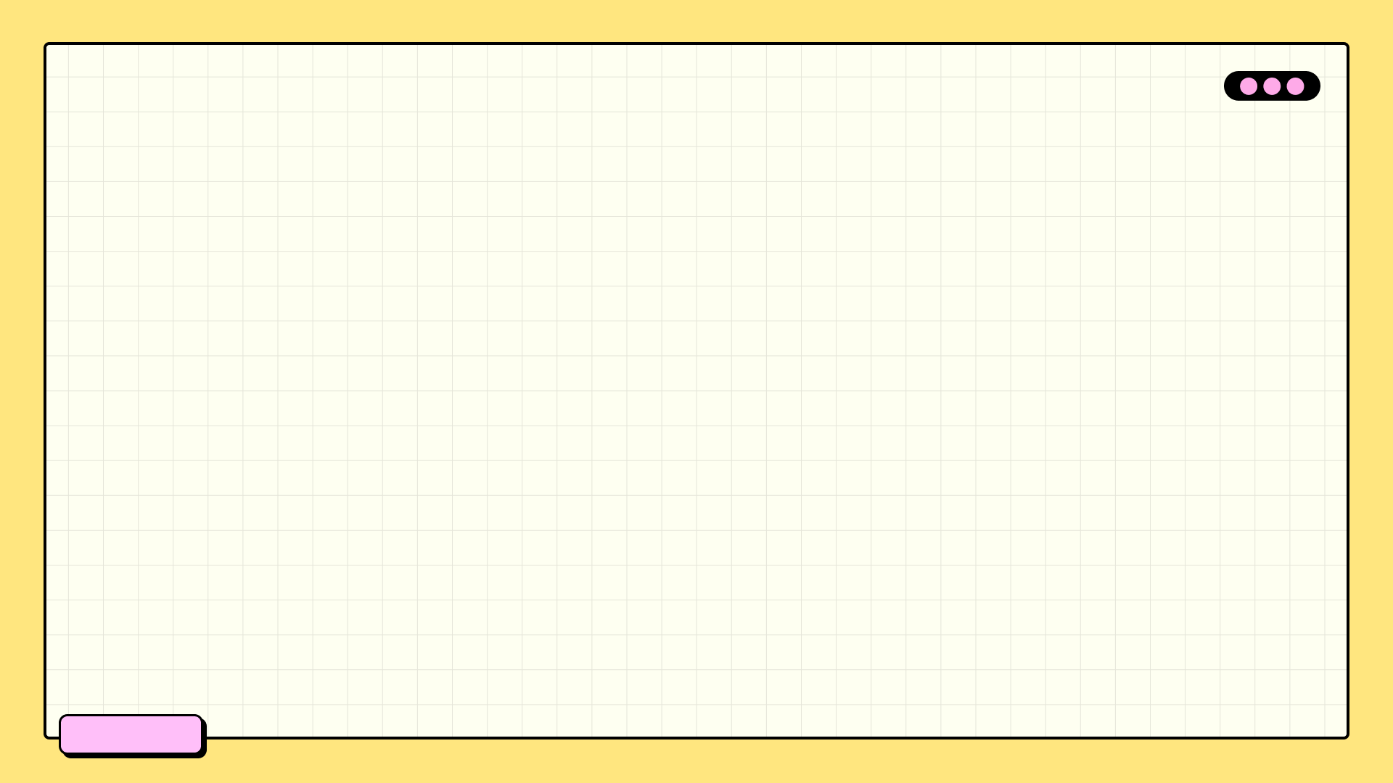

Scale Secrets: Design Harmony
Dominant Size
60%
Accent Size
30%
Tertiary Size
10%
Visual Weight
2x

Slide 9
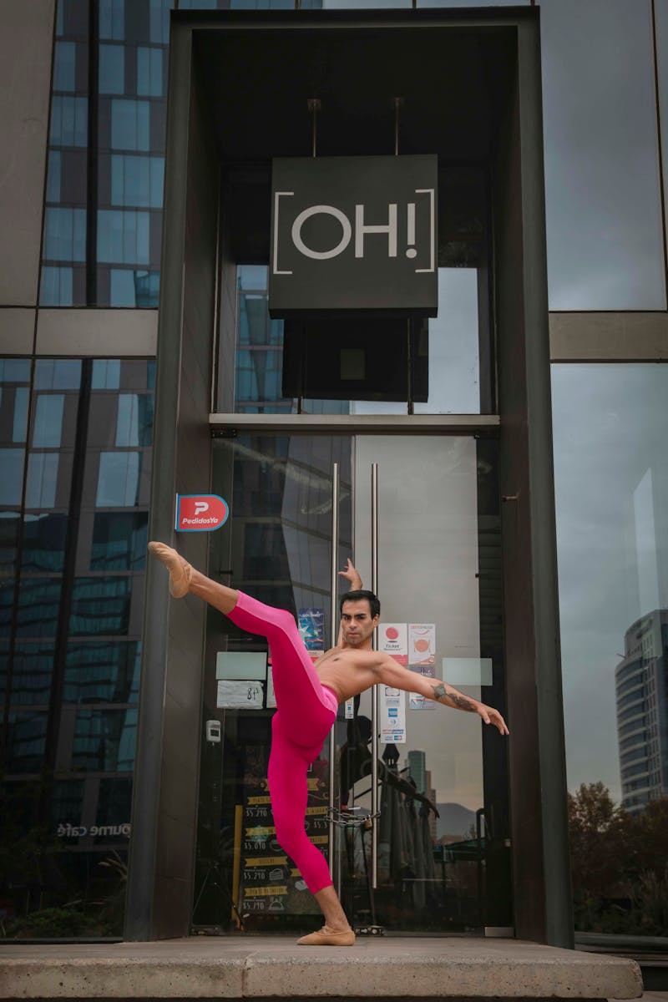
Pattern Clash Catastrophe!
Varying pattern sizes is key. Identical scales compete, creating visual noise instead of a cohesive mix.
Matching colors can't save a poorly scaled pattern mix. Scale is more important than hue here.
Use scale to establish a visual hierarchy. Larger patterns should lead, smaller ones should support.
One poorly scaled pattern can ruin the entire look. Assess each pattern's contribution critically.

Slide 10
Pattern Play: Dominance & Accent
Cat Print
75%
Paisley Accent
25%
Visual Weight
2x
Pattern Scale
1:4

Slide 11
Blooming Contrasts
Juxtaposing large florals with small dots creates dynamic visual tension and a modern, playful aesthetic.
Consider complementary colors for florals and dots to enhance the overall impact and visual balance.
Floral patterns provide organic shapes, while dots offer geometric structure, balancing boldness and subtlety.
Select fabrics with good drape and texture to elevate the design, adding depth and sophistication to the contrast.

Slide 12
Print Mixing: Yay or Nay?
The Upsides
The Downsides
Express personal style through unique combinations, showcasing individuality and creativity in fashion choices.
Create unique outfits that stand out from the crowd, moving beyond predictable pairings and embracing originality.
Add visual interest to wardrobes by breaking up monotony and injecting energy through contrasting patterns and textures.
Can appear visually overwhelming if not balanced carefully, resulting in a chaotic and disjointed overall look.
Risk of clashing patterns creating an unflattering or distracting appearance, detracting from the intended aesthetic.
Requires careful consideration of color palettes and pattern scales to avoid disharmony and maintain a cohesive style.

Slide 13
Pattern Mixing Mastery
Vary pattern sizes. Combine large-scale prints with smaller, more subtle designs for a balanced and visually appealing look.
Find a common color. Choose patterns that share at least one color to create a cohesive and intentional outfit or space.
Begin with neutrals. Introduce a patterned neutral with a bolder print for a safe and stylish starting point in pattern mixing.
Break the rules! Once comfortable, experiment with clashing colors and unexpected combinations for a unique, personal style.

