Slide 1
Discovering Philippine Money
Identifying, Recognizing, Reading, and Writing Money in Symbols and Words

Slide 2
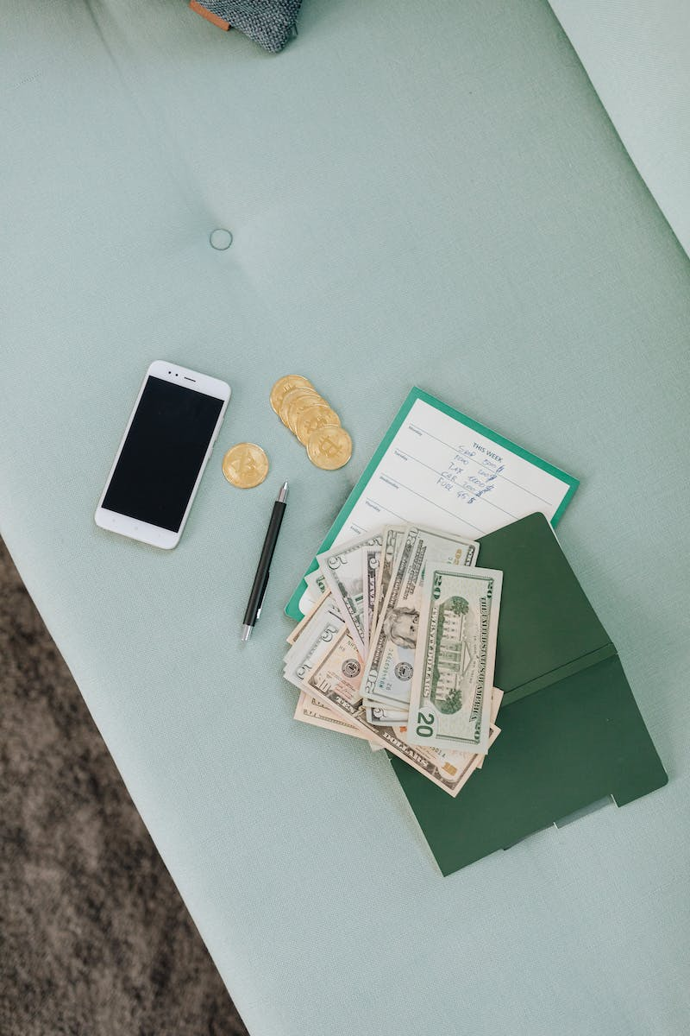
Learning Goals
• Recognize and identify coins and bills up to 500 pesos and their notations
• Read and write the amount of money in words and symbols
Photo by Pexels

Slide 3
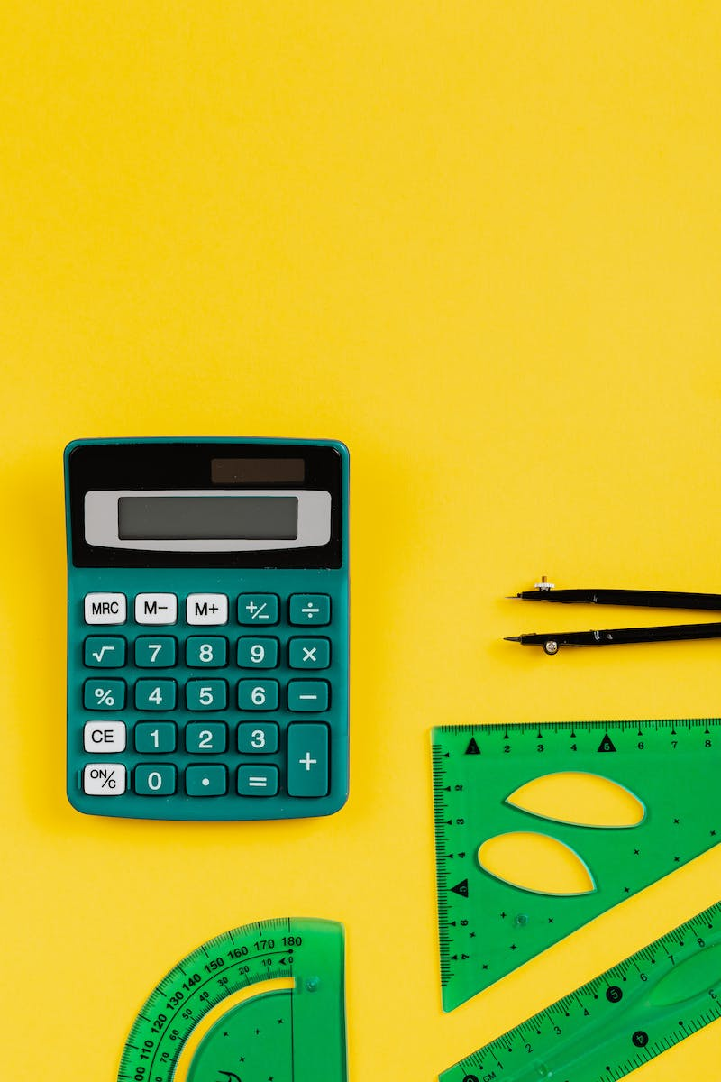
Oral Drill
• Find the sum of the following:
• 90 + 2 = 92
• 60 + 5 = 65
• 100 + 20 + 4 = 124
Photo by Pexels

Slide 4
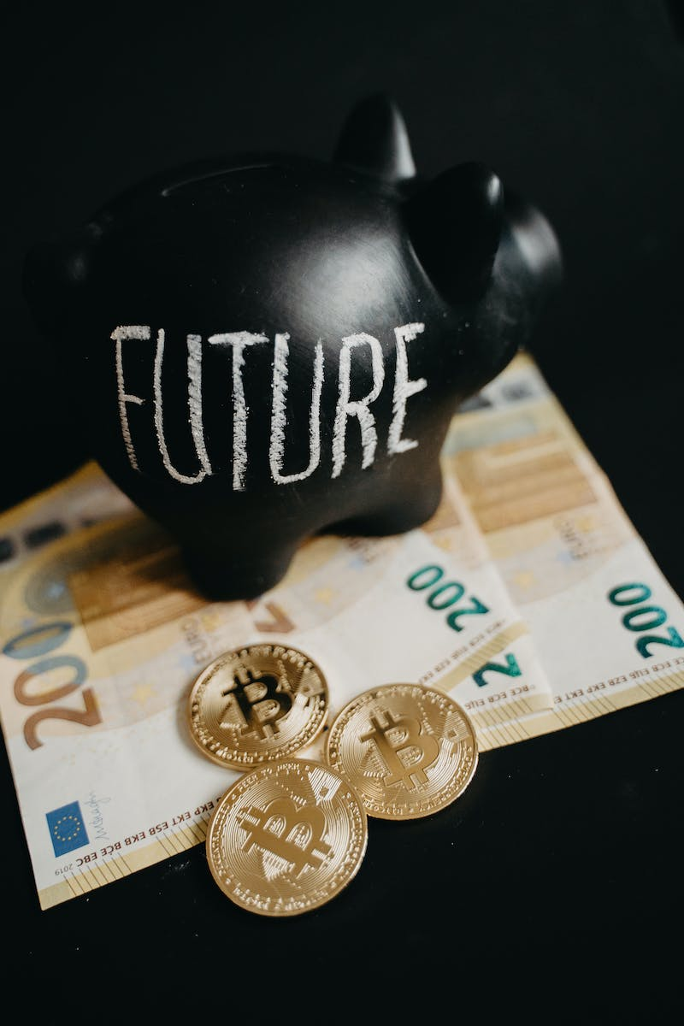
Problem of the Day
• If you have:
• 2 fifty-peso bills
• 3 twenty-peso bills
• 4 five-peso coins
• How much money do you have?
Photo by Pexels

Slide 5
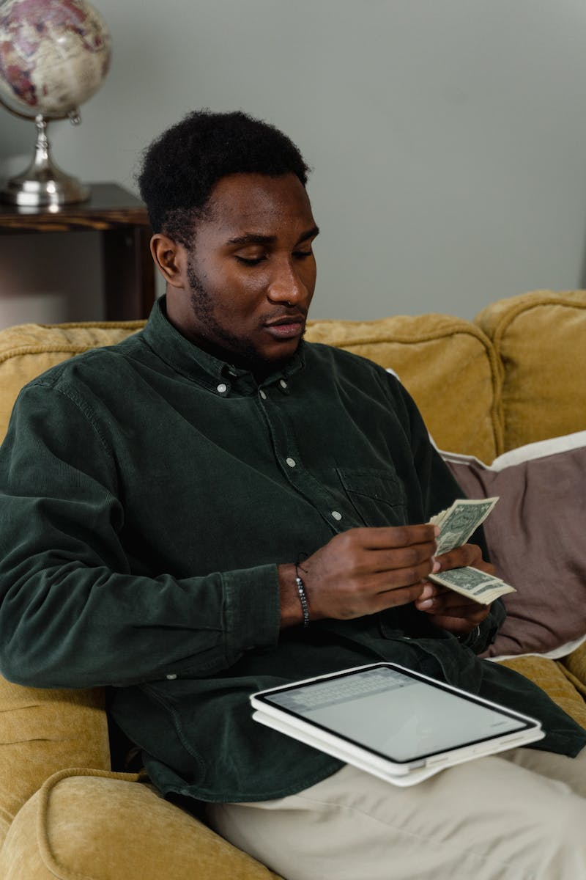
Solution
• Two 50-peso bills = 100 pesos
• Three 20-peso bills = 60 pesos
• Four 5-peso coins = 20 pesos
• Total money = 100 + 60 + 20 = 180 pesos
Photo by Pexels

Slide 6
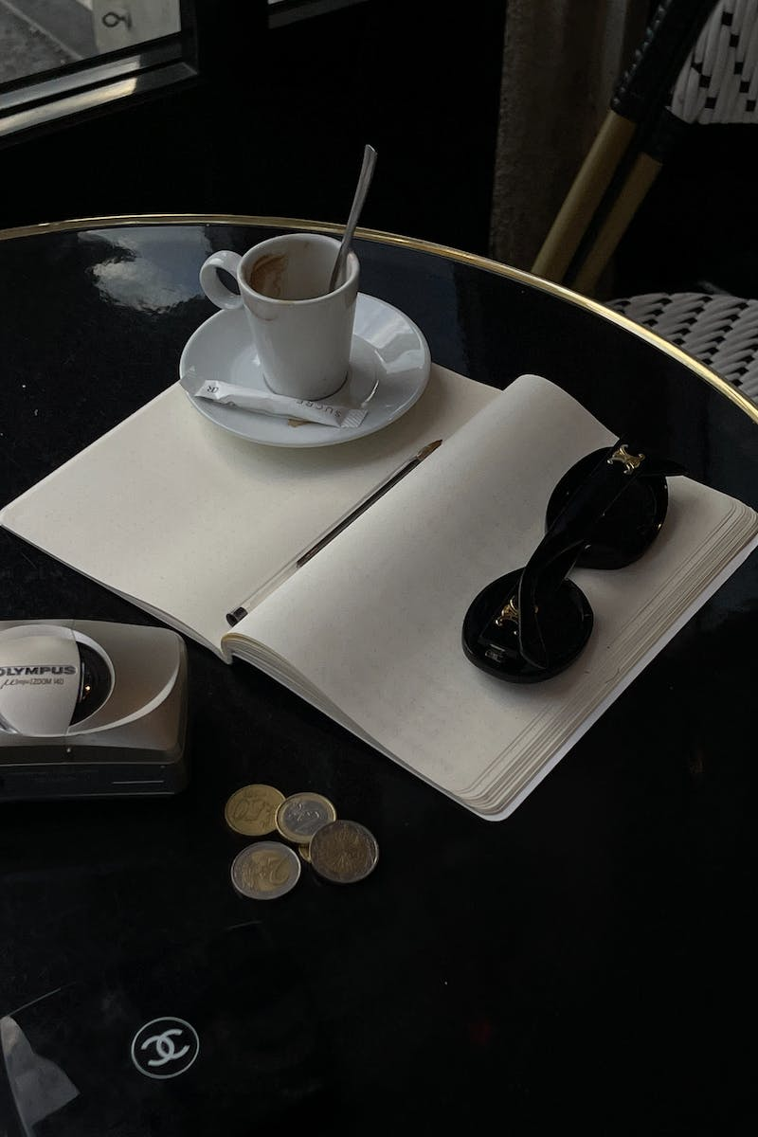
Guessing Game
• Do you know these two people?
• They are former President Cory Aquino and Senator Benigno Aquino Jr.
• Where can we find them?
• Yes, on a 500-peso bill
Photo by Pexels

Slide 7
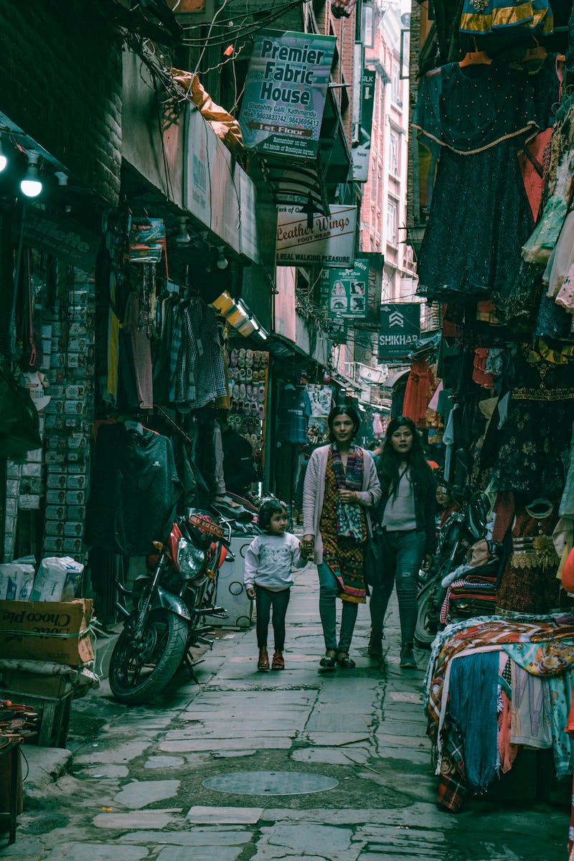
Children's Wishlist
• What will you buy if you have a lot of money?
• Think about what you need before buying what you want
• Spending money wisely is important
Photo by Pexels

Slide 8
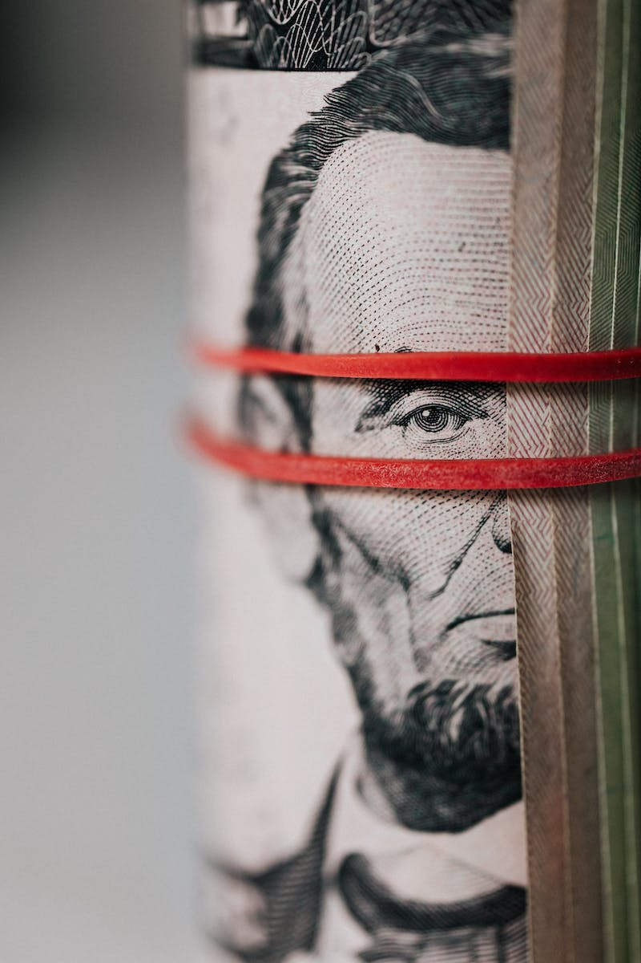
Trivia
• Did you know that our ancestors did not use money to buy?
• They practiced barter trade instead
Photo by Pexels

Slide 9
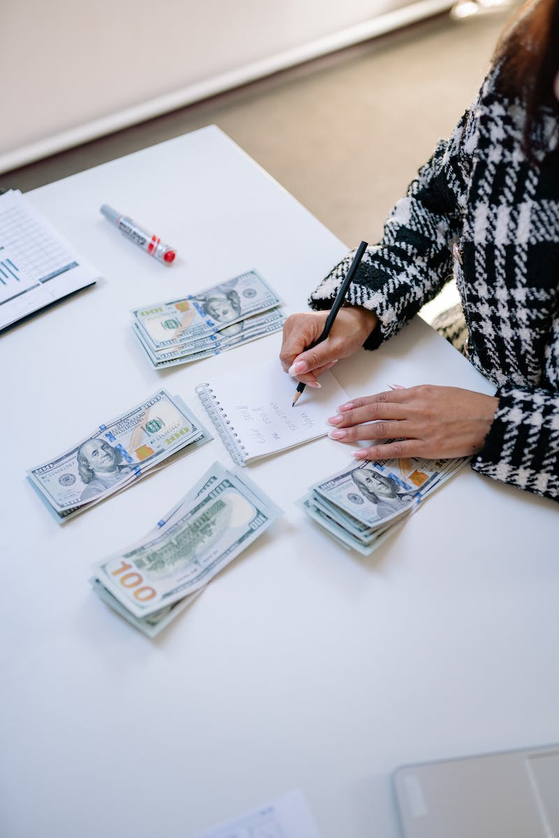
Practice: Writing Amounts in Words
• Write the amount in words:
• 26 pesos and 50 centavos
• 157 pesos and 25 centavos
• 75 pesos and 50 centavos
• 98 pesos
Photo by Pexels

Slide 10
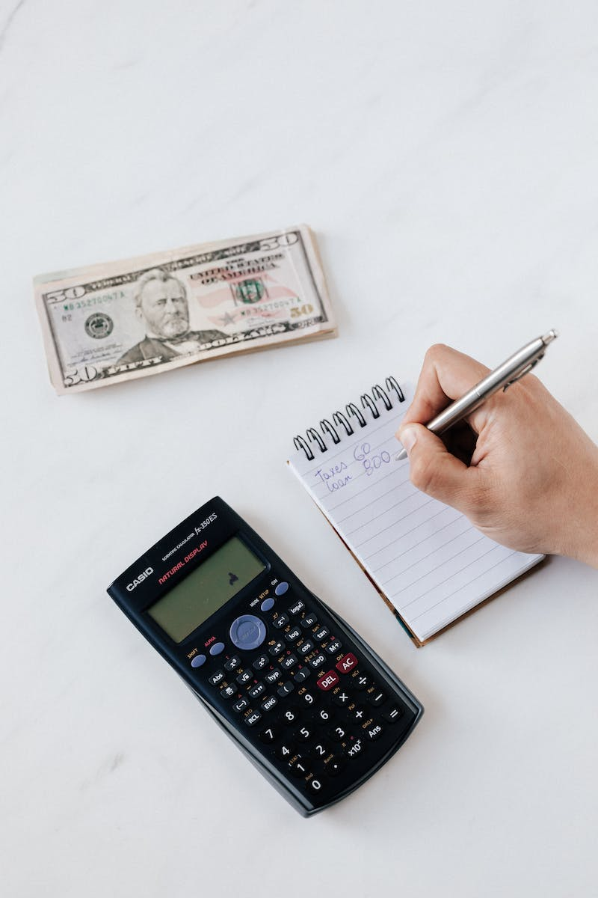
Practice: Writing Amounts in Symbols
• Write the amount in symbols:
• 30 pesos and 28 centavos
• 3,990 pesos and 40 centavos
• 100 pesos
Photo by Pexels

Slide 11
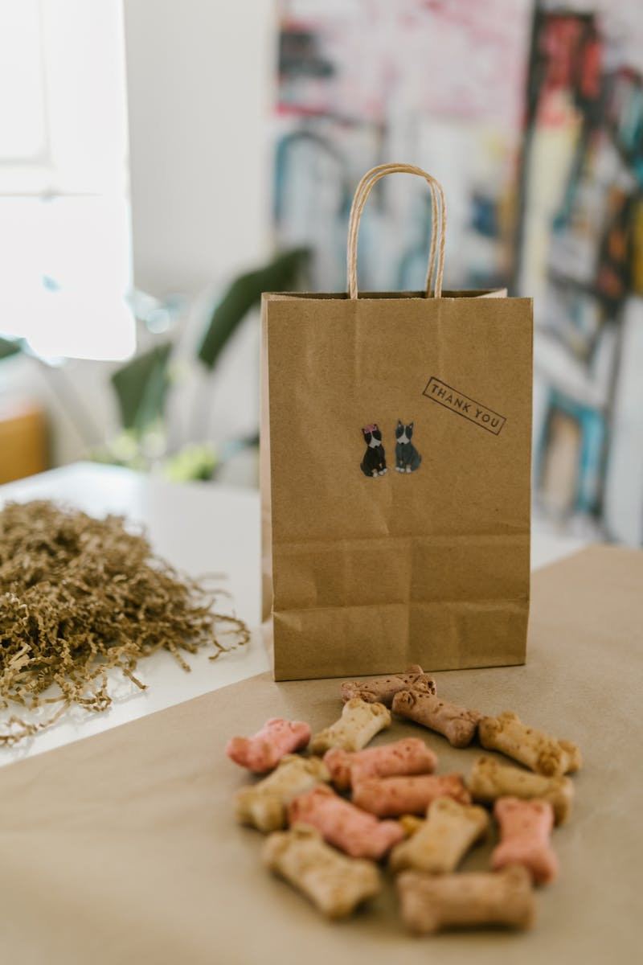
Conclusion
• Thank you for joining our session on Philippine money
• In our next session, we will learn about comparing money
• Make sure to stay updated by hitting the Bell button!
Photo by Pexels

