Slide 1
The Impact of Eco Production on Social and Economic Development
Exploring the connection between sustainable practices and growth

Slide 2
Introduction
• Welcome to the presentation on the impact of eco production
• Defining eco production and its relevance in today's world
• Brief overview of the agenda
• Highlight the importance of sustainable practices
Photo by Pexels

Slide 3
The Benefits of Eco Production
• Reduced environmental impact
• Cost savings through resource efficiency
• Improved public perception and brand reputation
• Creation of new job opportunities
Photo by Pexels

Slide 4
Eco Production in Action
• Case studies of successful eco production initiatives
• Highlighting companies that have implemented sustainable practices
• Examples of measurable positive impact
• Lessons learned and best practices
Photo by Pexels

Slide 5
The Role of Stakeholders
• Collaboration between government, businesses, and NGOs
• Importance of stakeholder engagement
• Incentives and policies promoting eco production
• Need for collective action
Photo by Pexels

Slide 6
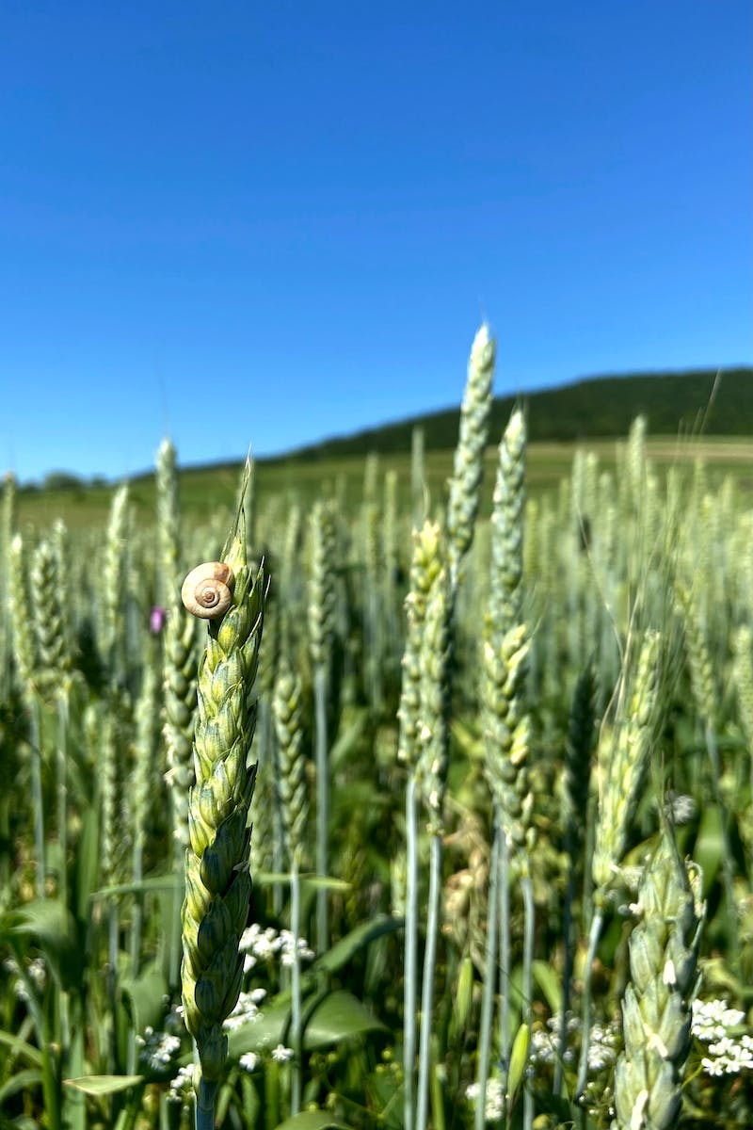
Conclusion
• Recap of the key points discussed
• Reiterate the importance of eco production
• Call to action for individuals and organizations
Photo by Pexels

