Slide 1
The Power of Software
Exploring the Impact of Software in Our Daily Lives

Slide 2
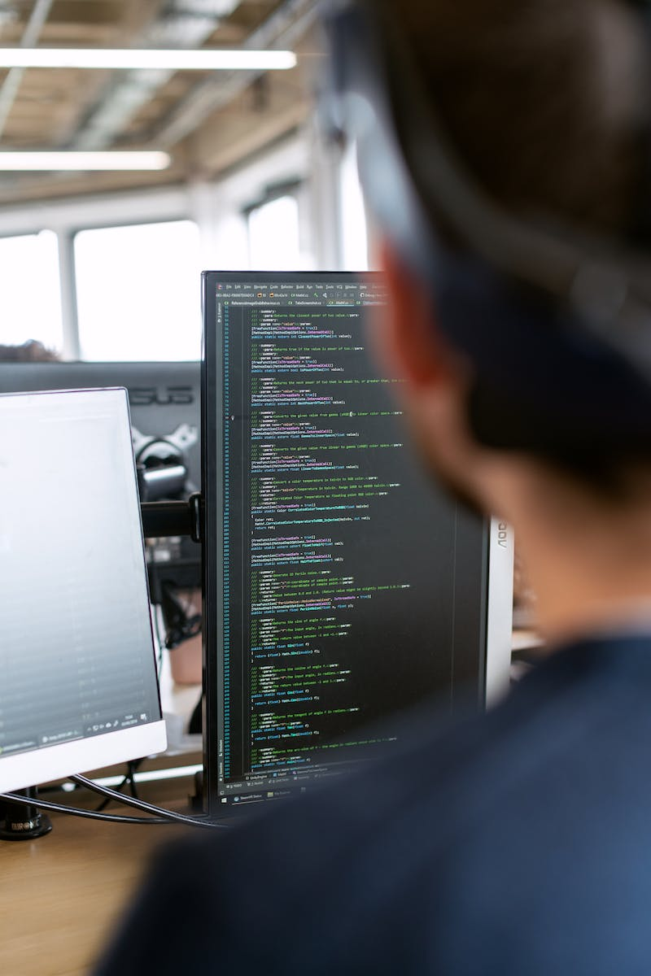
Introduction
• Software has become an integral part of modern society
• It influences our daily lives in various areas
• From communication to entertainment, software plays a critical role
• In this presentation, we will explore the significance of software
Photo by Pexels

Slide 3
Communication Revolution
• Software has transformed the way we communicate
• Platforms like social media and messaging apps have made global connectivity seamless
• Instantaneous communication has become the norm
• Software enables real-time collaboration and information sharing
Photo by Pexels

Slide 4
Enhancing Efficiency
• Software has greatly improved efficiency in various industries
• Automation and optimization algorithms streamline processes
• Tasks that once took hours can now be accomplished in minutes
• Software allows for accurate data analysis and informed decision-making
Photo by Pexels

Slide 5
Entertainment Revolution
• Software has transformed the entertainment industry
• Streaming platforms have changed the way we consume media
• Virtual and augmented reality technologies offer immersive experiences
• Software powers realistic graphics and interactive gaming
Photo by Pexels

