Slide 1
The Monster's Graveyard
A Spooky Journey Through the Land of the Undead

Slide 2
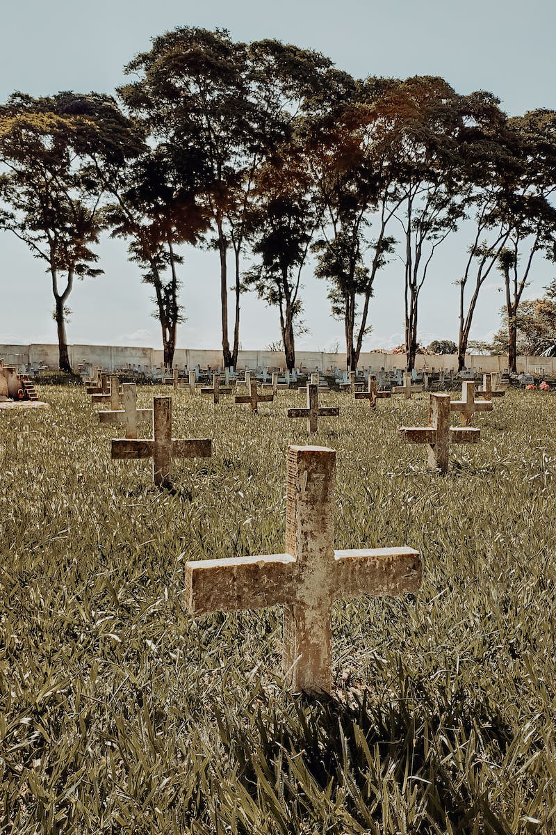
Introduction
• Welcome to The Monster's Graveyard
• Discover the eerie world of the undead
• Uncover the secrets of the night
• Prepare to be thrilled and terrified
Photo by Pexels

Slide 3
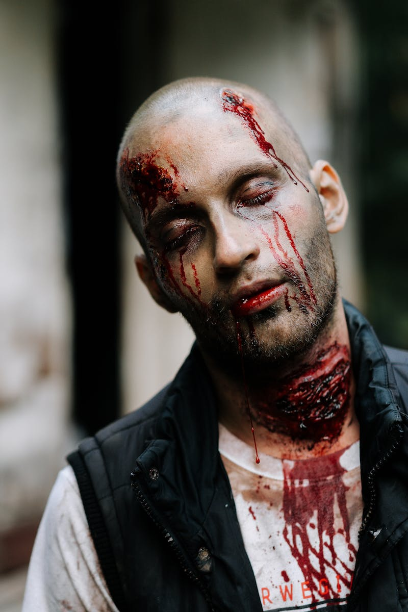
Rising of the Monster
• Light with my eyes behind an eerie sight
• My monster from his slab began to rise
• To my surprise, he did the to
• It was a graveyard man, rising from his tomb
Photo by Pexels

Slide 4
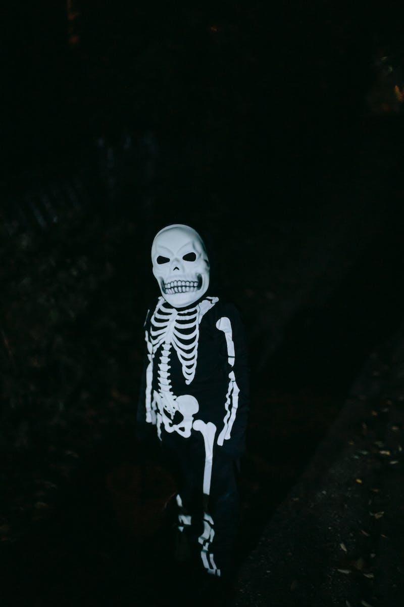
Gathering of the Undead
• The zombies were having fun
• The party had just begun
• Wolves, Dracula, and his son arrived
• The scene was rocking, Igor was alive
Photo by Pexels

Slide 5
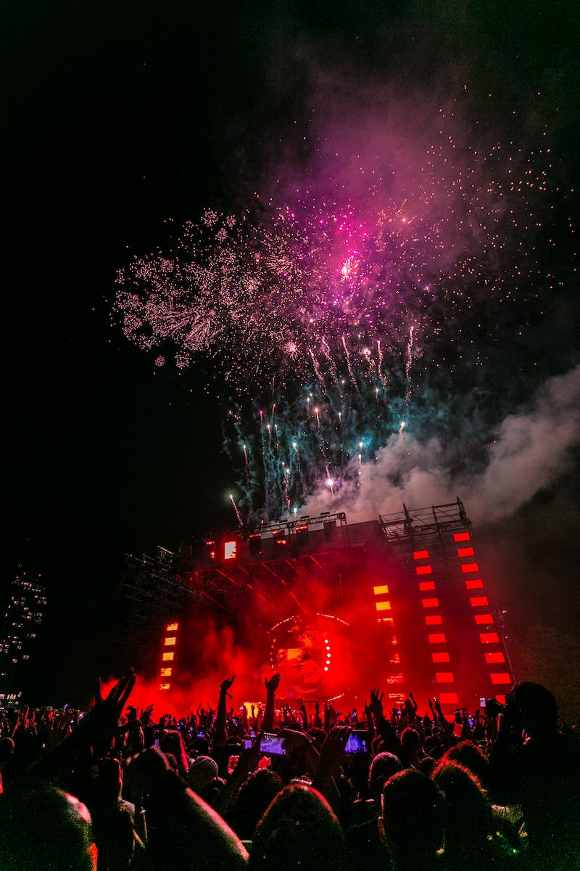
The Monster's Smash Hit
• My monster's smash is the hit of the land
• The youth love the high-energy sound
• The coffin banners are about to come alive
• But the vocal group, the Crypt Killer Five, keeps them in the vibe
Photo by Pexels

Slide 6
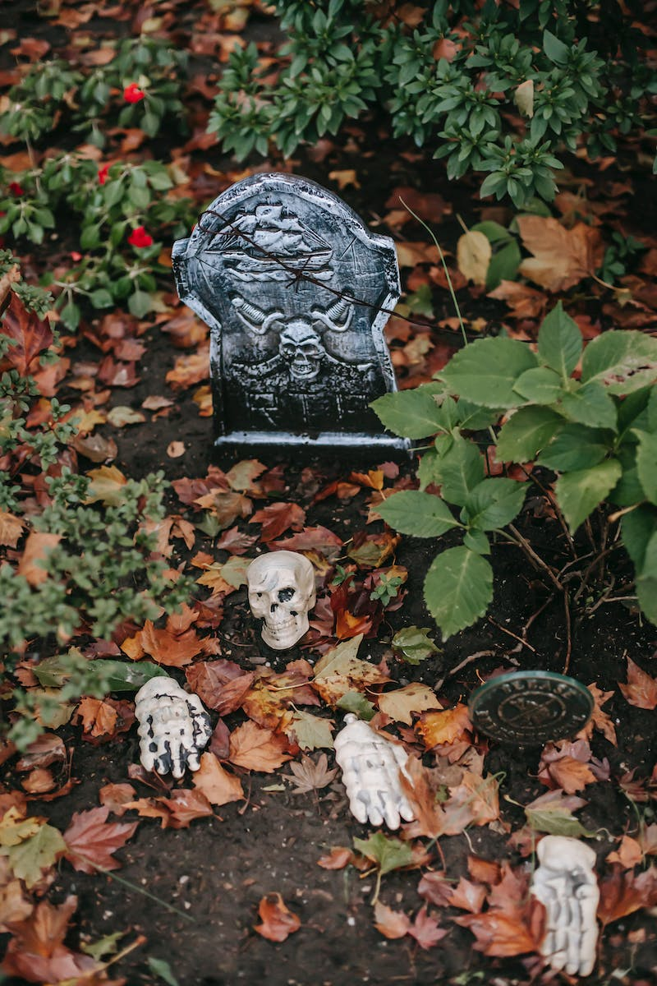
Conclusion
• In the Monster's Graveyard, it's a smash
• With the monster to man, it's always a bash
• Join the graveyard band, rock the night away
• Embrace the spooky and celebrate the decay
Photo by Pexels

