Slide 1
The Complexity of World War II
Unraveling the Story Behind Germany's Invasion of the USSR

Slide 2
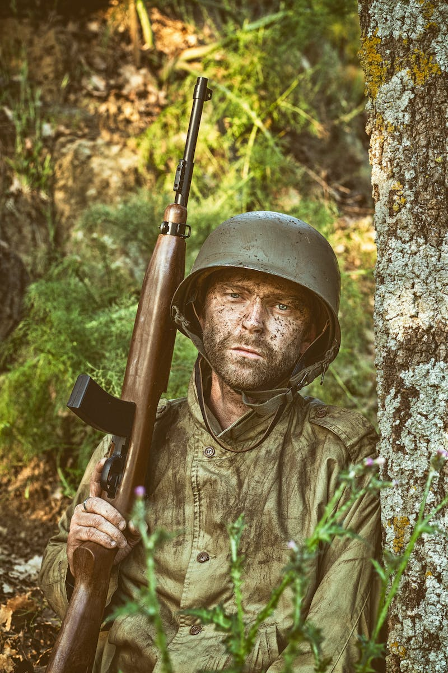
Introduction
• Childhood perceptions: Germany's invasion and USSR's victory
• The reality: A more complex and intricate narrative
• Historical backdrop: Austrian events in 1904
• A 15-year-old boy's dreams and aspirations
Photo by Pexels

Slide 3
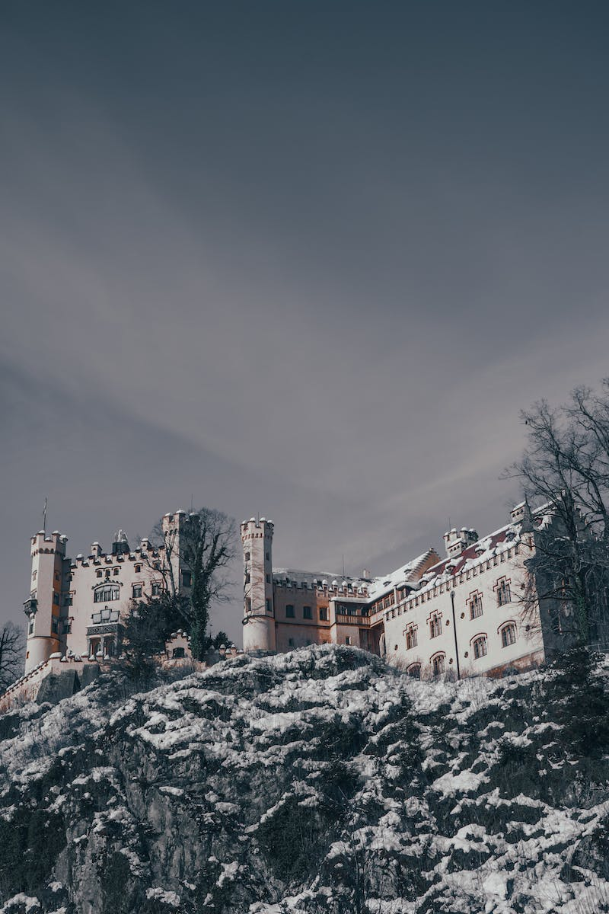
The Journey Begins
• Moving to Munich at 15 years old
• The outbreak of World War I
• Disappointment as allies lose the war
• Growing frustration and change in appearance
Photo by Pexels

Slide 4
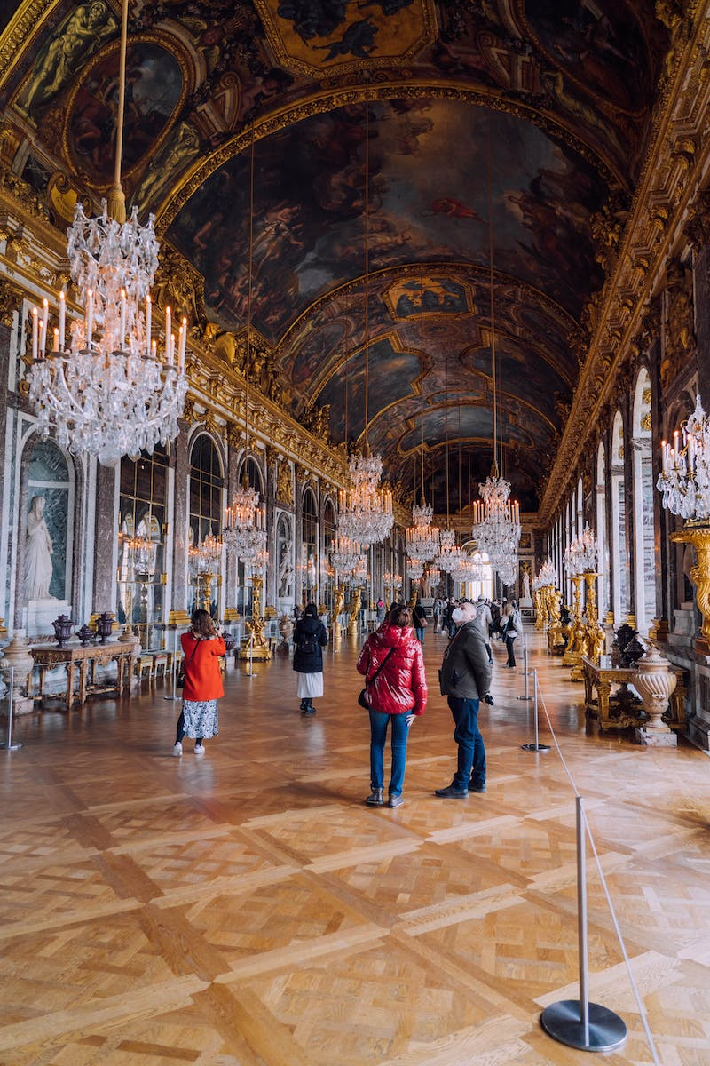
The Versailles Treaty
• Implications of the Versailles Peace Treaty
• Reparations and territorial adjustments
• Hyperinflation and currency devaluation
• Benito Mussolini's rise to power
Photo by Pexels

Slide 5
Hitler's Rise to Power
• Failed coup attempt and increasing popularity
• The formation of Hitlerjugend
• Influence of Mussolini and the march on Rome
• Resting period and growing media attention

Slide 6
Consolidation of Power
• Night of the Long Knives
• Elimination of potential rivals
• Hitler becomes the leader and abolishes the presidency
• Rapid militarization and territorial gains
Photo by Pexels

Slide 7
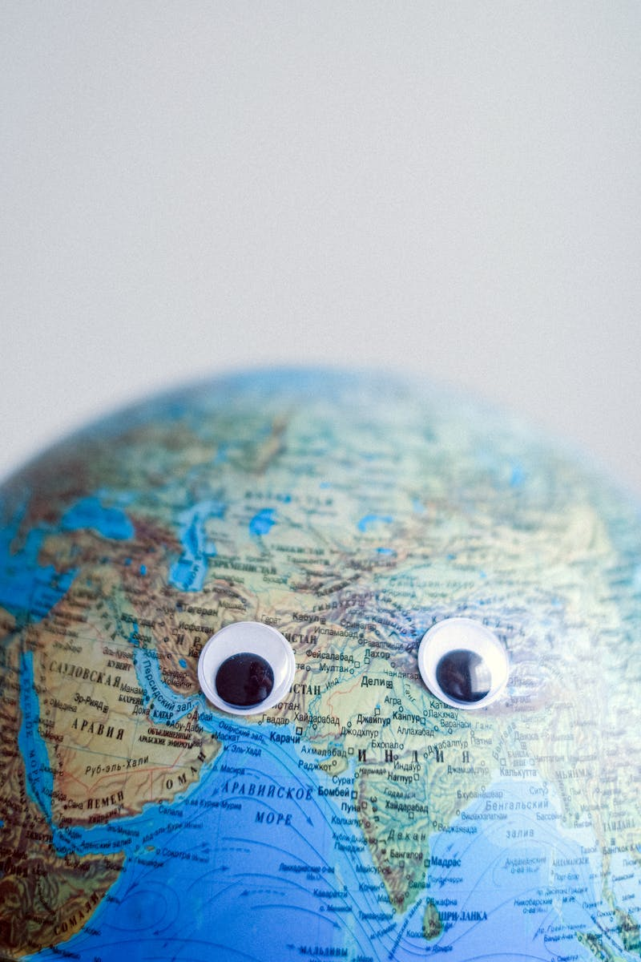
International Relations
• Dawes Plan and loans from the US
• Anti-Comintern Pact with Japan and Italy
• Munich Agreement and division of Czechoslovakia
• Secret negotiations with the UK
Photo by Pexels

Slide 8
World in Crisis
• Outbreak of the Great Depression
• The impact on Germany's plan for reparations
• Mass unemployment and social instability
• Germany's increasingly radical views
Photo by Pexels

Slide 9
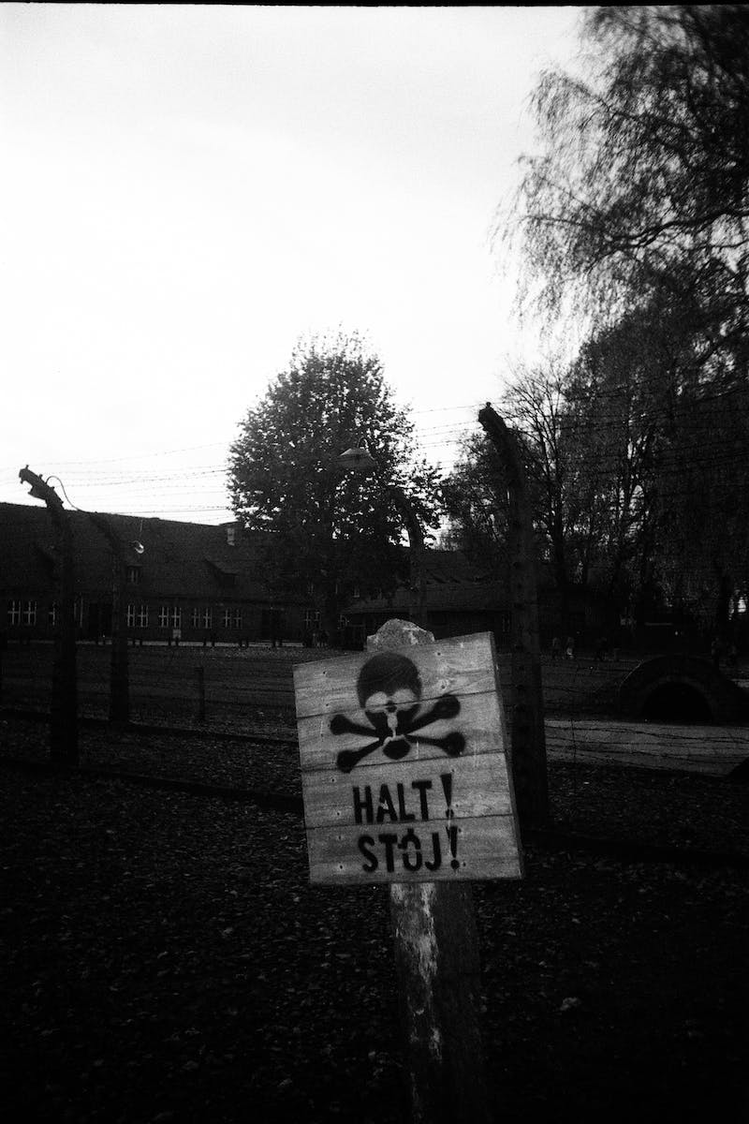
Outbreak of World War II
• German invasion of Poland
• Response from the UK and France
• Tensions between Germany and the Soviet Union
• Non-intervention of the US initially
Photo by Pexels

Slide 10
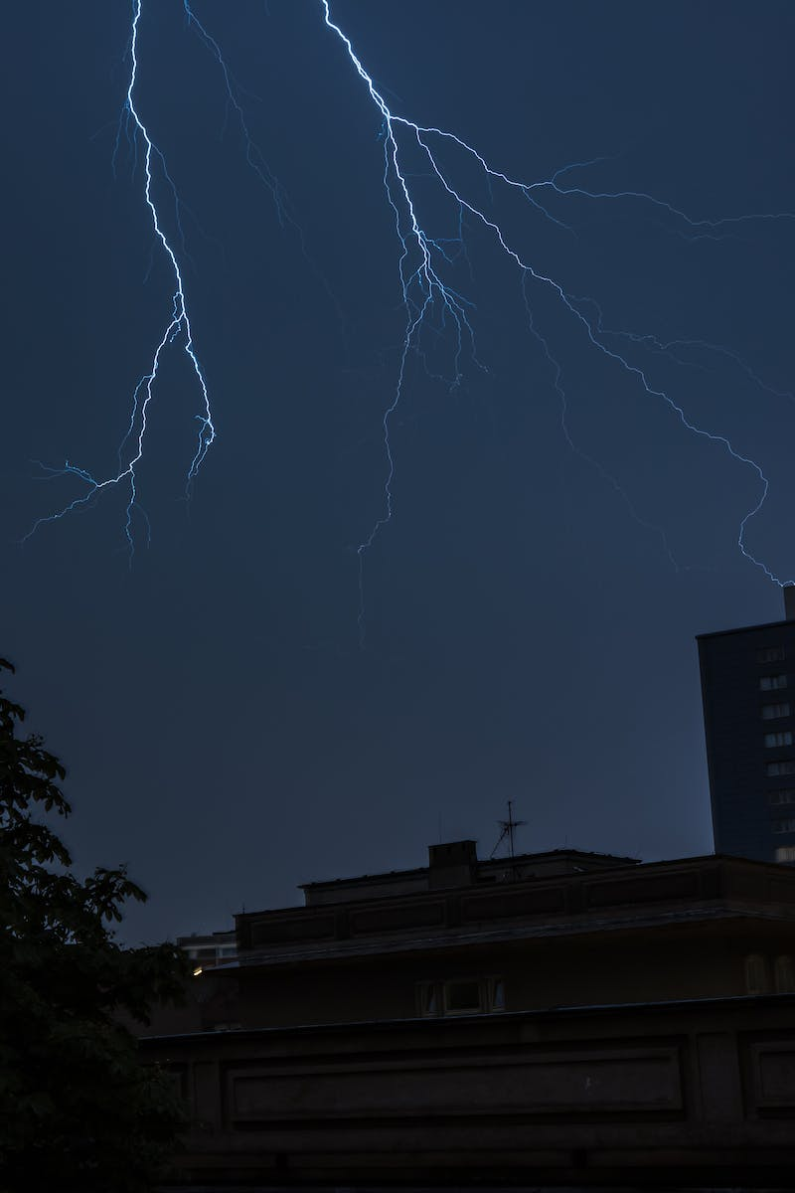
The War Continues
• German occupation of Denmark and Norway
• Preparations for the invasion of France
• British resistance and the Blitz
• Italian involvement in North Africa
Photo by Pexels

Slide 11
Turning Tides
• Soviet-German War intensifies
• Battle of Stalingrad
• Concentration camps and death marches
• Allied forces gain momentum
Photo by Pexels

Slide 12
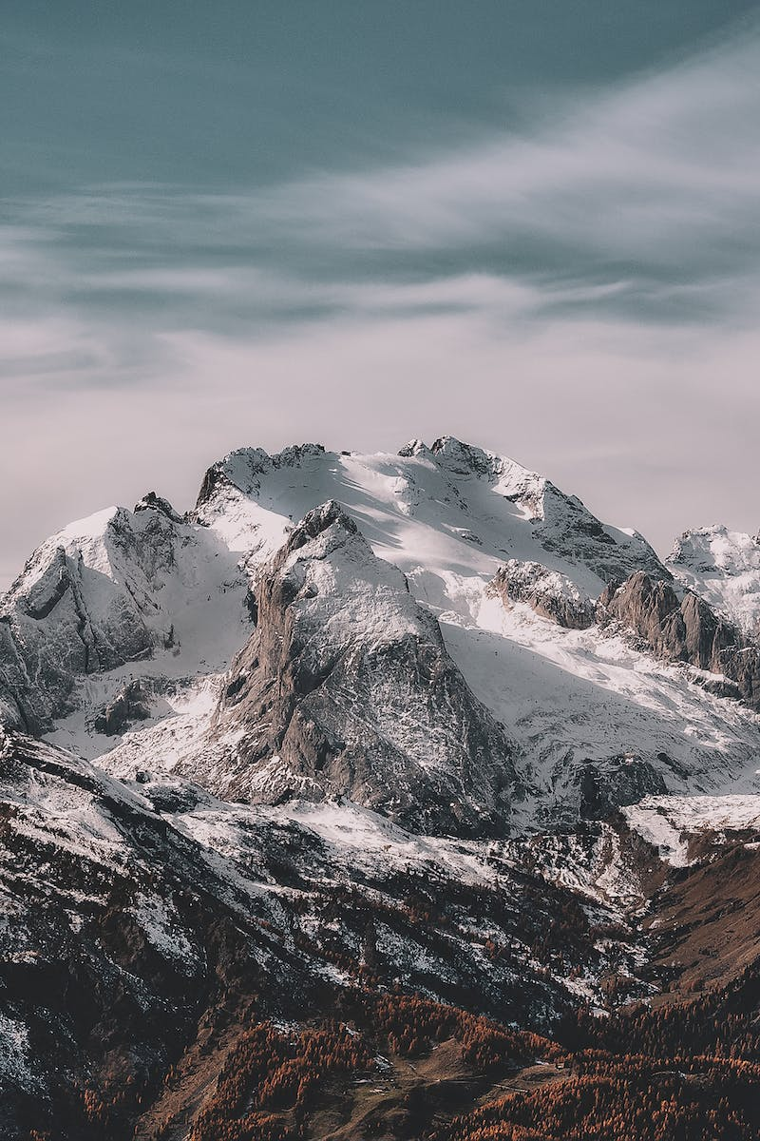
Allied Success
• D-Day and the liberation of France
• Resistance movements across Europe
• Fall of Mussolini and division of Italy
• Germany's retreat and occupation zones
Photo by Pexels

Slide 13
The Pacific Theater
• Japanese expansion in Southeast Asia
• Attack on Pearl Harbor
• Allied resistance in the Pacific
• Atomic bombings of Hiroshima and Nagasaki
Photo by Pexels

Slide 14
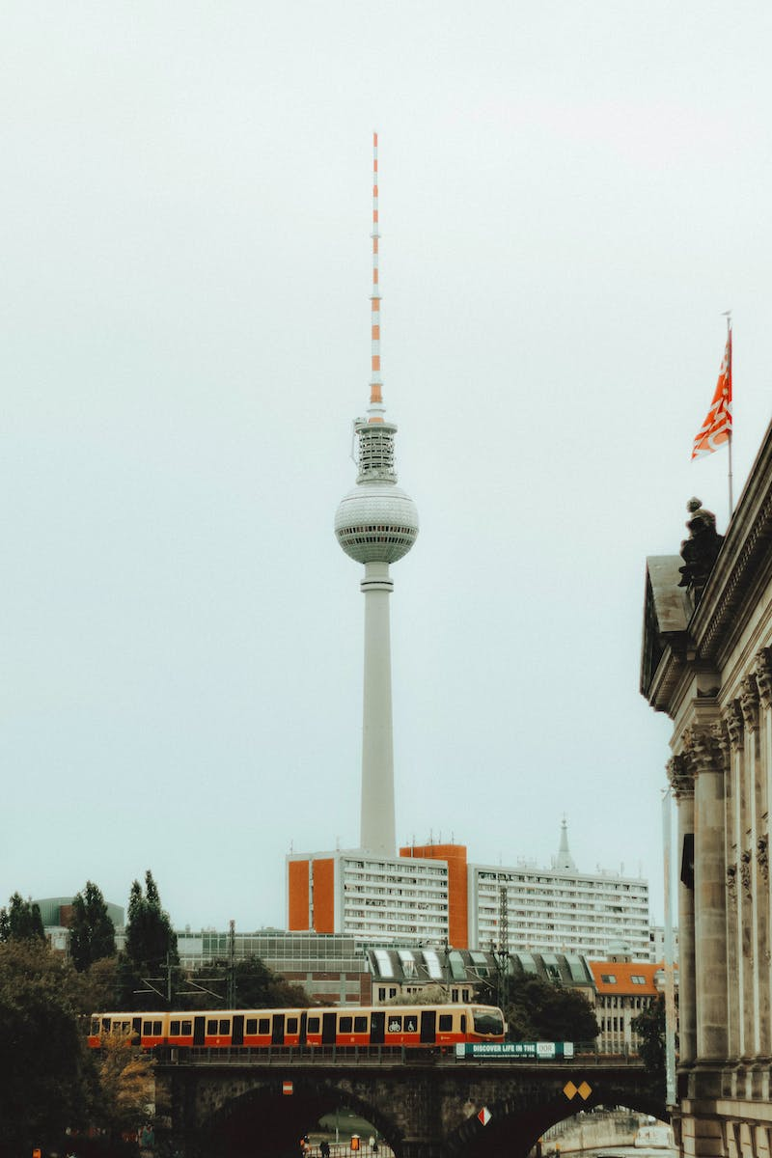
The Final Days
• Germany's surrender and occupation
• The division of Germany and Berlin
• Post-war trials and repercussions
• The end of World War II
Photo by Pexels

