Slide 1
The Rise and Survival of Poland in World War II
A Historical Analysis and Strategic Insights

Slide 2
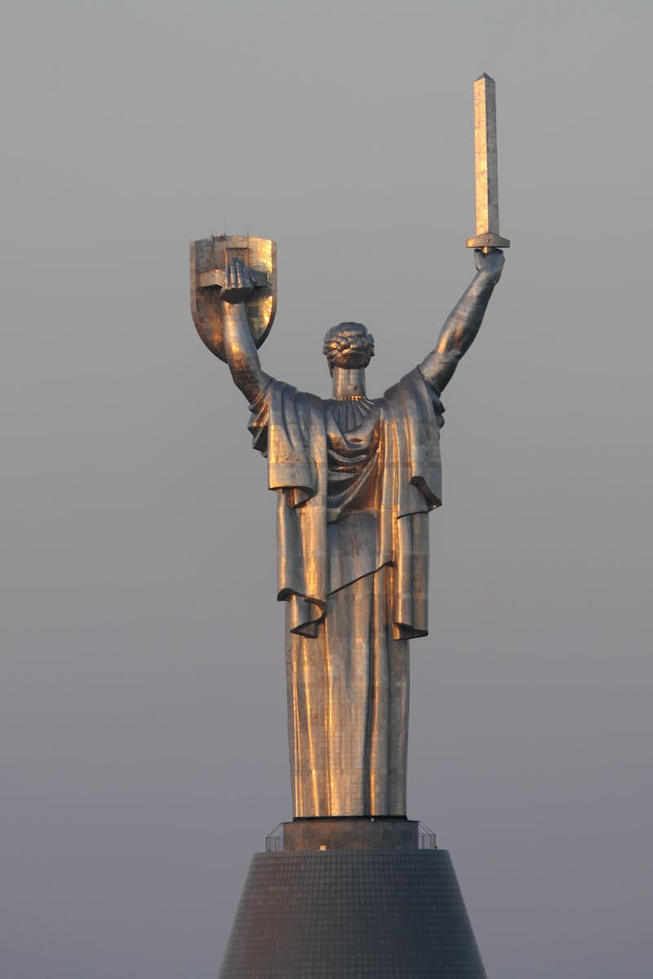
Introduction to Poland's Role in World War II
• Poland, a nation caught in the midst of war
• Strategic insights into Poland's survival tactics
• Exploring the impact of historical events on Poland
• The challenges faced by Poland in World War II
Photo by Pexels

Slide 3
Poland's Defensive Efforts and Strategies
• Analyzing Poland's defensive approach against German invasion
• Utilizing strategic alliances and non-aggression pacts
• The significance of defensive doctrines and military planning
• The role of Poland's geographical advantages
Photo by Pexels

Slide 4
The Soviet Threat and Polish Countermeasures
• The Soviet Union's expansionist ambitions
• Poland's response to Soviet aggression
• Strategies to thwart Soviet justifications
• Maintaining territorial integrity through diplomatic maneuvering
Photo by Pexels

Slide 5
Allied Support and the Battle for Survival
• The impact of Allied support on Poland's survival
• The challenges faced by Poland amidst a crumbling Allied front
• Strategic insights into Poland's role in the larger war effort
• The resilience and determination of the Polish people
Photo by Pexels

Slide 6
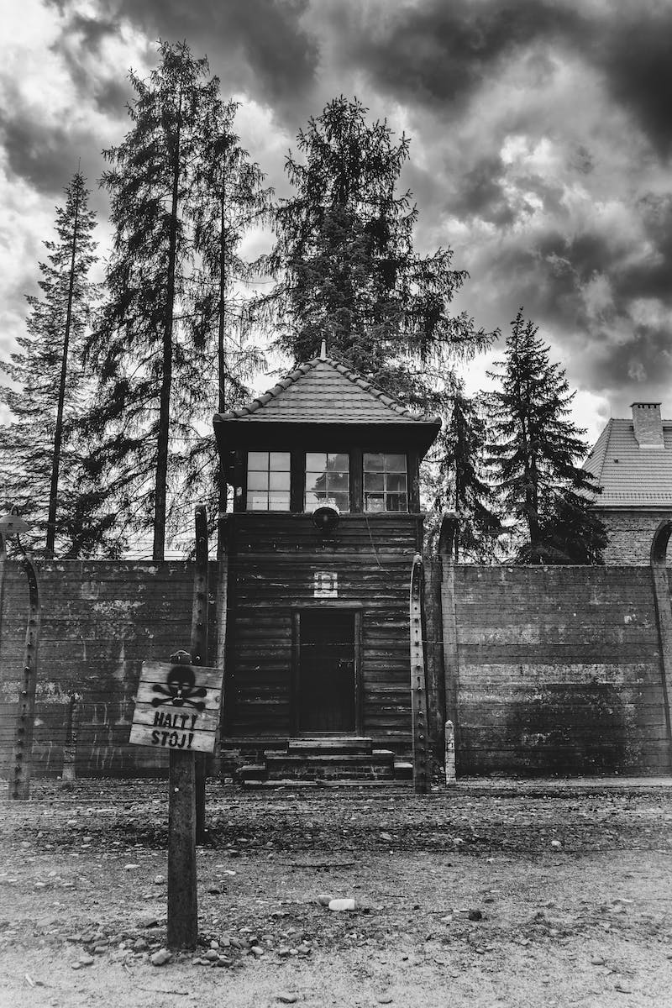
Conclusion: Legacy and Lessons from Poland's War Experience
• Examining Poland's legacy in World War II
• Lessons learned from Poland's survival strategies
• Applying historical insights to contemporary conflicts
• The enduring strength and resilience of the Polish nation
Photo by Pexels

